Slide 1
PHIA Surveys: Sample Designs and Estimation Procedures
Graham Kalton
Westat

Slide 2
PHIA sampling workshops
This presentation provides a broad overview of the PHIA sampling and weighting issues.
The next two sampling workshop will go through components of these issues in greater detail:
  The next sampling workshop will focus on design issues
  The following workshop will focus on weighting and variance estimation

Slide 3
Overview
Nationally representative three-stage sample design:
  First stage: Census Enumeration Areas (EAs).
  Second stage: Households
  Third stage: Persons
Weights adjust for unequal selection probabilities, nonresponse, and noncoverage
Weights need to be used in analyzing PHIA surveys to produce valid estimates
Standard errors of the survey estimates need to take account of the complex sample design and weighting.

Slide 4
Key estimates required from PHIA surveys
The sample designs are constructed to provide specified precision levels for 15-49 year olds:
  National HIV incidence rates
  Regional/provincial estimates of viral load suppression (VLS)
A secondary aim is to provide a specified precision level for an estimate of pediatric HIV prevalence
Since these objectives generally lead to different sample allocations across regions/provinces, a nonlinear programming procedure is used to produce the smallest overall sample size that satisfies both precision requirements.

Slide 5
Sampling the EAs
A stratified probability proportional to size (PPS) sample design
Stratification
  Primary stratification by region/province
  Within region/province, proportionate stratification by geographical location, urban/rural
  Equal selection probabilities within regions
PPS sampling
  PPS measure of size: household count from the last Population Census
  Problems arise when out-of-date Census counts are poor estimates of the current household counts.

Slide 6
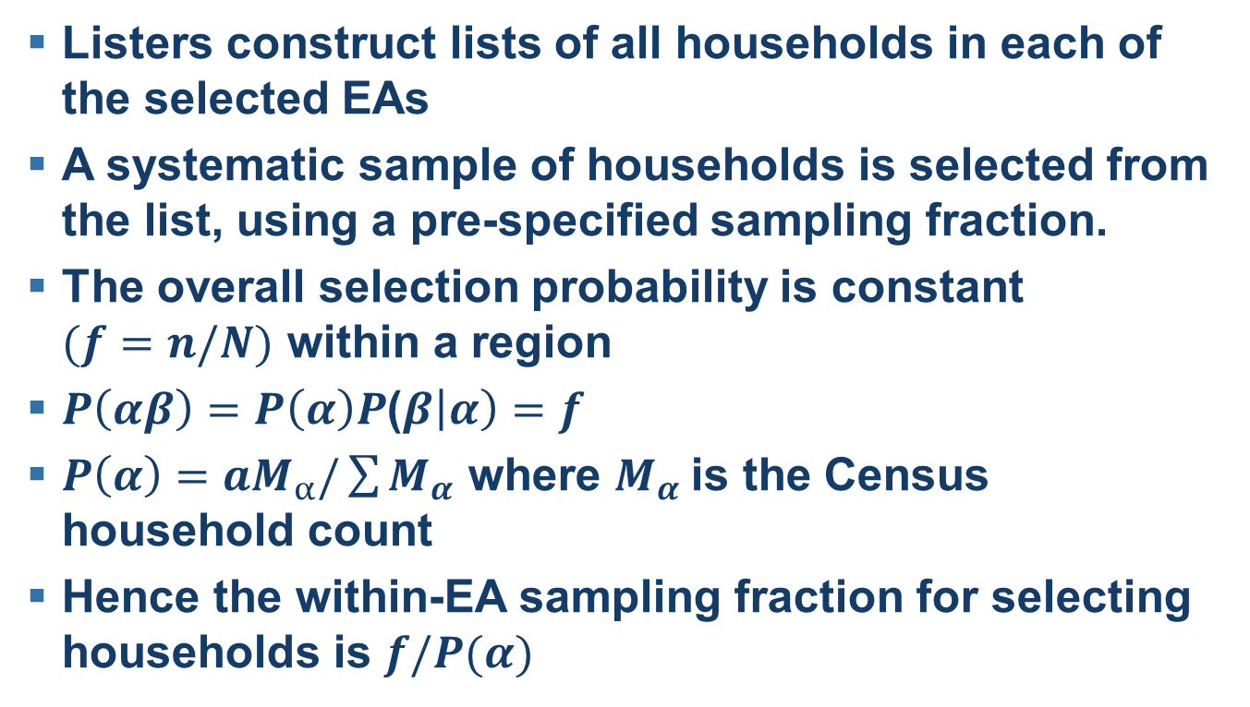
Sampling households in selected EAs
Listers construct lists of all households in each of the selected EAs
A systematic sample of households is selected from the list, using a pre-specified sampling fraction.
The overall selection probability is constant $(f=n/N)$ within a region
$P\left(αβ\right)=P\left(α\right)P$($β\left|α\right)=f$
$P\left(α\right)=aM_{α}/\sum{M_{α}}$ where $M_{α}$is the Census household count
Hence the within-EA sampling fraction for selecting households is $f/P(α)$

Slide 7
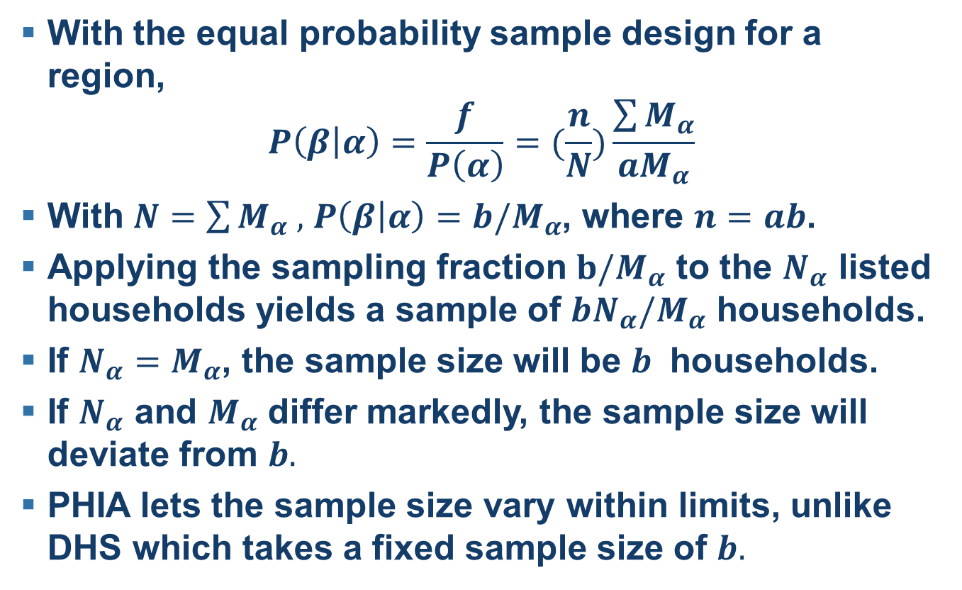
Household sampling
With the equal probability sample design for a region,
$$P\left(β | α\right)=\frac{f}{P\left(α\right)}=(\frac{n}{N})\frac{\sum{M_{α}}}{aM_{α}}$$
With $N=\sum{M_{α} ,}$ $P\left(β | α\right)=b/M_{α}$, where $n=ab$.
Applying the sampling fraction $b/M_{α}$ to the $N_{α}$ listed households yields a sample of $bN_{α}/M_{α}$ households.
If $N_{α}=M_{α}$, the sample size will be $b$ households.
If $N_{α}$ and $M_{α}$ differ markedly, the sample size will deviate from $b.$
PHIA lets the sample size vary within limits, unlike DHS which takes a fixed sample size of $b.$

Slide 8
Person sampling
Construct a household roster and take all eligible persons in selected households.
  De facto population, those sleeping in the household the previous night
  Up age limit varies: no limit, 60 and over, 65 and over
Guardians provide the data for children aged 0-14
Data for all others are collected by personal interviews
In some countries, children 0-14 years of age are subsampled with data collected for them in one-half or one-third of the households.

Slide 9
Weighting
Weighting has three purposes:
  To compensate for unequal selection probabilities, particularly across regions
  To compensate for nonresponse
    To the household questionnaire
    Person nonresponse within responding households
    Nonresponse to the blood draw among interview respondents
  To compensate for noncoverage
    Incomplete household listings
    Failure to include all eligible persons on the roster.

Slide 10
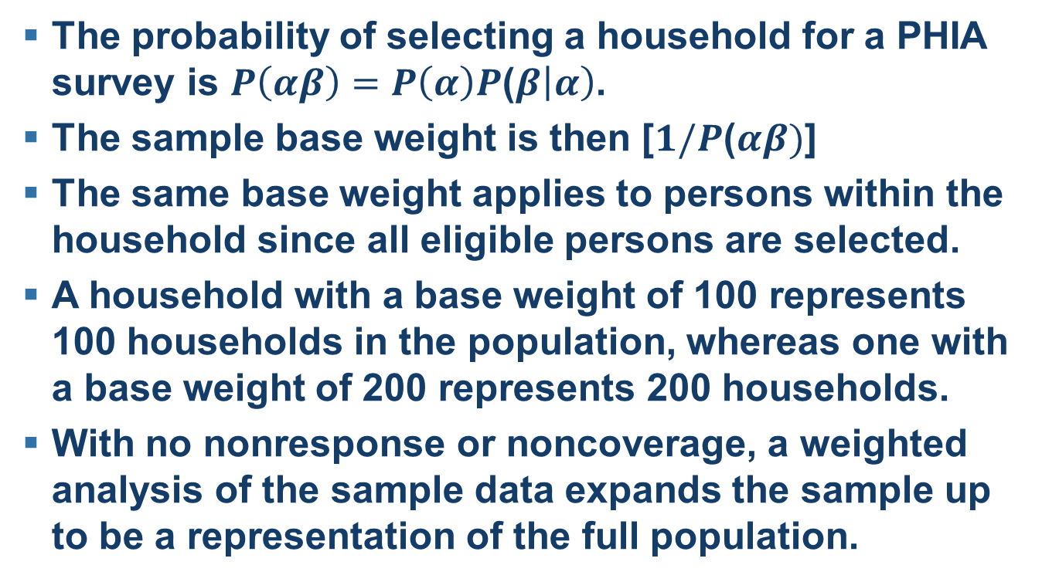
Weights for unequal selection probabilities
The probability of selecting a household for a PHIA survey is $P\left(αβ\right)=P\left(α\right)P$($β\left|α\right)$.
The sample base weight is then [$1/P$($αβ)$]
The same base weight applies to persons within the household since all eligible persons are selected.
A household with a base weight of 100 represents 100 households in the population, whereas one with a base weight of 200 represents 200 households.
With no nonresponse or noncoverage, a weighted analysis of the sample data expands the sample up to be a representation of the full population.

Slide 11
Nonresponse adjustments
The aim is to increase the weights of the eligible respondents so that they also represent eligible nonrespondents.
For household level nonresponse, the only information available for the nonrespondents is their EA.
Compensation for household nonresponse is therefore being made by inflating the weights of the responding households in an EA so that they represent the nonresponding households in that EA.

Slide 12
Person level nonresponse adjustments
In addition to EA, a great deal of information about nonresponding persons is available from the household questionnaire.
The nonresponse weighting cells are being obtained from a CHAID analysis (using SI-CHAID) that uses response status as the dependent variable.
Within each cell, the weights of the respondents are increased so that they also represent the nonrespondents.
For the blood collection nonresponse, the same approach is being used, but now also including information from the interview

Slide 13
CHAID tree

Slide 14
Noncoverage adjustment
The nonresponse adjusted weights should represent the full population of those who had a chance of selection for the sample.
These weights are then further adjusted to make the final weights conform to known population counts.
A source for the population counts is the population projections for the survey year, say by age/sex and perhaps within region.

Slide 15
Analyzing PHIA surveys
The analyses need to conducted using the final weights in order that the survey estimates represent the full population.
The sampling errors of the estimates should be estimated with a method that takes account of the complex sample design and the weights
The methods supported by the PHIA data files are:
  The Taylor series (linearization) method
  The jackknife repeated replications (JRR) method
    This method repeatedly drops out some observations from the full sample, and reweights the remaining sample in compensation.

