Slide 1
Presentations: Shifting into storytelling and imagery
5th ISIbalo Conference of African Young Statisticians
14 June 2016

Slide 2


Which items are increasing the cost of your grocery bill?
Percentage rise in food prices over a period of a year (March 2016 compared with March 2015)
Vegetables
18,7%
s
Fruit
18,7%
Oils & fats
18,1%
Bread & cereals
13,3%
Sugar & desserts
11,7%
Entire food basket
9,8%
Fish
6,4%
Meat
6,1%
Dairy
3,6%
Source: Consumer Price Index (CPI), March 2016 Dairy includes eggs Headline CPI for March 2016: 6,3% http://www.statssa.gov.za

Slide 3
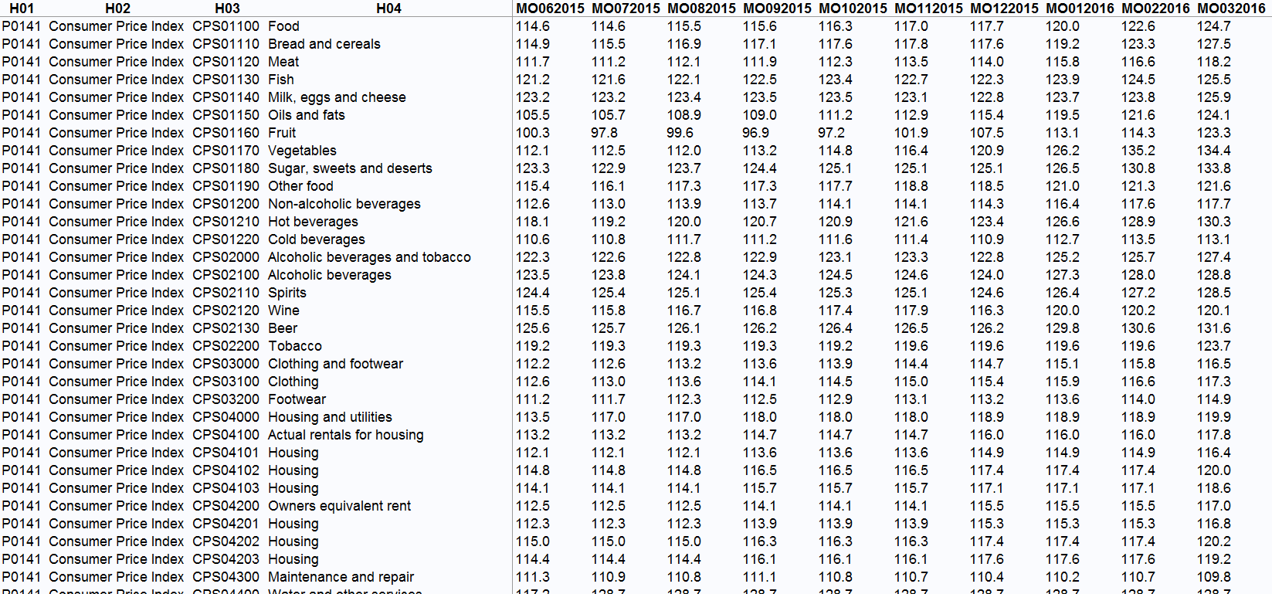

Slide 4
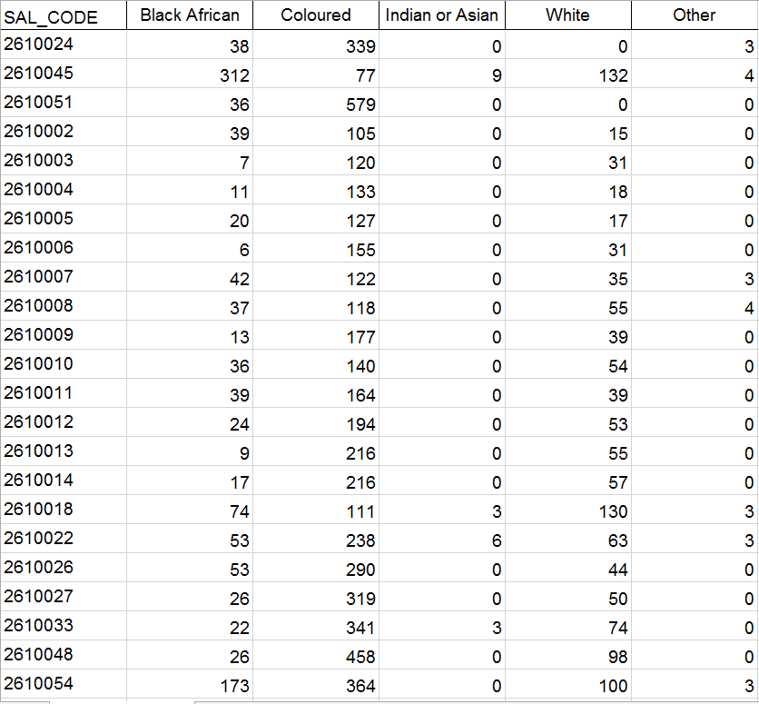

Slide 6
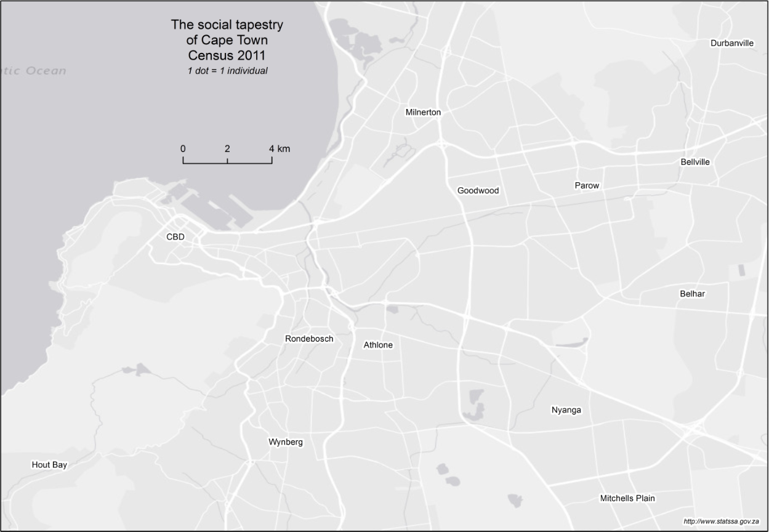
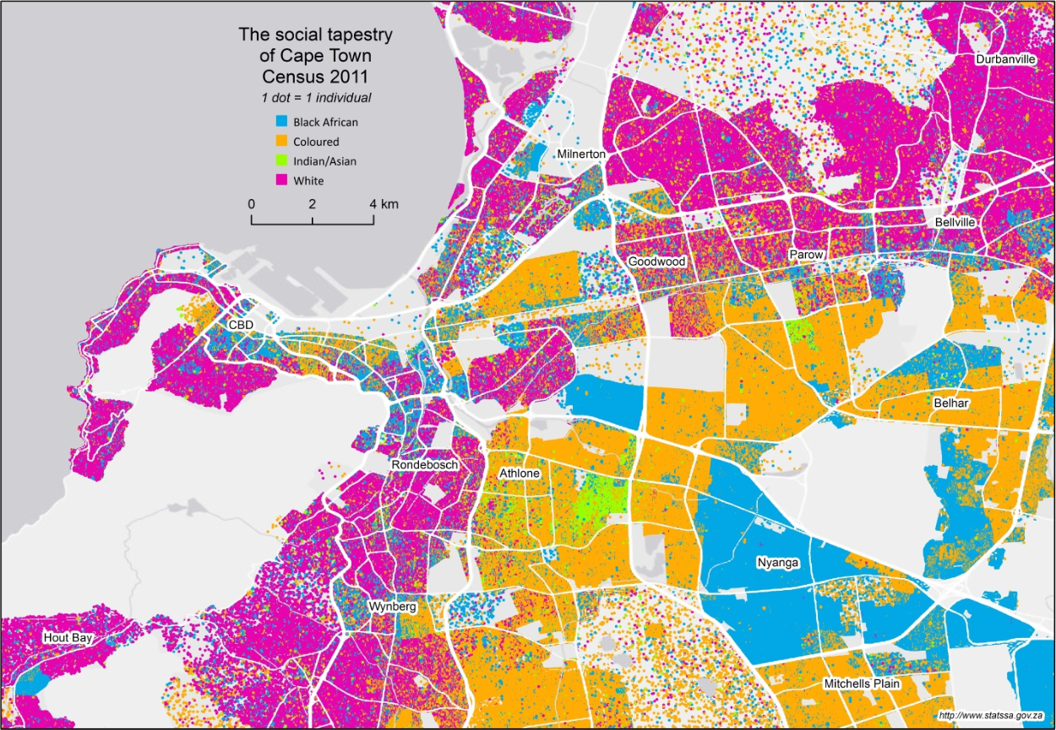

Slide 7
Steps towards data visualisation

Slide 8
International trend
Stat SA’s strategy
Bringing data to life

Slide 9
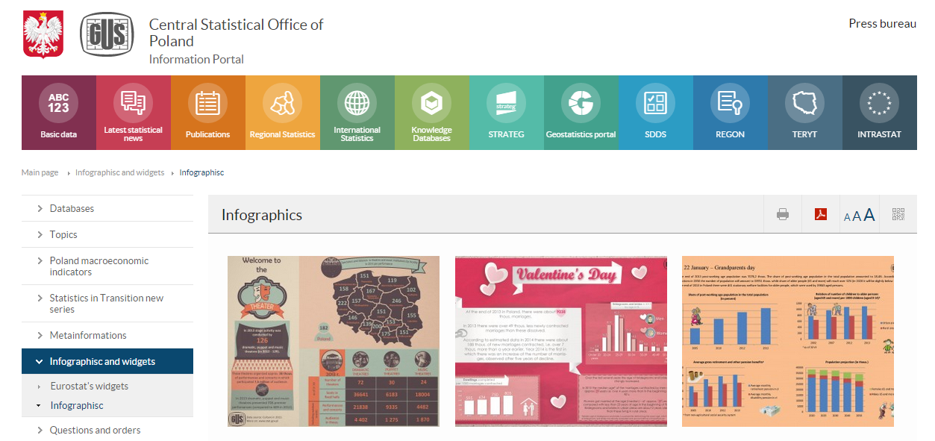
Growing international trend

Slide 10
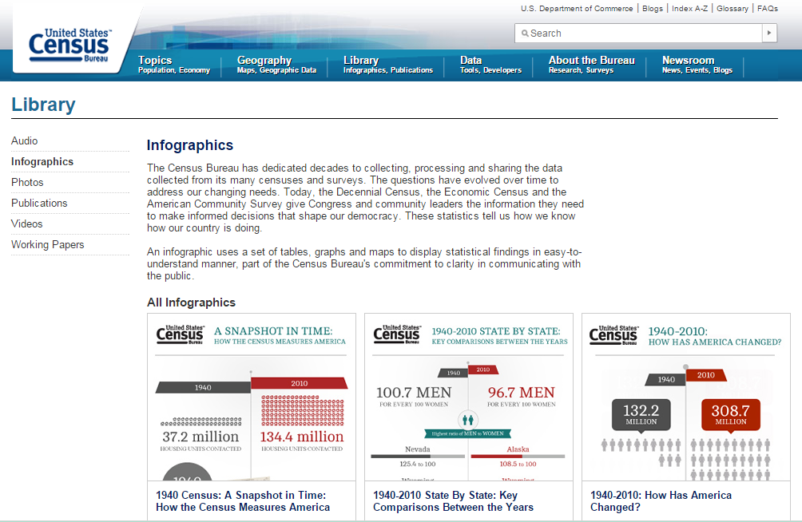
Growing international trend

Slide 11
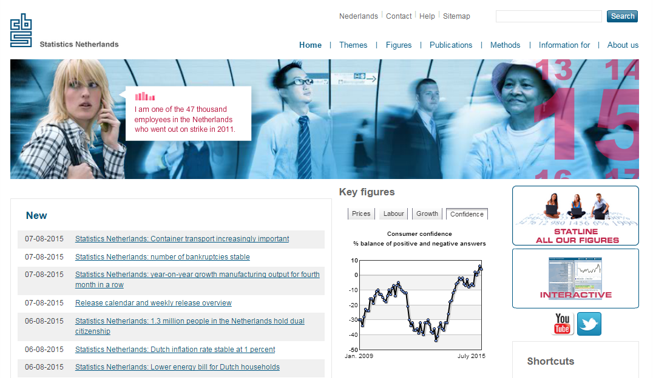
Growing international trend

Slide 12

Stats SA’s strategy
One of the strategic objectives…
Develop new and innovative statistical products and services to respond to increased user demand

Slide 13

Bringing data to life
Align with the mindset of our users. . .
Unemployment data for all suburbs?
Population of South Africa?
Analysis of unit record data?
Packaging data into different formats that cater to the needs of differing types of users

Slide 14


Bringing data to life
Talk about the subject, not the container
Census 2011
GHS
QLFS
Population by municipality
Employment by suburb
Population of South Africa
Employment by province
Occupation by province
Demographics
The Labour Force
Adopting a thematic approach to presenting data

Slide 15

Bringing data to life
Cater to society’s concerns
My brother is unemployed
My community is worried about crime
My son’s education fees are so expensive
Crafting data into stories that connect statistics with everyday life

Slide 16
Science
data

Slide 17
Science
data
You are here!
Story-
telling
narrative
Art
graphic design

Slide 18
Application:
Stories
Images
Community

Slide 19

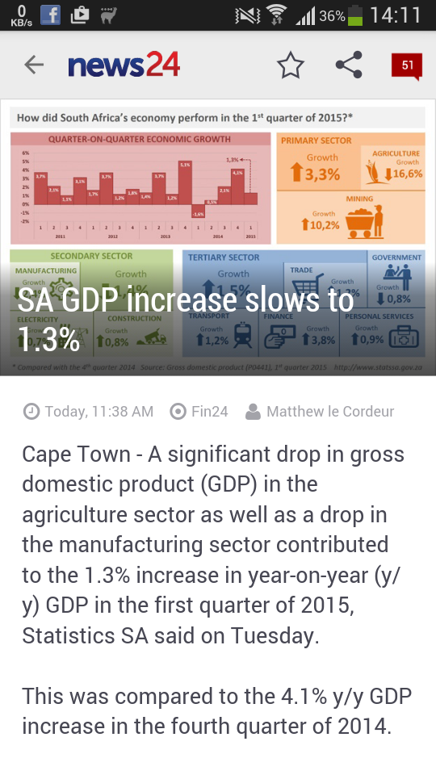
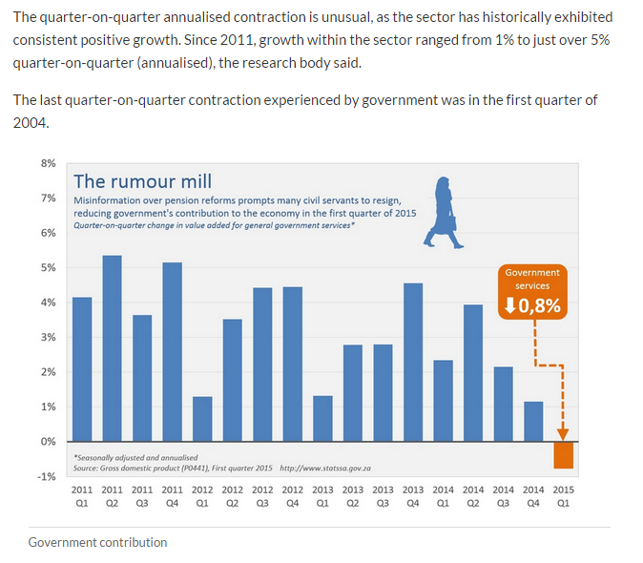
Data stories

Slide 20
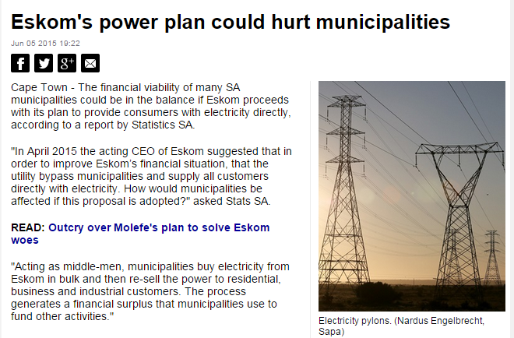
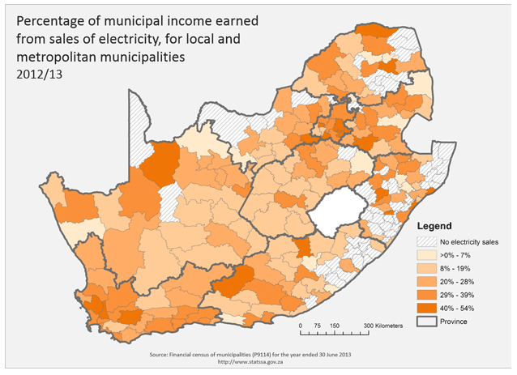
Data stories

Slide 21
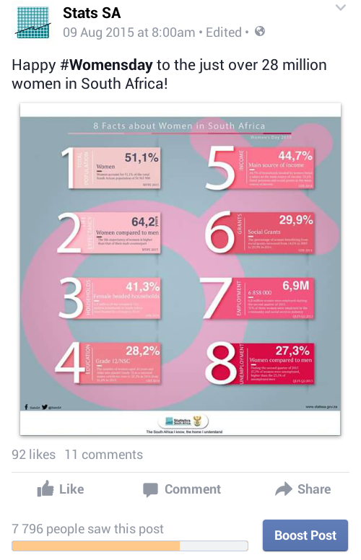
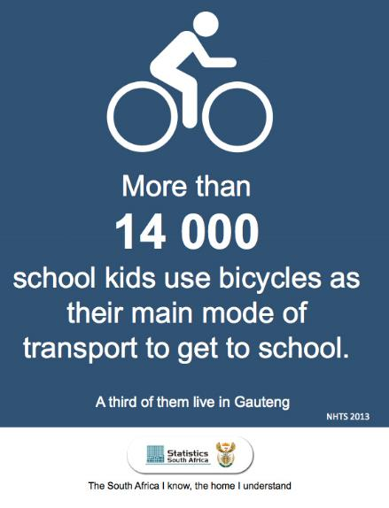
Social media

Slide 22
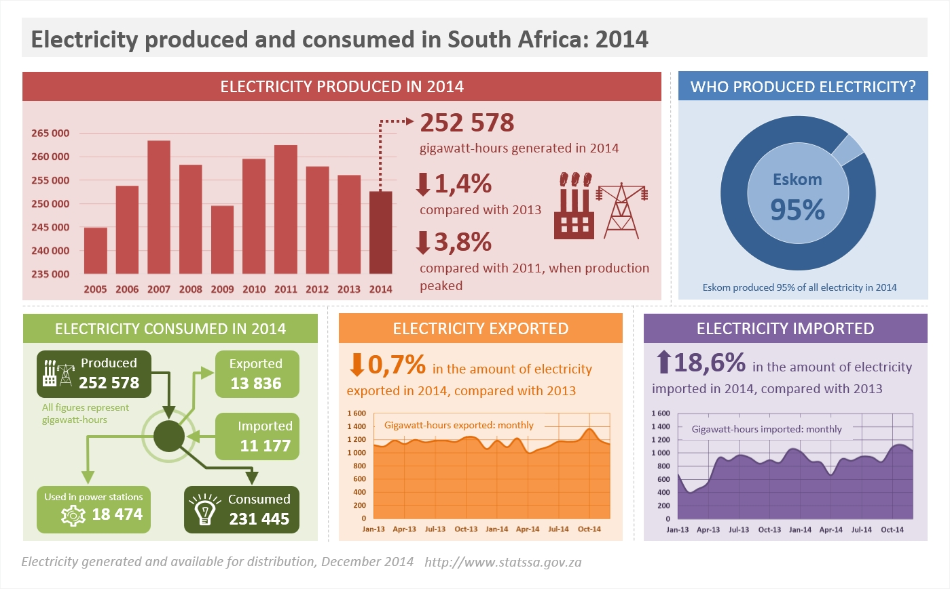
Infographics

Slide 23






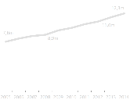

Development indicators: the South African story
10,8
million
Total number of households in SA
2002
15,6
million
2014
More households have access to sanitation. In 2002, 62% of households had access to sanitation. This increased to 80% in 2014
86%
77%
2002
2014
Households with access to water also increased. In 2002, 80% of household had access. This number increased to 86% in 2014.
86%
2014
The number of households with access electricity increased from 77% in 2002 to 86% in 2014
80%
2002
Households with access to sanitation
Source: Development indicators, 2014

Slide 24
Presentations

Slide 25
Presentations: 21 tips

Slide 26
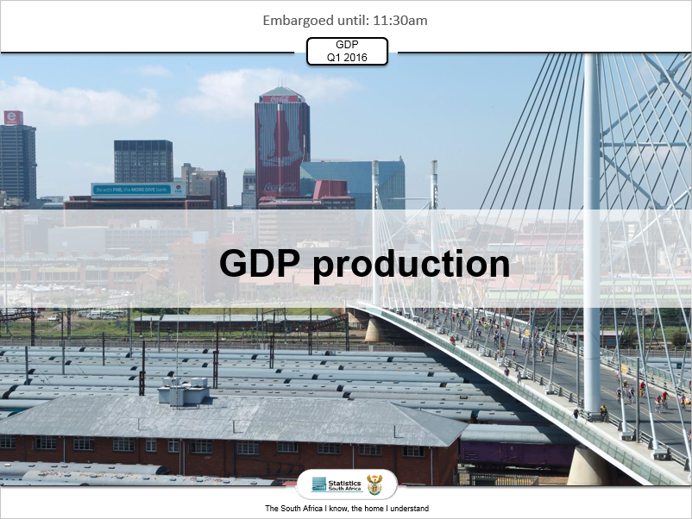
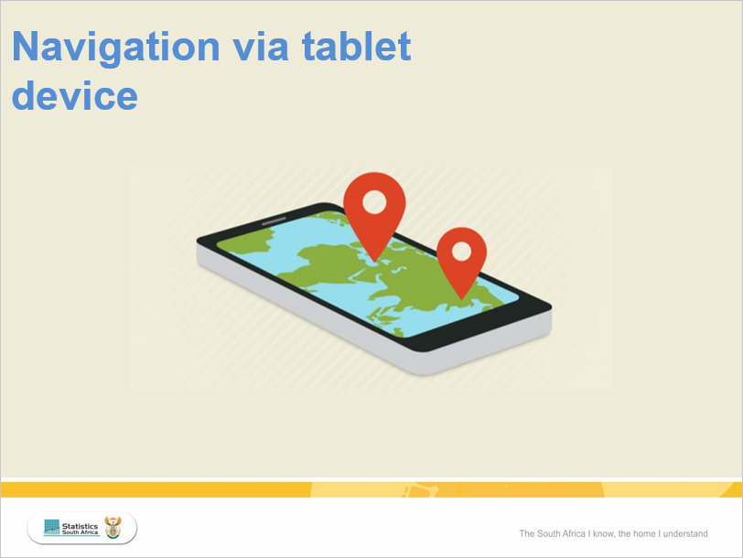
Consistency in design
Chose a consistent design
Go for a professional look (clean and flat)
Introduce breathing space: sections heading slides
A heading slide can include an image

Slide 27
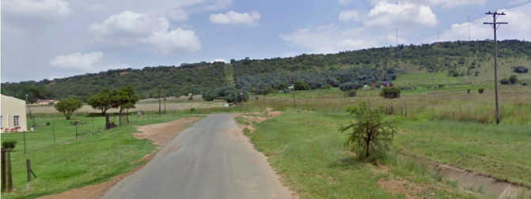
The need for story
No need for a contents slide
The first few seconds are vital: begin with a story
Present your content in the middle, and at the end come back to your story

Slide 28
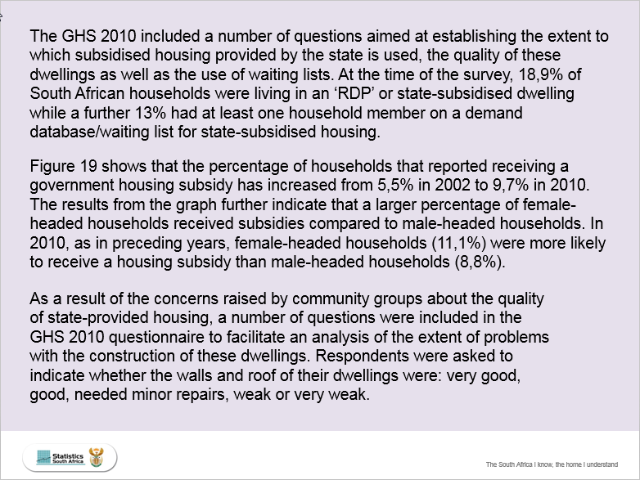
A
Text
Less is better. Your audience is not there to read, but to listen
Use a consistent text type throughout
Summarise your points in short sentences

Slide 29
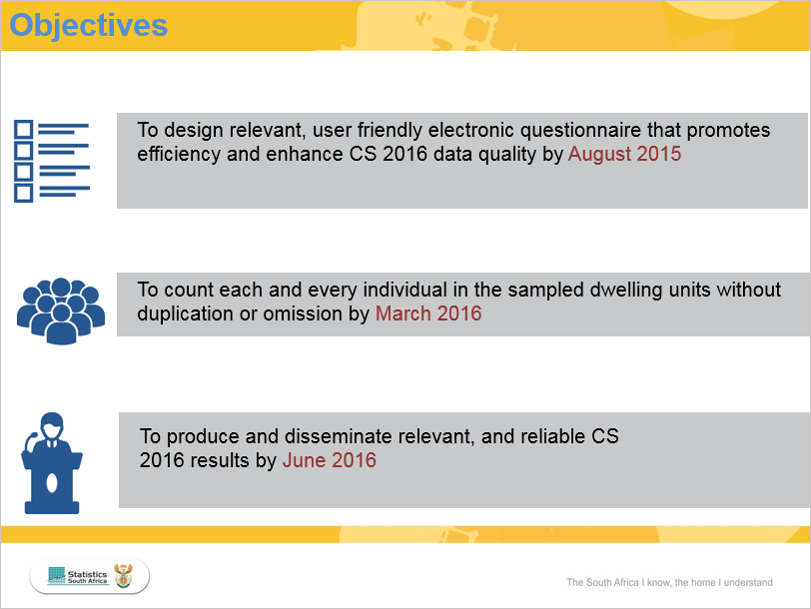
A
Text
Less is better. Your audience is not there to read, but to listen
Use a consistent text type throughout
Summarise your points in short sentences

Slide 30
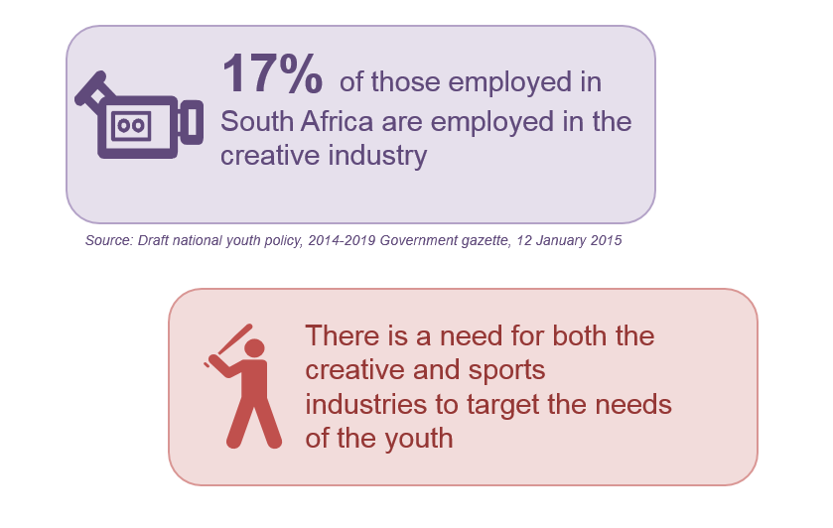
A
Text

Slide 31

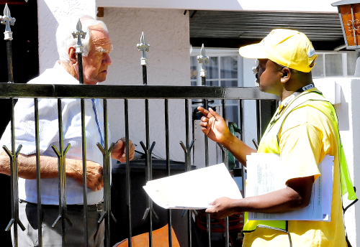
Images
Copyright: do not use Google Images. Use copyright free sites
Beware of pixilation
Beware of distortion

Slide 32
Tables and charts
One table or chart per slide
Bring attention to contrast: the lowest and highest values in a table or chart
Bring attention to the key message: the most important part of the table or chart
Ensure that the text size of data labels and values are large enough
Accompany the chart with an icon

Slide 33
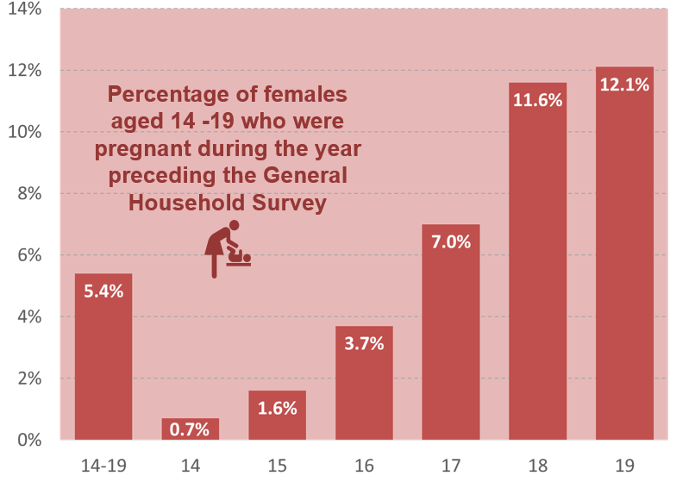
Tables and charts

Slide 34
Beyond the normal
Express concepts in flowcharts (using PowerPoint Shapes and SmartArt)
Accompany your text with icons (available online)
Move beyond tables and charts: express your data in more visually appealing ways

Slide 35

Beyond the normal
Before

Slide 36
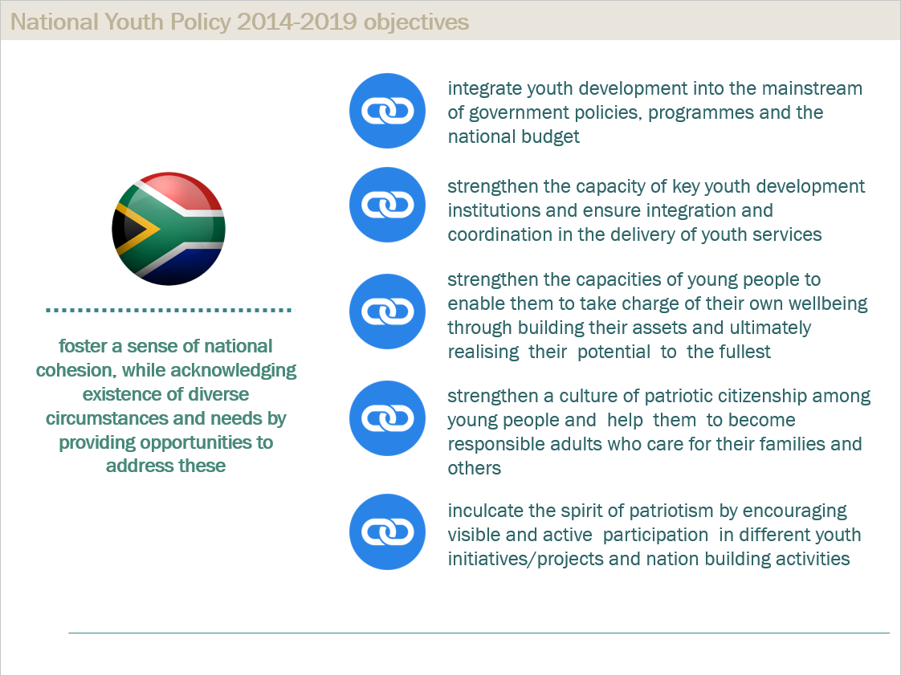
Beyond the normal
After

Slide 37
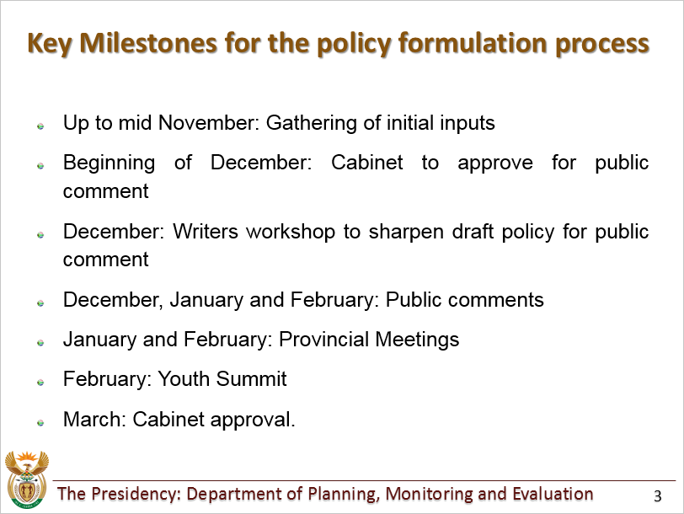
Beyond the normal
Before

Slide 38
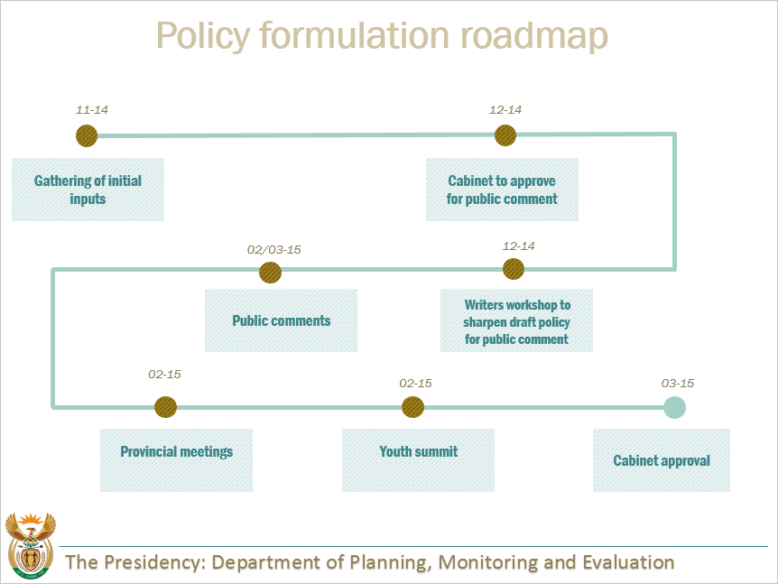
Beyond the normal
After

Slide 39
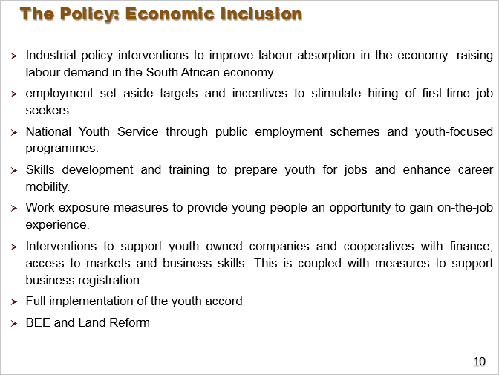
Beyond the normal
Before

Slide 40
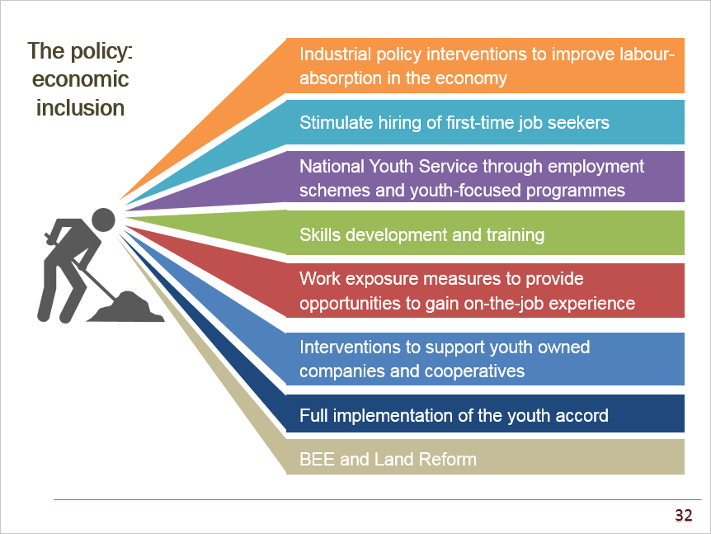
Beyond the normal
After

Slide 41
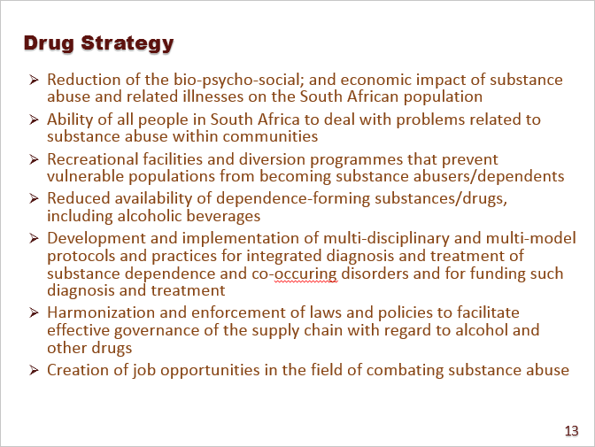
Beyond the normal
Before

Slide 42
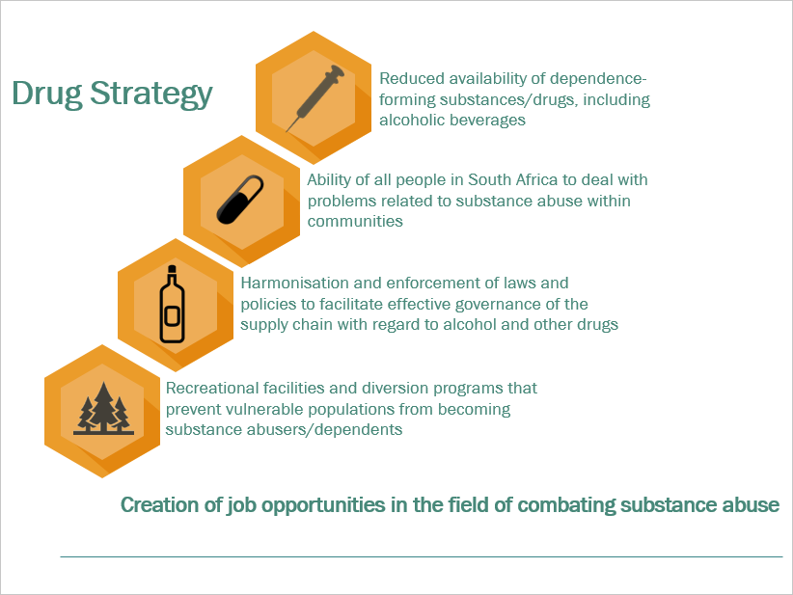
Beyond the normal
After

Slide 43
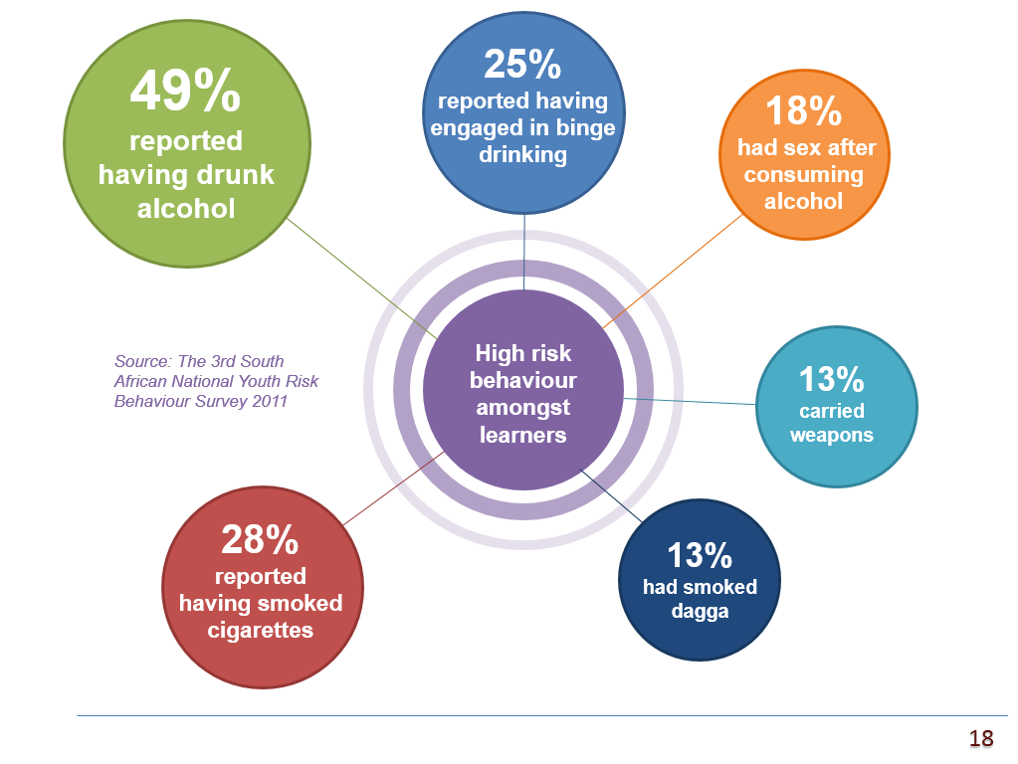
Beyond the normal

Slide 44
Resources
Images
  Media Club South Africa: http://www.mediaclubsouthafrica.com
  Pixelbay: http://pixabay.com
  Morguefile: http://morguefile.com
Colours
  Colorbrewer: http://colorbrewer2.org
  Adobe colour wheel: http://color.adobe.com/create/color-wheel
  Colour lovers: http://www.colourlovers.com
  Colorhexa: http://www.colorhexa.com
Icons
  Flaticon: http://www.flaticon.com
  Clker: http://www.clker.com
Presentations
  Nancy Duarte: http://www.duarte.com
  Presentation Zen: http://www.presentationzen.com

