Slide 1
Overview of the Population HIV Impact Assessment Surveys (PHIA) in Africa
Professor Sally E. Findley
ICAP, Mailman School of Public Health,
Columbia University
ISIbalo Conference 2016,
St. George Hotel, Pretoria

Slide 2
Objective of this presentation
Rationale, objectives, and design of the Population HIV-Impact Assessments in Africa ( Sally Findley)
How PHIA differs from and complements DHS surveys assessment of HIV prevalence
The importance of biomarker data in the PHIA surveys
A PHIA Road Map for African Demographers, and why you should be on that road

Slide 3
HIV epidemic in Africa: Progress in last 10 years
25 million people in Sub-Saharan Africa are living w. HIV
Large regional variations in HIV prevalence, from 27% in Swaziland down to 0.5% in Senegal.
1.5 million new HIV infections per year (2013), with 40% of new infections among young women 15-24
12.9 million of those infected are on ART, vast increase in the last 10 years.

Slide 4
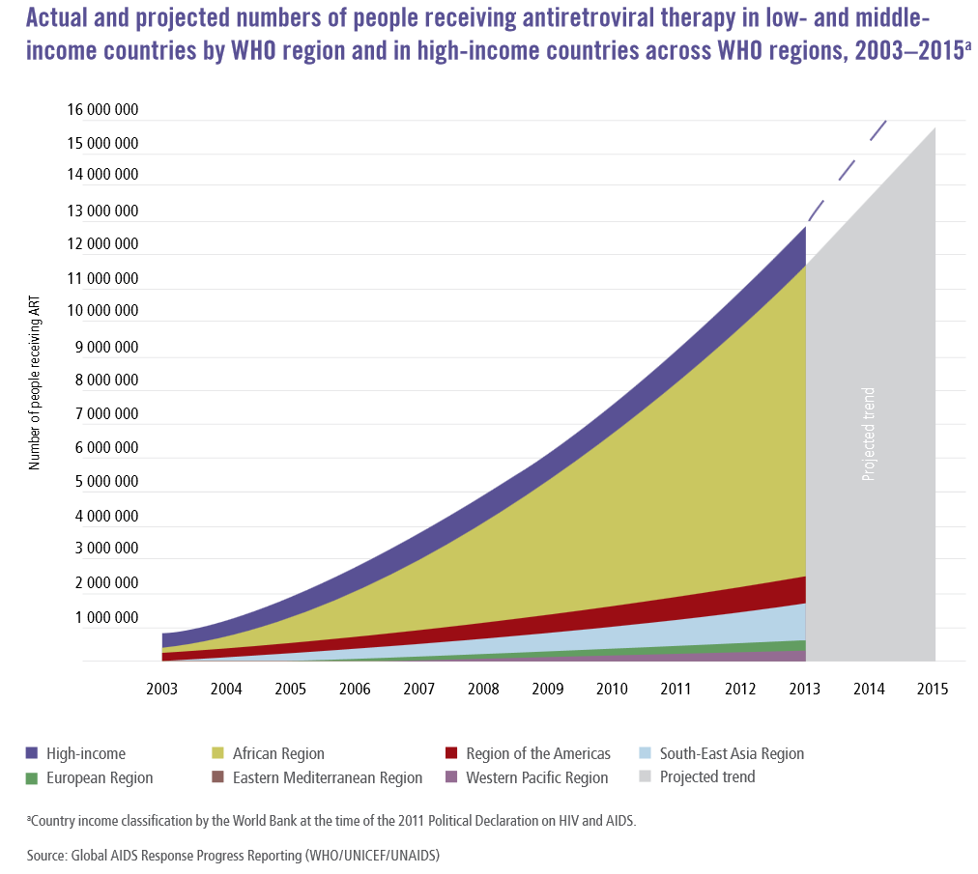
Rapid increases in ART coverage
15 million
10 million
Number receiving ART
12.9
5 million
Projected Trend
African Region
2003
2013
Source: Global AIDS Response Progress Reporting (WHO/UNICEF/UNAIDS)
Notes:
This graph shows the scale-up of ART over the last decade.
In 2005, approx 1 million PLWH were receiving ART, by 2103, there were almost 13 million PLWH receiving ART, and this number reached 15 million.
This impressive scale-up of ART reflects a huge global investment, much of it with PEPFAR support.
The initial response to the global HIV epidemic focused on establishing HIV care and ART treatment in large, centrally located hospitals and clinics and setting ART targets higher each year. The results of these efforts, shown in this graph, are based on data collected at health care facilities.
Notes:
Most of the 12.9 million, 11.7 million, were receiving ART in low- and middle-income countries.
The 11.7 million people on ART represent 36% of the 32.6 million people living with HIV in low- and middle-income countries.
The percentage of people living with HIV who are not receiving ART was reduced from 90% in 2006 to 63% in 2013
The section in grey on the right side of the graph represents UNAIDS’ projections which predict 13.9 million people accessed ART in 2014 and 15 million people will access ART in 2015.
http://www.who.int/hiv/data/art_2003_2015.png?ua=1
PEPFAR: As of September 30, 2014, PEPFAR is supporting life-saving antiretroviral treatment for 7.7 million men, women, and children (of which, 4.5 million are receiving direct support and an additional 3.2 million are benefiting from essential technical support to partner countries).

Slide 5
What have been the drivers behind this increase?
A dramatic increase in HIV Counseling and Testing (HCT) and reduction in HIV-related stigma
Establishment of an integrated continuum of care from HTC through support for adherence,
Expansion of ARV treatment to persons with less advanced disease (CD4<500 instead of <350)
International donor support for HIV prevention, care, and treatment programs.
Global Fund partners with local governments to provide HIV treatment services.
PEPFAR supports free medications to 1 out of 3 Africans on ART

Slide 6
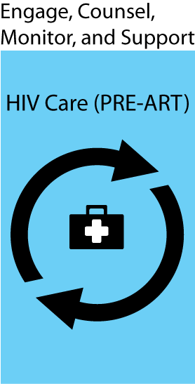
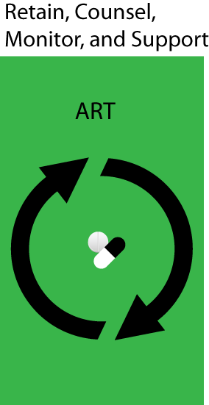
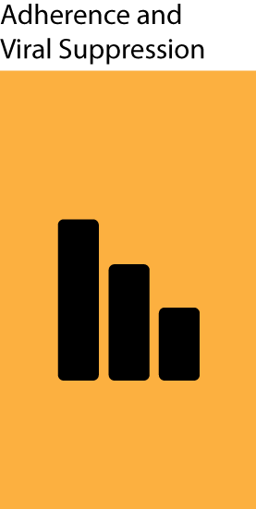


Continuum of Care and Impact: Coverage and Quality in Facilities
Link
ART
Eligible
McNairy, El-Sadr AIDS 2012
Notes:
In 2011, the Gardner cascade, also called the continuum of care, gained traction as way to think about impact.
As a result, the response efforts expanded beyond ART targets to include a focus on treatment coverage and the quality of treatment in health care facilities.

Slide 7
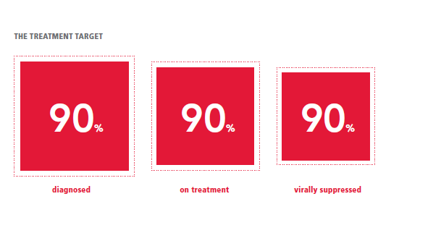
Ending new infections by 2030: Only if 90-90-90 by 2020
Notes:
And then, less than a year ago, UNAIDS , using the continuum of care as a guide, set an ambitious global target of 90-90-90 by 2020.
{What does 90-90-90 mean? It means if the percentage of people with HIV who are aware of their HIV diagnosis increases from where it is now, at less than 50%, up to 90% by 2020, and 90% of those aware of their HIV go on treatment, and 90% of those on treatment achieve viral suppression, models predict that new infections will finally get to zero by 2030.}
This global target of 90-90-90 underscores the importance of achieving coverage and quality in the population and to measure this, population-based HIV impact assessments are necessary.

Slide 8
Need to target HIV program effort
Can not reach 90-90-90 unless we can document achievements towards these targets
Programs should be targeted towards regions and populations groups with low uptake including high risk groups
Need to target communities/districts with high prevalence rates
Groups not attaining each of the 90-90-90 targets may differ
Decisions about to whom and where to target specific HIV program components need to be informed by detailed and current data.

Slide 9
Can DHS+ address these program planning needs?

Slide 10
What we can learn about HIV from DHS
HIV prevalence: National, by age, and urban/rural
Access and use of HIV/AIDS services:
HIV counseling and testing
HIV/AIDS care and support services
Antiretroviral medications
Prevention of mother-to-child-transmission
Post-exposure prophylaxis
HIV knowledge, attitudes and Behaviour
Knowledge of HIV prevention methods
High risk sex in last 12 months
Condom use
HIV in pregnancy

Slide 11
Limitations of the DHS+ for Program Planning
National prevalence only, with information only for basic demographic categories (gender, age, urban/rural)
Prevalence estimate is subject to testing bias (unknown more likely to refuse)
Small sample size limits the detailed analyses that can be made of subpopulations and their access and use of HIV-related services
HIV testing only for adults 15-49, only AIS has information on children or older adults
ART treatment and adherence measured only by self-report
No return of results to respondents , so does testing does not link to awareness of status and care

Slide 12
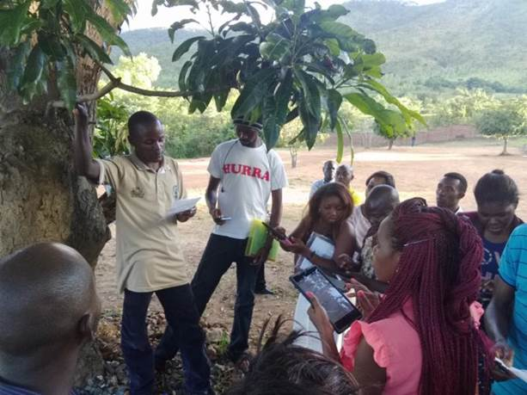
PHIA Project
Notes:
Now we’ll turn to the PHIA Project

Slide 13
Population HIV Impact Assessment: The PHIA Project
PHIA Project Aim:
Provide critical information needed to develop targeted HIV prevention and treatment programs which can help countries reach the 2020 goal of 90-90-90.
PHIA Project Goals:
Describe the epidemic in sufficient detail to inform HIV program planning in specific PEPFAR-supported countries
Build capacity by strengthening the workforce and infrastructure needed in targeted countries to design, conduct, analyze and disseminate results of PHIAs
Notes:
The PHIA Project, led by ICAP with funding from CDC, is a multi-country initiative to plan and implement HIV-focused, household-based national surveys in 15 to 20 countries, almost all of which are in Africa.
The goals of the project are….
There a few different names for these kinds of HIV-focused surveys: AIS, DHS+ and HIA
We’ve opted to go with PHIA in order to emphasize that they are population-based studies.

Slide 14
PHIA Survey Objectives: Overview
To estimate national HIV incidence among adults age 15-64
To estimate subnational prevalence of viral load suppression [HIV RNA <1000 c/ml] among adults age 15-64
To estimate national prevalence of HIV among children under age 15 years
To estimate the 90-90-90 levels at national and subnational levels
To identify practice of HIV prevention behaviors among high-risk groups
Notes:
Goals, objectives/study design, sample size are all similar
Standardized methods, innovative features
We’ll hear about the approach to choosing secondary objectives in ZIMPHIA later this afternoon from Dr. Mugurungi

Slide 15
Similarities of DHS and PHIA
Use of a generic protocol, questionnaires, and analysis/report template
Multi-agency sponsorship of the survey
Population-based household survey
Cross-sectional, nationally representative
Household and individual questionnaires
Reports include basic demographic variables
National and urban/rural HIV prevalence estimates, by age and gender

Slide 16
Key differences between DHS and PHIA
DHS
3000 HH, 5-10,000 indiv.
No children tested for HIV
HIV rapid test only without return of results
No viral load, CD4, EID, ARV metabolite or growth monitoring
May not have detailed HIV program options in survey
PHIA
15,000 HH, 30,000+ indiv.
Children tested
HIV rapid test + lab confirmation, w. return visit if discrepant results
Testing and counseling at home for HIV, also syphilis, Hepatitis B
Respondents get test results
Full HIV continuum of care included

Slide 17
Samples powered to assess national incidence and viral load at subnational levels: Malawi and Zimbabwe examples
Malawi:
500 EA’s ~ 25-30 HH/EA
15,000 households
Adults 15-49: 19,845
Adults 50-64: 2,995
Children 0-14: 10,988
Total Indivs: 33,828
Zimbabwe:
500 EA’s ~ 25-30 HH/EA
15,000 households
Adults 15-49: 16,650
Adults 50+: 4,509
Children 0-14: 7,309
Total Indivs: 28,468

Slide 18
Adult/Adolescent Interview Question Modules
Finding out who the participant is
Modules: Background, Marriage
Asking about the participant’s children
Modules: Reproduction, Children
Starting to get more personal
Modules: Male circumcision, Sexual activity, Violence
Talking about HIV
Modules: HIV testing, HIV support, care and treatment
Other health issues
Modules: Tuberculosis, Hepatitis B, Syphilis
Cultural context
Modules: Gender norms, Violence
Notes:
List the descriptive summary titles of each questionnaire subsection and indicate the relevant modules within each subsection.
Explain that the ordering of modules is generally done to start with less sensitive questions and to build in sensitivity throughout subsequent modules. This pacing allows for interviewer to establish growing rapport and trust with the participant and may facilitate greater likelihood of disclosure of increasingly sensitive information towards the middle and end of the interview.

Slide 19
PHIA: Biomarkers are Key!
HIV biomarkers:
HIV rapid testing and CD4 in the home w. immediate return of results
HIV RNA (viral load suppression)
HIV recency assays to measure HIV incidence (infection in the past year)
Drug resistance/ ARV metabolite analyses
Optional biomarkers: Hepatitis B, syphilis

Slide 20

PHIA Project: Countries
TUNISIA
MOROCCO
WESTERN
ALGERIA
LIBYA
EGYPT
Expected Year
of Implementation
SAHARA
MAURITANIA
MALI
NIGER
SUDAN
ERITREA
SENEGAL
2015
THE
CHAD
DJIBOUTI
GAMBIA
BURKINA
GUINEA
GUINEA
2016
BISSAU
COTE
BENIN
NIGERIA
ETHIOPIA
SIERRA
D’IVOIRE
GHANA
TOGO
CENTRAL
SOUTH
SUDAN
LEONE
AFRICAN
LIBERIA
CAMEROON
REPUBLIC
2017
EQUATORIAL
REP. OF
DEMOCRATIC
UGANDA
KENYA
SOMALIA
GUINEA
THE
REPUBLIC
GABON
CONGO
OF THE CONGO
RWANDA
ANGOLA
BURUNDI
TANZANIA
HAITI
ANGOLA
MALAWI
ZAMBIA
ZIMBABWE
MOZAMBIQUE
NAMIBIA
BOTSWANA
LESOTHO
SWAZILAND
SOUTH
AFRICA
Notes:
The map shows the location of the initial countries in which the PHIA Project will work, according to anticipated year of survey implementation
Implementation of PHIA surveys for Zimbabwe, Malawi and Zambia was initiated in 2015. Shown in Green
Priority high prevalent countries to be completed by the end of 2016 include Lesotho, Tanzania, Uganda, Swaziland, and Namibia.
Additional lower prevalent countries to be considered for PHIA in this time frame include: Ethiopia, Rwanda, Haiti, Cote d’Ivoire and Cameroon. (Orange)
Kenya and Rwanda are anticipated for 2017.
The Project forms partnerships with the ministries of health and the national statistical bureaus in each country in order to define the survey objectives, especially the secondary objectives, and the model of implementation.
For example, in some places, the national bureau of statistics will lead the implementation of the field work and on other countries we may decide to have a non-governmental local survey organization do this.

Slide 21
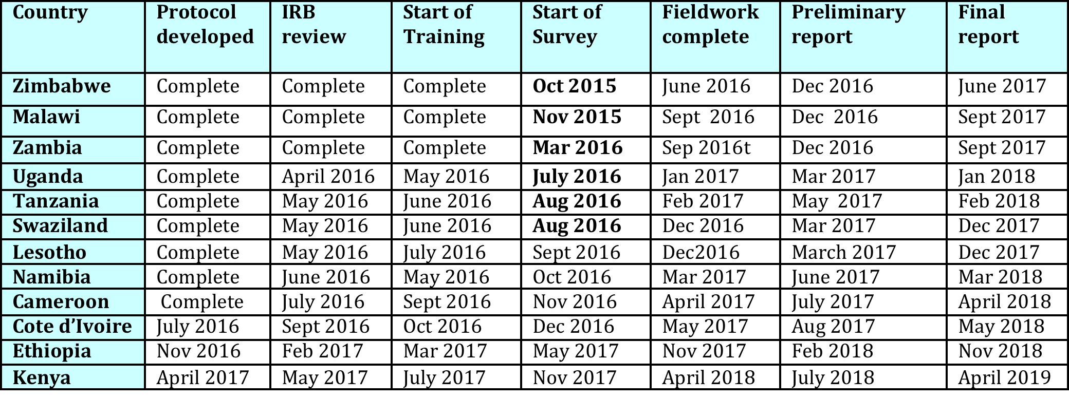
What is the timeline in each country?

Slide 22

Summary
What we hope to learn from PHIA
Population HIV impact assessments will provide information on the HIV epidemic among adults and children in 12 severely affected African countries
Will assess reach and quality of national and regional treatment service “cascades” and guide use of resources and future efforts to control the epidemic
Repeating surveys every 5 years can allow countries to assess the impact of their programs on attaining 90-90-90 goal.

Slide 23
What YOU can learn about PHIA at ISIbalo : The PHiA Block led by Graham Kalton and Sally Findley
Walk through the complexities of the PHIA sample design
Learn the details of wieghting and variance estimation
Identify the special strengths of the PHIA data
Have your creativity sparked in developing innovative research questions and hypotheses
Dive into the PHIA questionnaires and data dictionary to plan an analytic sequence with PHIA variables
Learn how to specify possible multivariate models
Appreciate the importance of linking analyses back to programs

Slide 24
PHIA ISIbalo Sequence Road Map
Monday, 12 00 – 13 00 : Introduction to PHIA surveys
Monday, 14 00 – 15 30 : PHIA sample design
Monday, 15 45-17 15: Formulating Innovative research questions with PHIA data
Tuesday, 11 30 – 13 00: Analysis plans for PHIA data
Tuesday, 9 30 – 11 00: PHIA Weighting & Variance Estimation
Tuesday 15 45 – 17 15: Specifying multivariate models
Wednesday , 9 30 – 11 00: Mentored support to groups on presenting their PHIA research proposals
Wednesday, 15 45-17 15: Optional PHIA sequence groups present their research proposals

Slide 25
PHIA data is useful only if you use it!
We want you to come to the PHIA sequence to:
Get excited about the PHIA surveys
Tap into your creativity
Emposer you to be a leader with the other PHIA team members in your country
Talk to others about PHIA surveys and form PHIA analysis teams
Be ready to start analysis as soon as the data are released

