Slide 1
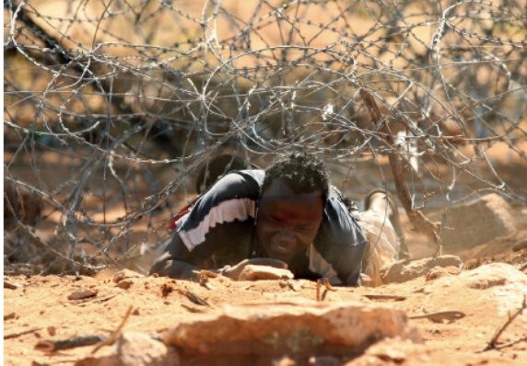
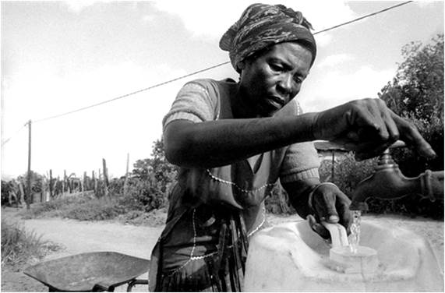
Data Methods and Sources An overview
Mark Collinson
MRC/ Wits Agincourt Health and Demographic Surveillance System
Wits School of Public Health
Wits Demography and Population Studies
INDEPTH Migration, Urbanisation and Health working group
Health and Demographic Surveillance System – National Research Infrastructure - RSA
5TH ISIbalo Conference of African Young Statisticians; Pretoria; 13-17 June 2016

Slide 2
Data Methods and Sources - Overview
Part 1 – Data Methods and sources
Introduction to demographic questions
Data sources for demographic analyses
Census
Surveys
Civil Registration and Vital Statistics
Health and Demographic Surveillance
Access to micro-data
Questions and discussion
Part 2 – Making the most of the data
Appraising data accuracy
Strengths and weaknesses of each data source
Triangulation of data sources
Examples: Urbanisation; household change; CRVS quality
Questions and discussion

Slide 3
A changing world
Population changing
size - urbanisation, transitions, gender roles
inequality - new visibility, injustice, post-colonial
data – variety of formats; scope and scale; limitations
the role of evidence – governance at all levels
The field of Demography changing
stable fundamentals and evolving methods
computing capability and Internet
knowledge institutions - collaborations; Africa rising

Slide 4
What is Demography?
Demography is the scientific study of human populations primarily with respect to their size, composition and development
It starts with a question relating to what is happening in a given population
It is not an application ‘recipes’

Slide 5
Types of questions
Formal demography
Modelling population processes – starting with what we know
formal mathematical relationships between demographic variables: fertility, mortality, migration and population structure
Social demography
the socioeconomic correlates of demographic processes (fertility, mortality, and migration)
the distribution of social goods such as health, wealth, and education within and between populations
What is driving change and where is it going?

Slide 6
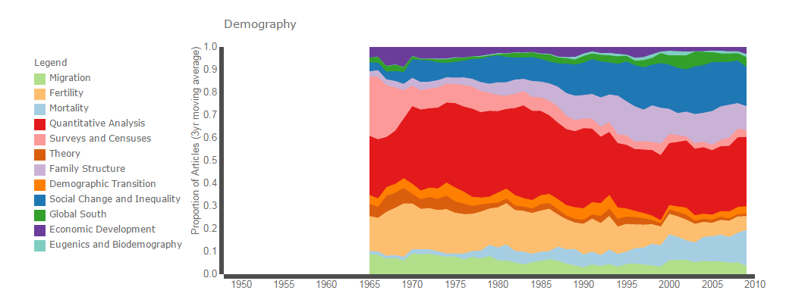
Sub-fields in the journal: Demography
Source: http://www.emilyklancher.com/digdemog/tmod/topjournal.html
Accessed 4 May 2016

Slide 7
Why?
Planning services
Strengthening the evidence for developing and targeting policies and programmes
Evaluating the impact of policies and programmes

Slide 8
National census

Slide 9
Censuses – an introduction
Partial censuses have a long history – but results rarely published
1990 round of censuses unprecedented – of 153 countries (1M+ population) 134 conducted censuses which enumerated 94% of the world’s population = 6 billion people
The beginnings of standard designs and classification schemes:
United Nations Statistical Division. Principles and Recommendations for Population and Housing Censuses (1998)
UNESCO. The International Standard Classification of Education (ESCED 1997)
United Nations Statistical Division. International Standard Industrial Classification of All Economic Activities.
Chronological and spatial comparability hugely increased

Slide 10
Census characteristics
legal authority by a national government,
definition of the area to be enumerated,
complete coverage (i.e. universal),
individual enumeration,
simultaneity of enumeration,
periodicity, UN recommends decennial
publication and dissemination of results
(Domschler and Goyer, 1986).

Slide 11
Census practice
Effort around geographical boundary definition: area and sub-areas
Decide on the questionnaire - What knowledge is needed for policy-making and planning?
Assigned enumerators go to each household – suitable respondent – fill in each row and column
Gvt compiles the information from subareas – tabulates people by subarea and by individual trait
Makes sampled data available for research

Slide 12
Census topics
Each nation decides topics reflect political priorities:
Geographical and migration characteristics
Household or family characteristics
Demographic and social characteristics
Fertility and mortality
Educational characteristics
Economic characteristics

Slide 13
Content universally adopted
four social variables: sex, age, marital status and relationship to householder
two education variables: literacy and years of schooling,
four economic variables: activity status, occupation, industry, and employment status.
Income was rarely asked.
asked in a majority of countries: educational qualifications, ethnicity/race, language, and number of living children.
two-thirds or more countries asked about: housing, number of children everborn, school attendance, religion and citizenship, a variety of migration indicators.

Slide 14
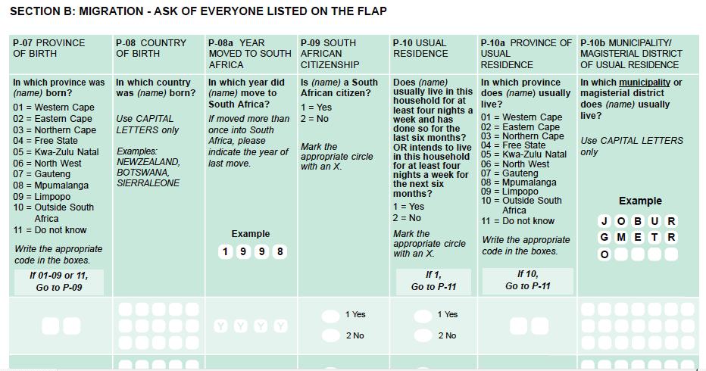

Slide 15
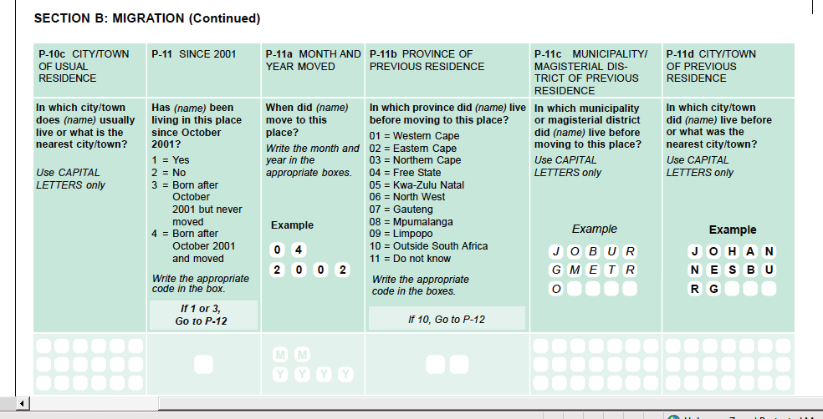

Slide 16
Releasing census microdata
Relatively recent development
Balance needed: the risk to privacy of publicly accessible microdata; and the social cost of restricting access to information.
Confidentiality maintained through:
remove names and addresses
don’t release identifying information
strip off all geographic detail below a certain level
Income coded to prevent the identification of the very rich
1% or 10% sample
Other methods of preserving confidentiality
Restricted data enclaves
Web-based analysis systems that incorporate automatic suppression of small cells.

Slide 17
Census as a sampling frame
National census provides the sampling from for nationally representative surveys
Demographic and Health Surveys (DHS)
Multiple Indicator Cluster Surveys (MICS)
Panel studies: in SA, National Income Dynamics Survey (NIDS); other Living Standards Measurement Survey (LSMS)

Slide 18
Demographic and Health Surveys

Slide 19
Demographic and Health Surveys introduction
Since 1984, the Demographic and Health Surveys (DHS) Program has supported more than 300 DHSs in over 90 countries
DHSs collect information on fertility and total fertility rate (TFR), reproductive health, maternal health, child health, immunization and survival, HIV/AIDS; maternal mortality, child mortality, malaria, and nutrition among women and children.
Aims to improve and institutionalise the collection and use of data by host countries for program monitoring and evaluation and for policy development decisions.

Slide 20
DHS methods
Sample Design
The sample is generally representative:
At the national level
At the residence level (urban-rural)
The sample is usually based on a stratified two-stage cluster design:
First stage: Enumeration Areas (EA) are generally drawn from Census files
Second stage: in each EA selected, a sample of households is drawn from an updated list of households
Geolocation of interviews recorded

Slide 21
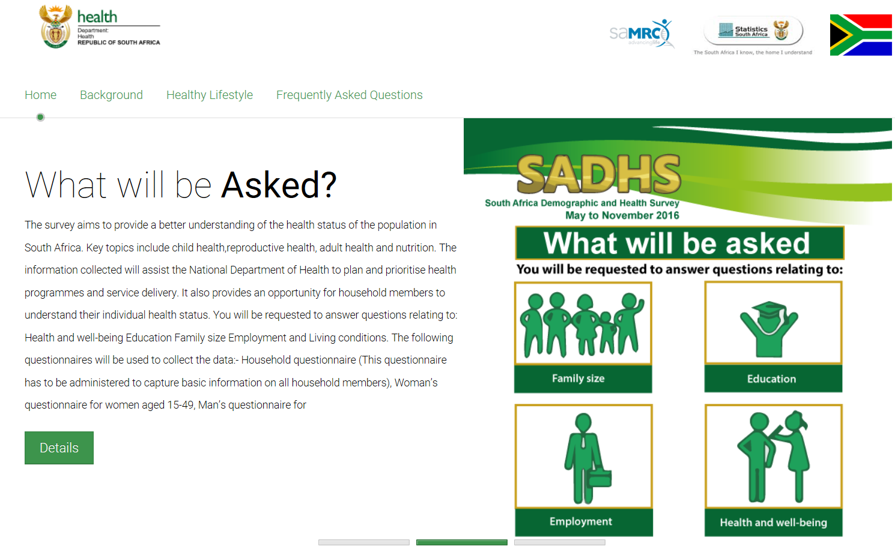

Slide 22
Special topic areas: Biomarkers
DHS has collected biomarker data relating to conditions and infections: anaemia, HIV, sexually transmitted diseases such as syphilis and the herpes simplex, serum retinol (Vitamin A), lead exposure, high blood pressure, and immunity from vaccine-preventable diseases like measles and tetanus.
Biomarkers complement self-reported health by providing an objective profile of a specific disease or health condition in a population.
Contributes to the understanding of behavioral risk factors and determinants of different illnesses.

Slide 23
Special topic areas: HIV prevalence
Since 2001, in over 15 countries in Africa, Asia and Latin America and Caribbean, DHS has conducted population-based HIV testing.
Collects Dry-Blood-Spot, for HIV testing from representative samples of men and women
The testing protocol provides for anonymous, informed, and voluntary testing of women and men
Produces population estimates of HIV prevalence
The project also collects data on the capacity of health care facilities to deliver HIV prevention and treatment services

Slide 24
Special topic areas: Malaria
Since 2000, surveys have collected data on ownership and use of mosquito nets, treatment of fever in children, and intermittent preventive treatment of pregnant women.
In recent years, additional questions on indoor residual spraying, and biomarker testing for anemia and malaria have been conducted.
Produces data on malaria infections and prevention programmes

Slide 25
Special topic areas: Gender
The DHS Program integrates gender into population, health and nutrition programs and HIV/AIDS-related activities.
Questions on gender roles and empowerment are integrated into most DHS questionnaires.
Some in-depth data on gender through modules on specific topics such as status of women, domestic violence, and female genital mutilation.

Slide 26
Special topic areas: Youth
Focus on young youth: education, employment, media exposure, nutrition, sexual activity, fertility, unions, and general reproductive health, including HIV prevalence.
The Youth Corner on the DHS website presents findings about youth and features profiles of young adults ages 15–24 from more than 30 countries worldwide.
Part of the broader effort by the Interagency Youth Working Group (IYWG) to support programs to improve the reproductive health of young adults.

Slide 27
Other surveys
Representative households surveys
Quarterly labour force surveys – series
National Income Dynamics Study
Panel study
Re-interview the same households each round
Keep track of individuals and their associated hhs

Slide 28
Civil Registration and Vital Statistics

Slide 29
Civil Registration and Vital Statistics (CRVS) - Introduction
CRVS is increasingly understood as a core capability needed in LDCs and MDCs to underpin the post-2015 development agenda.
Initiatives such as “Africa Programme on Accelerated Improvement of Civil Registration and Vital Statistics” (APAI-CRVS).
Visibility of all persons including the vulnerable and isolated.
Adequate data for planning of public services (coverage and quality)

Slide 30
How the South African System CRVS works:
A decentralised vital registration system where all the provinces conform to the same provisions, procedures and legislation regarding the registration of vital events.
Each province has regional offices that consist of several district offices, depending on the size of the population of the province.
Some districts have municipal offices where civil registration services are provided to the local communities.
Service is provided at no cost.

Slide 31
Innovations by SA government to improve coverage of vital registration
Computerisation:
Increasingly, the Department of Home Affairs offices have a fully computerised service allowing for processes to be performed quickly and efficiently
In offices with online terminals, data are captured directly onto the National Population Register (mostly district or regional offices) and parents are issued with an abridged birth certificate or death certificate
Mobile units:
DHA dispatches mobile units to rural areas to render services in rural and difficult-to-reach areas
Facilities:
Hospitals have been given the ability to register births and deaths on-line
Public Awareness campaigns:
A range of fora for public awareness have been employed: media, posters, health facilities

Slide 32
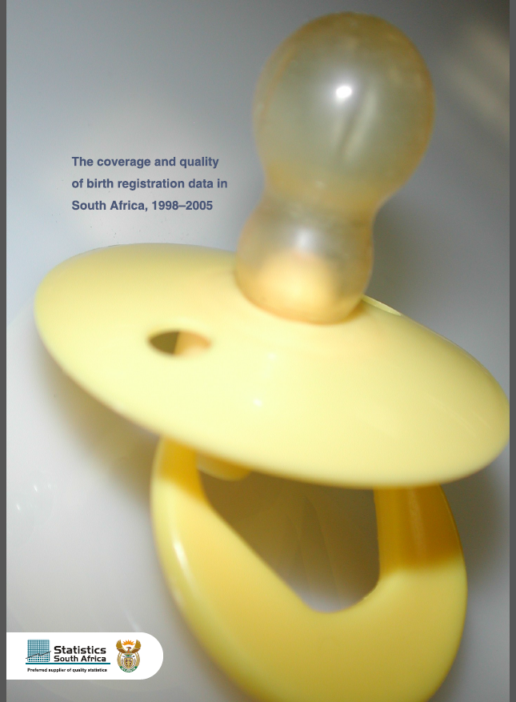

Slide 34
National civil registration death registration in SA
The Births and Deaths Registration Act requires a clinician to complete the death notification form - ICD format used - immediate, antecedent, underlying and contributory causes
For deaths in health facilities, attending or on-duty clinicians complete the form.
For natural deaths at home, the deceased is taken to a morgue by undertakers – a clinician examines the deceased and completes the form. Insufficiently available medical information about the deceased is commonly supplemented by information from relatives.
When a clinician is not available, as may happen in some remote rural areas, a Death Report is completed by an authorized traditional leader - certifies the death and describes the circumstances . Approximately 10% of deaths certified like this.
Unnatural deaths are subject to medico-legal investigation pursuant - the deceased is taken to a government morgue where an autopsy is conducted.
For death registration, the notification is submitted to a regional office of the Department of Home Affairs. Forms are compiled at national level, and then delivered to Stats SA where trained nosologists code causes of death to ICD-10 three-digit codes.
They determine the underlying cause of a death using the Automated Classification of Medical Entities software (ACME 2000.05).

Slide 35
Health and Demographic Surveillance

Slide 36
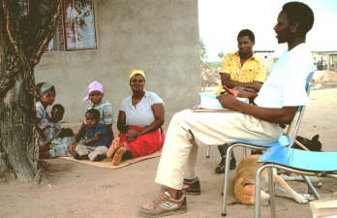
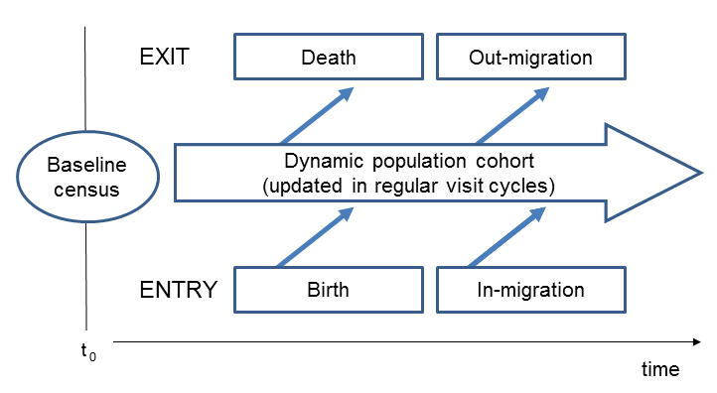
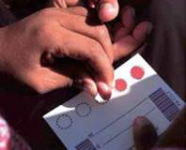
Health and Demographic Surveillance Systems (HDSS)
Geographically-defined sections of impoverished communities
A standardised, population-based information system
Regular repeated visits – prospective collection of longitudinal population, health and socio-economic data
A versatile platform for policy evaluation and intervention testing
Population data linked to service utilisation: health, schools, civil reg.
Notes:
.. Of which we know too little about

Slide 37
Verbal autopsy method to establish Cause of Death
For all deaths, trained fieldworkers interview the closest carer of the deceased
They elicits signs and symptoms of the illness or injury preceding death,
using a locally validated, local-language, VA instrument.
Two medical doctors independently review the VA information and assign probable immediate, contributory and underlying causes using ICD-10 conventions.
When a consensus cause cannot be reached, a third clinician, blind to earlier findings, assesses the details.
The cause is coded ‘undetermined’ if an agreement cannot be reached.
Cause attribution automated through a probabilistic algorithm ‘InterVA4’

Slide 38
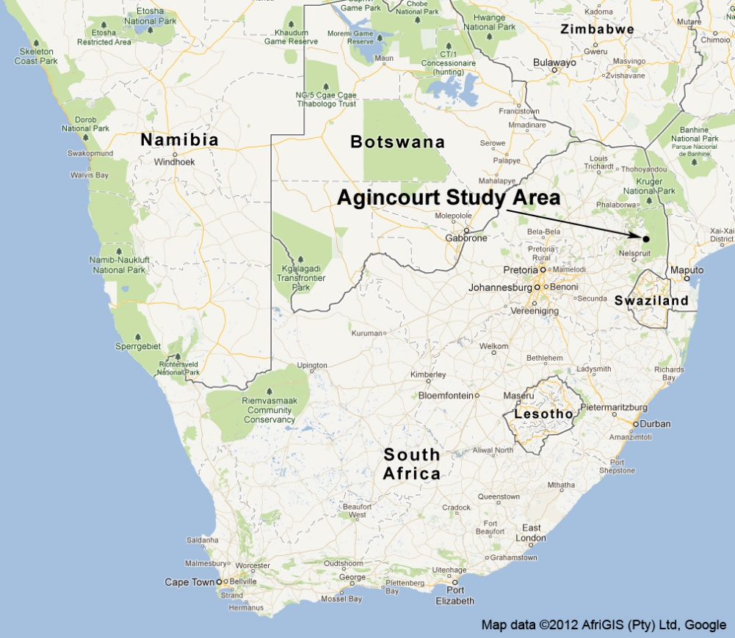

Agincourt sub-district,
Bushbuckridge
31 villages, 20,000 households, 110 000 people
Rural, densely settled former Bantustan (Gazankulu)
31% Mozambican immigrants (self-settled former refugee)

Slide 39
Status observations updated routinely, Agincourt HDSS, 2000-2015
Census year | 2000 | 2001 | 2002 | 2003 | 2004 | 2005 | 2006 | 2007 | 2008 | 2009 | 2010 | 2011 | 2012 | 2013 | 2014 | 2015
Modules
Education
Labour
Household assets
Temporary migrations
Child Care Grants
Health Care Utilisation
Food Security
Adult Health
Father support
Vital Documents
Residence status

Slide 40
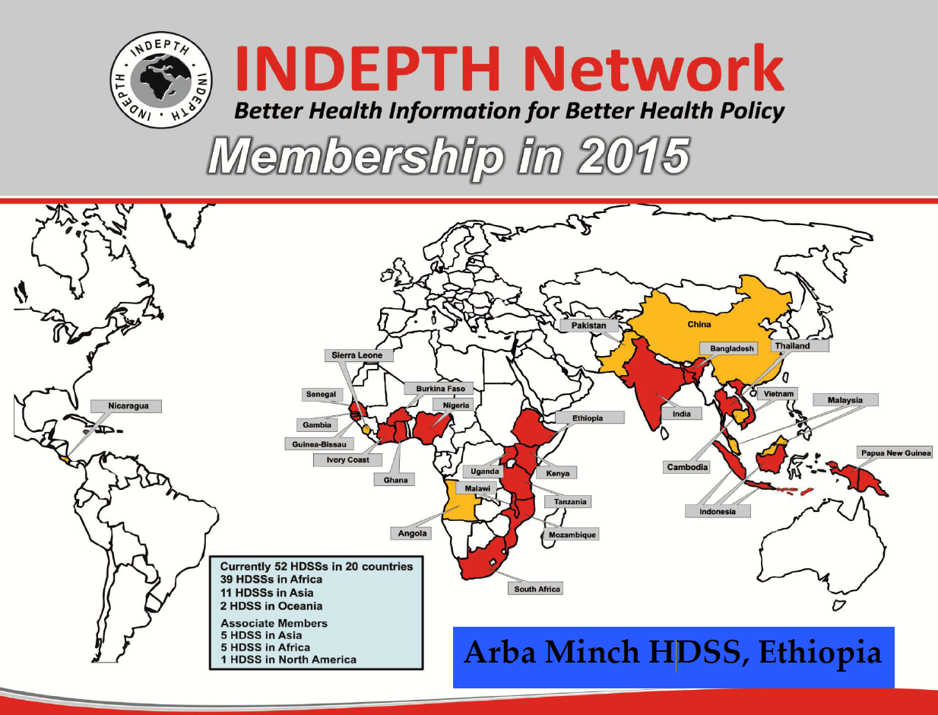

Slide 41
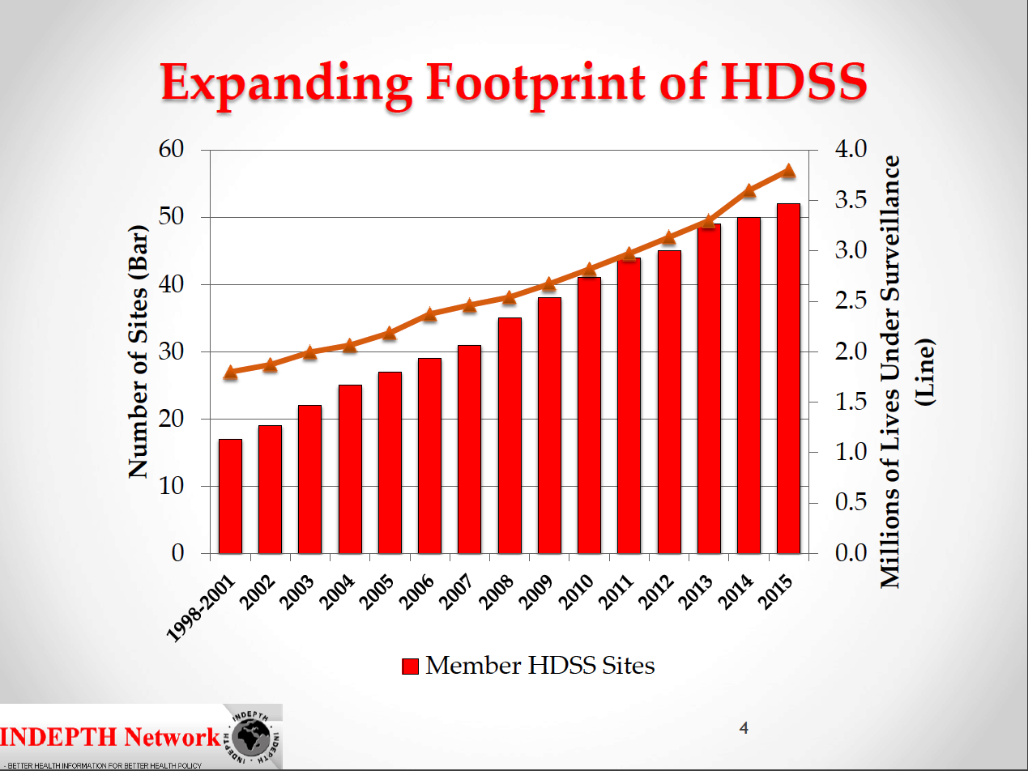

Slide 42
Data Sources

Slide 43
Access to Census and CRVS data in South Africa
Statistics SA web-site
http://www.statssa.gov.za
Statistics SA interactive data portal (Nesstar)
http://interactive.statssa.gov.za/
South African Data Archive:
http://sada.nrf.ac.za/

Slide 44
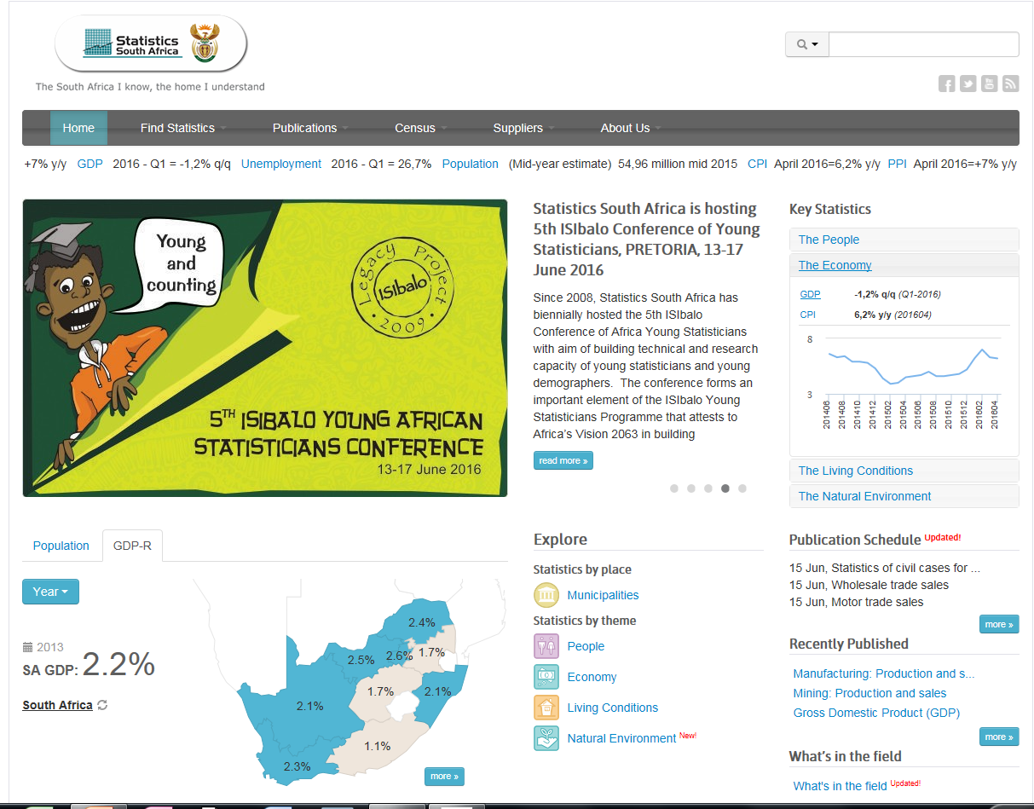

Slide 45
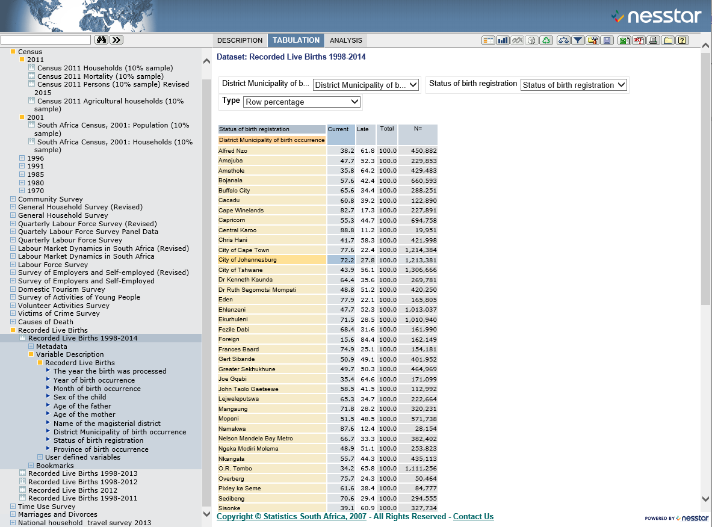

Slide 46
Integrated Public Use Microdata Series (IPUMS) International
82 countries - 277 censuses – harmonised data
Inventory machine readable census microdata
Preserve census micro-datasets identified as at-risk
Create an integrated international census database with a harmonized system of concepts, variables and codes
Disseminate integrated microdata samples via the internet, restricting access to bona fide researchers who have signed a non-disclosure agreement.
http://www.ipums.org

Slide 47
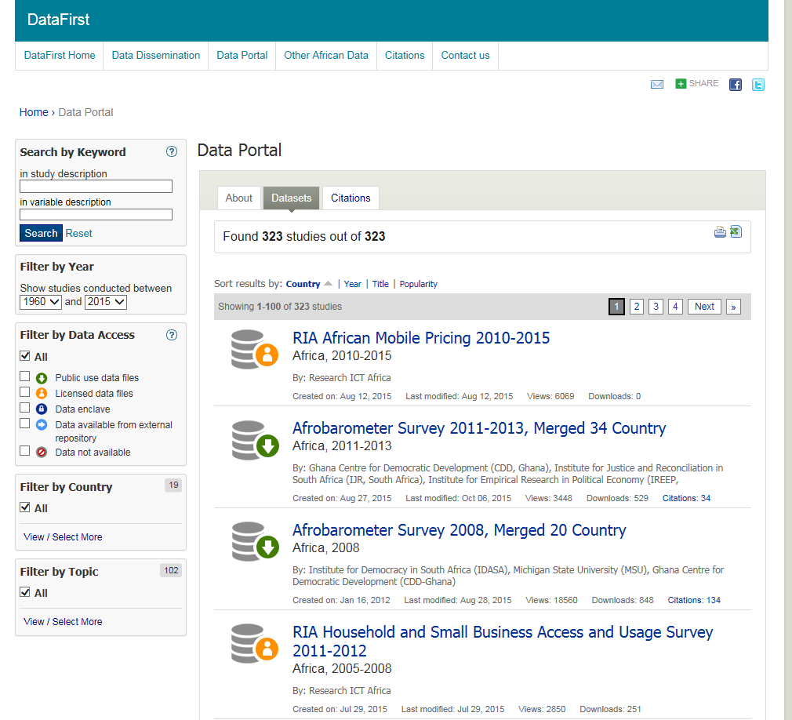
DataFirst: Research Unit and Data Service based at the University of Cape Town, SA

Slide 48
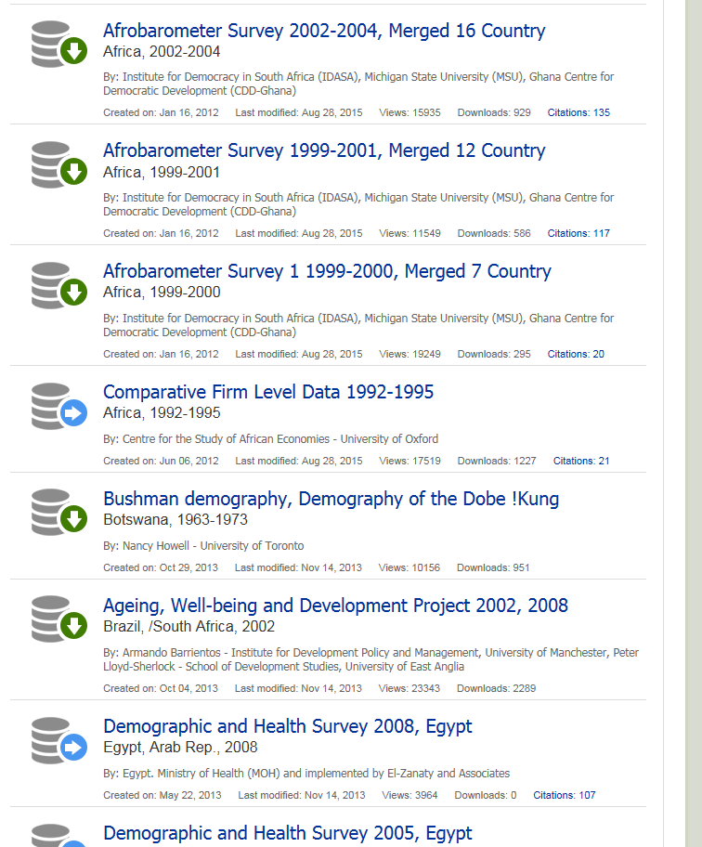

Slide 49
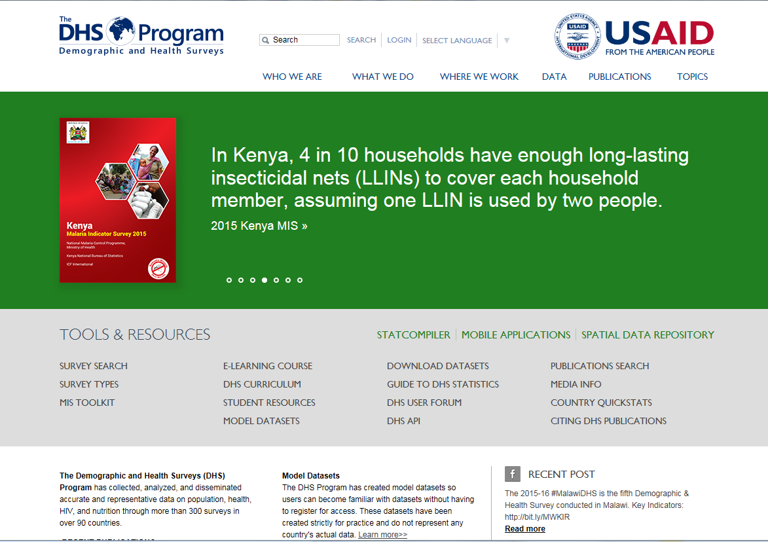

Slide 50
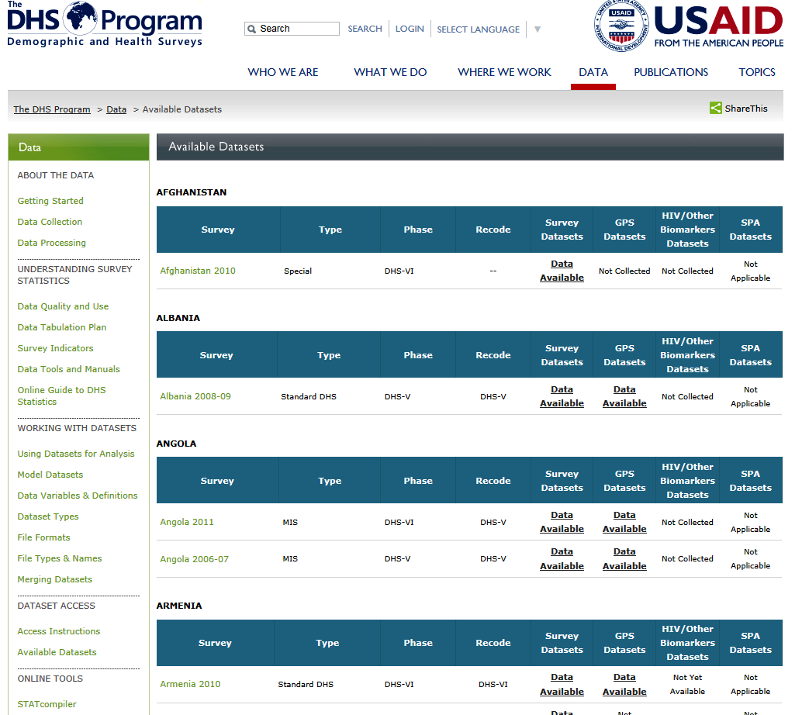

Slide 51
Minnesota Population Centre - Integrated DHS project (IDHS)
Focus on sub-Saharan Africa in first phase,
The main challenges of the DHS are data discovery and logistics.
Integrated DHS harmonize all the variables, documents comparability issues, and provides a web system for data browsing and creation of cross-national extracts for downloading.
Comparative DHS research could require managing hundreds of files and many thousands of variables, with no central mechanism for exploring the detailed contents of the samples.
Websystem links to the DHS Program
https://www.idhsdata.org/idhs/

Slide 52
UNICEF Multiple Indicator Cluster Surveys (MICS) program
Since 1995, - statistically sound and internationally comparable data on women and children worldwide
Topics range from maternal and child health; education; child mortality; child protection; HIV/AIDS ; water and sanitation; intervention coverage; knowledge of and attitudes to certain topics; specific behaviors of women, men and children
Survey activities carried out by the implementing agencies – with technical support from UNICEF
Standard MICS questionnaires customized by implementing agencies
Surveys are designed to be representative. The average sample size in the 5th round is 12,000 households, but it varies.
In the 5th round, data on >130 internationally agreed-upon indicators
Releases microdata to examine disparities by age, gender, education, wealth, location of residence, ethnicity, etc.
http://mics.unicef.org

Slide 53
International Household Survey Network (IHSN)
International Household Survey Network (IHSN) an informal network of international agencies.
Aims to improve the availability, accessibility, and quality of survey data within developing countries; to encourage the analysis and use of this data by national and international development decision makers, the research community, and other stakeholders
coordinates internationally sponsored survey programs
provides practical technical and methodological guidelines for all stages of the survey life cycle
provide a central survey data catalog
standards, tools, and guidelines to document, disseminate, and preserve microdata according to international standards and best practices
http://www.ihsn.org
IHSN Microdata Cataloging Tool (NADA) for web-based portal Http://www.ihsn.org/home/software/nada
IHSN inventory of national and international micro-datasets public archives (NADA): 86 repositories by national statistical offices and research organizations in more than 60 countries or areas as of March 2016: http://adp.ihsn.org/survey-catalogs

Slide 54
INDEPTHStats is a website to visualise key demographic indicators
INDEPTH Data Repository is a long term project to share anonymised, quality assured and fully documented individual level data from INDEPTH studies and member Centres
iSHARE2 is an INDEPTH project to support and promote good research data management practices at INDEPTH Member Centres

Slide 55
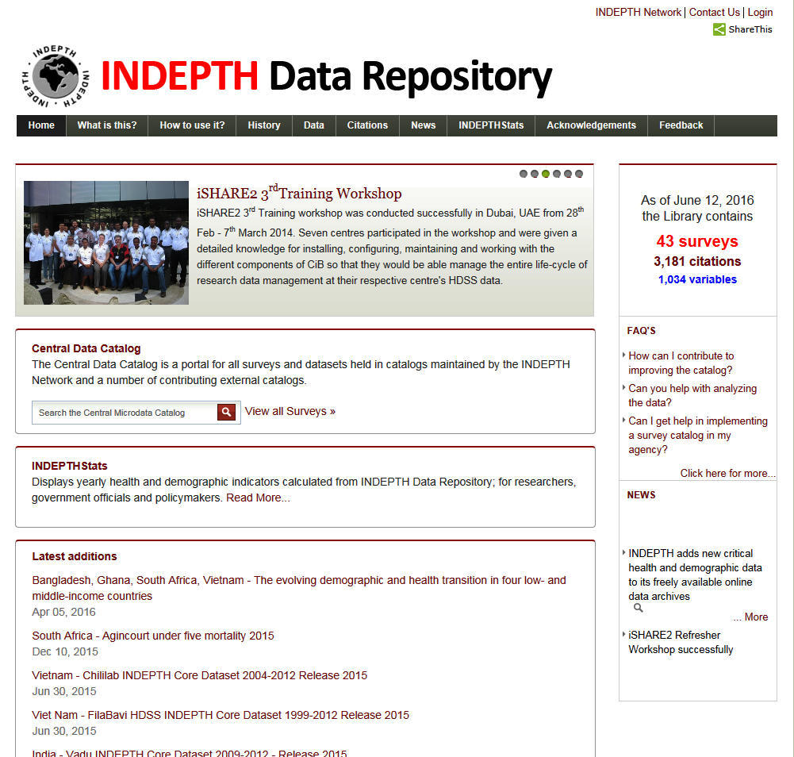

Slide 56
Access to Agincourt HDSS datasets
INDEPTH Data Repository and INDEPTH Stats: http://www.indepth-ishare.org/indepthstats/
INDEPTH-WHO SAGE: www.who.int/healthinfo/systems/sage
Agincourt Data Section: survey/cohort datasets and tailored data extractions http://www.agincourt.co.za/index.php/data/
Agincourt 1-in-10 database: www.agincourt.co.za

Slide 57
End-of-part-1
Questions/ discussion

Slide 58
Part 2: Making the most of the data
Appraising data acuracy
Data sources
Know the strengths and weaknesses
Match question with data source
Triangulation of data sources

Slide 59
Appraising data accuracy
Refer to: Moultrie T, Dorrington R, Hill A, Timæus I, Zaba B (eds) 2013 “Tools for Demographic Estimation” Paris: IUSSP
Population statistics are subject to error – are the data accurate enough for the application?
Coverage errors and content errors
Obtain as much background documentation as possible

Slide 60
Types of possible testing procedures
Consistency checks, based on one or more censuses;
Comparison of observed data with a theoretically expected configuration, for example the use of balancing equations and population projection models;
Comparison of data observed in one country with those observed elsewhere;
Comparison with similar data from other sources;
Direct checks (re-enumeration of samples of the population etc).

Slide 61
Data type | Strengths | Weaknesses
National Census | Representativity high Coverage wide Can model associations | Snap-shot in time Demographic processes estimated Very infrequent updates (10 years) Possible undercount/ non-response Measurement error
Survey – cross sectional | Representative, More detail possible Can model associations | Snap-shot in time Potential bias in the sample Sampling design can change Must use weights to get back to population Infrequent updates
Survey – panel study | Representative More detail possible Some temporal dimension/ causality | Potential bias in the sample Potential attrition bias Must use weights to get back to population
Civil Registration and Vital Statistics (CRVS) | Event-based Temporal, prospective Potential wide coverage | Coverage low in poor SES sub-populations Quality may be poor Hard to release micro-data Limited co-variates
Health and Demographic Surveillance (HDSS) | Event-based Temporal, prospective Frequent updates Can pre-populate forms No weights needed Links to service utilization in real-time | Small area Representativity may be limited Potential Hawthorne effect Potential attrition bias

Slide 64
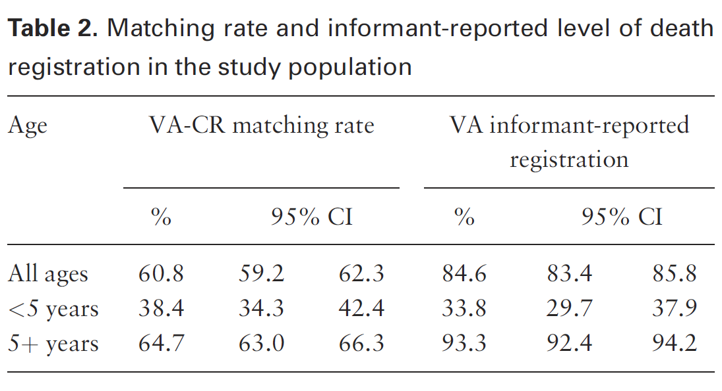
Cause-of-death data quality
Matching achieved: 61% of HDSS deaths found in the National Death register
In the HDSS record of this time 85% of deaths were registered
Deaths <5years
Lowest in both
systems
(Reference: Joubert, J., Bradshaw, D., Kabudula, C., Rao, C., Kahn, K., Mee, P., Tollman, S., Lopez, A.D. and Vos, T., 2014. Record-linkage comparison of verbal autopsy and routine civil registration death certification in rural north-east South Africa: 2006–09. International journal of epidemiology, 43(6), pp.1945-1958)

Slide 65
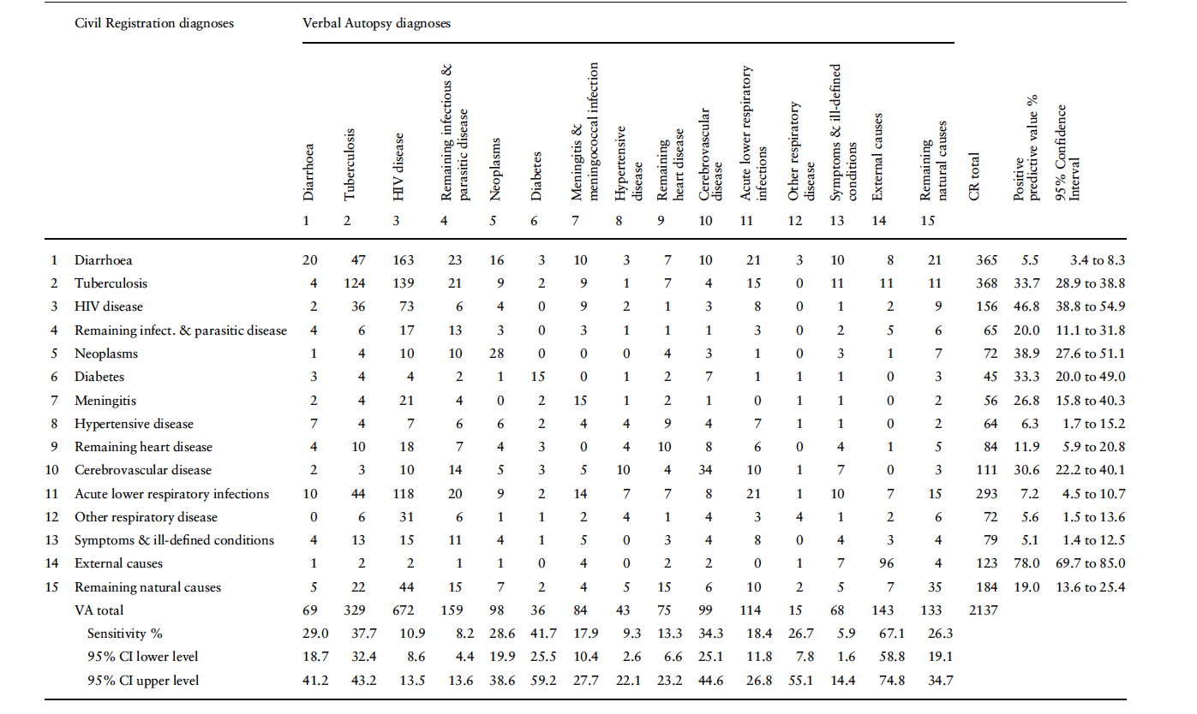
Misclassification patterns for selected causes
HIV disease misclassification is highlighted by the red line
The blue ovals show the total number of deaths by HIV in the two systems

Slide 66
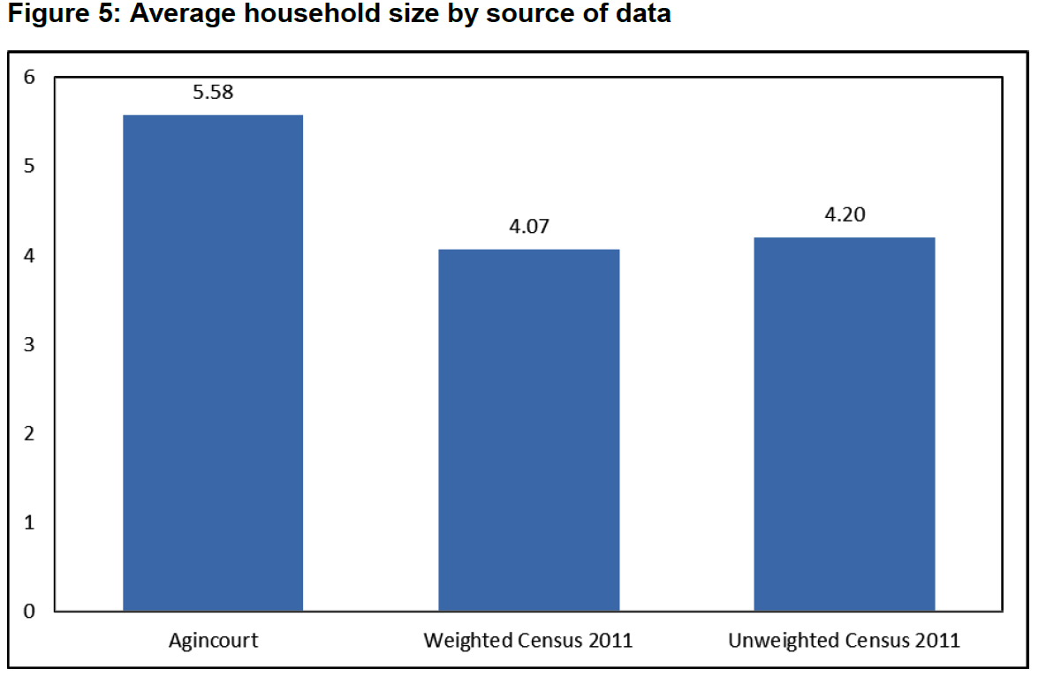
Shoko, M., Collinson, M.A., Lefakane, L., Kahn, K., Tollman, S.M. “What can we learn about South African households by comparing the national Census 2011 with the Agincourt Health and Demographic Surveillance System in the rural northeast Mpumalanga?” African Population Studies – revise and resubmit

Slide 67
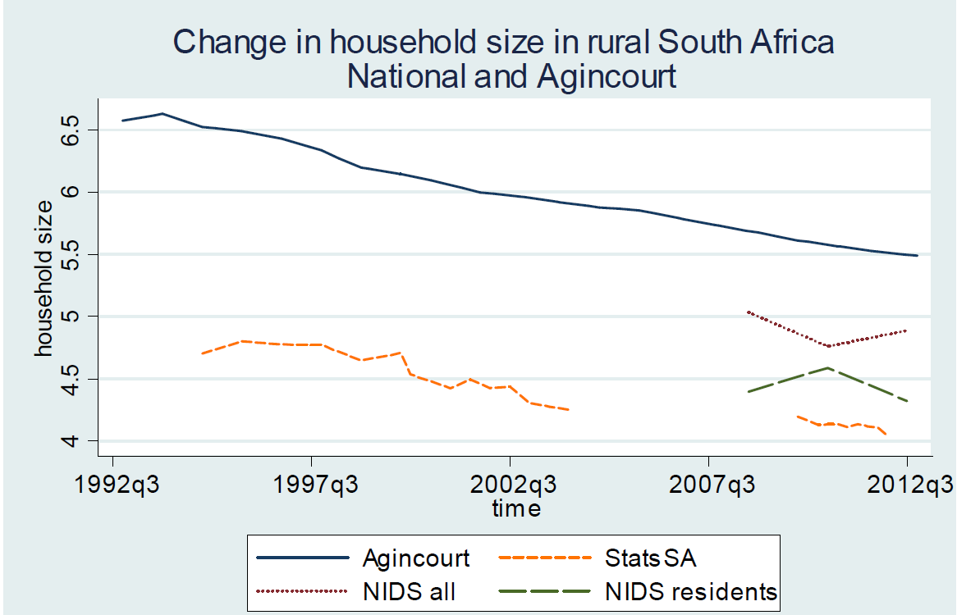
Wittenberg M, Collinson MA, Harris T, “Decomposing changes in household measures: Household size and services in South Africa 1994-2012”, Demographic Research – revise and resubmit

Slide 68


Municipal Type – Migration Transition Matrix: Black Males and Females
National census 2011
Origin Local Municipality Type - From 2006 | Destination Local Municipality Type - 2011
 | Core-Metro |  | Secondary City |  | Large Town |  | Small Town |  | Mostly Rural |  | Total
 | N | % Of Total Internal Migrants | N | % Of Total Internal Migrants | N | % Of Total Internal Migrants | N | % Of Total Internal Migrants | N | % Of Total Internal Migrants | N | % Of Total Internal Migrants
Core-Metro | 234873 | 12.18% | 97136 | 5.04% | 117427 | 6.09% | 50142 | 2.60% | 50725 | 2.63% | 550302 | 28.53%
Secondary City | 148869 | 7.72% | 52812 | 2.74% | 76641 | 3.97% | 46895 | 2.43% | 29543 | 1.53% | 354760 | 18.39%
Large Town | 166522 | 8.63% | 65272 | 3.38% | 65658 | 3.40% | 40556 | 2.10% | 35533 | 1.84% | 373542 | 19.37%
Small Town | 132427 | 6.87% | 69091 | 3.58% | 75535 | 3.92% | 38782 | 2.01% | 33389 | 1.73% | 349224 | 18.11%
Mostly Rural | 124006 | 6.43% | 42435 | 2.20% | 69739 | 3.62% | 27162 | 1.41% | 37688 | 1.95% | 301029 | 15.61%
Total Internal Migrants | 806696 | 41.82% | 326746 | 16.94% | 404999 | 21.00% | 203538 | 10.55% | 186878 | 9.69% | 1928857 | 100.00%
Ginsburg, C., Collinson, M.A., Gómez-Olivé, F.X., Kahn, K., Tollman, S.M. 2016. “Migration and Settlement Change in South Africa: Triangulating Census 2011 with Longitudinal Data from the Agincourt Health and Demographic Surveillance System”. Southern African Journal of Demography (accepted, in press)

Slide 69

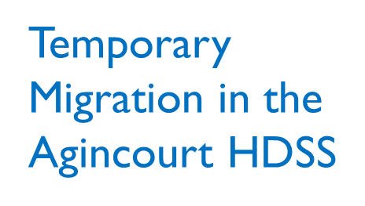


Slide 70
Conclusions
Unprecedented microdata availability
A question must guide the analysis
Different questions favour different data sources
Each dataset has limitations
Where possible triangulate data sources

