Slide 1

Household Income and Expenditure Survey (HIES)
Liberia

Slide 2
Contents
Household Income and Expenditure Survey (HIES) Background & Objectives
Introduction and objectives of the paper
Sampling design
Region covered
Field data collection
Data quality assurance
HIES 2014 results for National Accounts
Challenges
Pending Activities on the HIES 2016/2017

Slide 3
Household Income and Expenditure Survey (HIES) Project Background & Objectives
The Government of Liberia has not implemented a national Household Income and Expenditure Survey (HIES) since 1964 due to financial challenges, capacity constraints and the civil war
LISGIS implemented a HIES in 2014 which collected detailed information on:
consumption expenditure
income
household characteristics
The key objectives of the HIES 2014 are:
Produce poverty measure
Update the Consumer Price Index weights and basket
Update the household component of National Accounts
Produce baseline indicators for the Agenda for Transformation (AfT)
Modernize statistical methods
However, only 6 months data were collected because of a major crisis.
A rerun of HIES data collection begun on 14 January 2016 and will end by mid-January 2017;
The sample size and methodology are the same as the HIES 2014, in order to allow for comparison and the sample size will allow for analysis at the county level;

Slide 4
Sampling Design
Primary sampling unit is the EAs; 836 EAs are in the sample
Secondary sampling unit is the household; 10 households are randomly selected from a household listing in each EA; 8360 households should fall in the sample {Completed 4090 HHs in 2014 HIES}
Designed in a way that data is nationally representative on a quarterly basis, data is also representative at county level; this was achieved in 2014 for the 6 months HIES covering all districts
Sample Design
Sampling frame based on 2008 census data
Stratified two-stage sample design was used

Slide 5
HIES 2016/2017 Sample Design

Slide 6
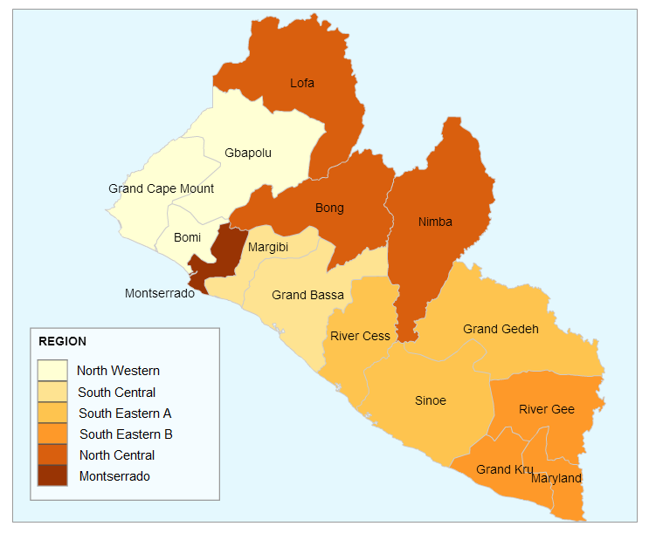
Regions
Region | Counties
North Western | Bomi, Grand Cape Mount, Gbarpolu
South Central | Margibi, Grand Bassa
South Eastern A | River Cess, Sinoe, Grand Gedeh
South Eastern B | Rivergee, Grand Kru, Maryland
North Central | Bong, Nimba, Lofa
Montserrado | Montserrado

Slide 7
Field Data Collection
Category of Field Staff | Total Number of Staff | EAs Covered Per Quarter | EAs Per Month | Days Alloted per EA | Total Zones | Funding Sources
Field Supervisor, Enumerators, GIS, Data Entry Clerk, Driver | 112 | 15 | 5 | 6 | 14 (One team per Zone) | GOL, World Bank, USAID, EU SIDA, AfDB

Slide 8
Data Collection and Quality Assurance
Data quality assurance
Close field monitoring of field teams
Comparing GPS coordinates with actual GPS coordinates on the field during data collection
Review questionnaires during field monitoring visit to minimize response errors
Trends are observed by county, team, and in some cases enumerator, to identify strange patterns (outliers)
Double data entries of completed questionnaires for comparison
Field data entry
Headquarter data entry
Data cleaning using STATA

Slide 9
HIES 2014 Results for National Accounts

Slide 10
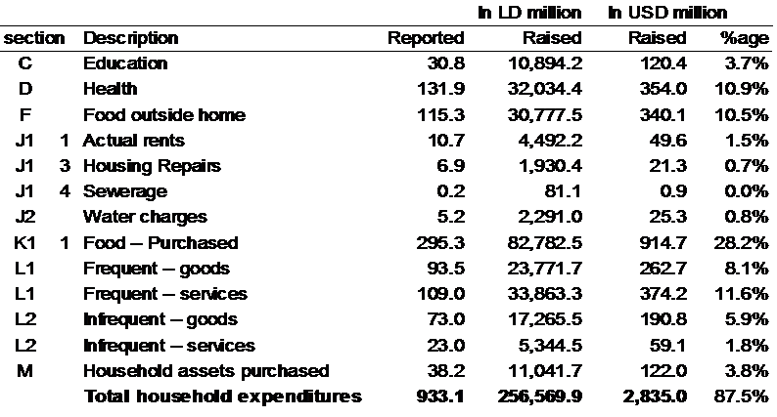
HIES Overall Estimates, 2014

Slide 11
Actual and Imputed Rent, 2014
Rent Arrangement | Liberia | Montserrado | Other Counties | Liberia | Montserrado | Other Counties
 |  |  |  | Percentage Shares
Employer Provided - Free | 18,392 | 1,547 | 16,845 | 2.00% | 0.50% | 2.80%
Employer Provided - Subsidized | 7,173 | 2,504 | 4,669 | 0.80% | 0.80% | 0.80%
Free | 219,311 | 50,817 | 168,494 | 23.50% | 15.60% | 27.70%
Owner Occupied | 445,156 | 102,190 | 342,966 | 47.70% | 31.30% | 56.40%
Rented | 244,012 | 169,005 | 75,007 | 26.10% | 51.80% | 12.30%
All Households | 934,044 | 326,063 | 607,981 | 100.00% | 100.00% | 100.00%

Slide 12
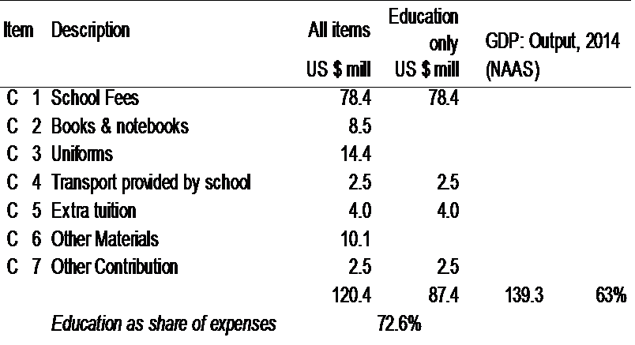
Households Education Expenses Reported, 2014

Slide 13
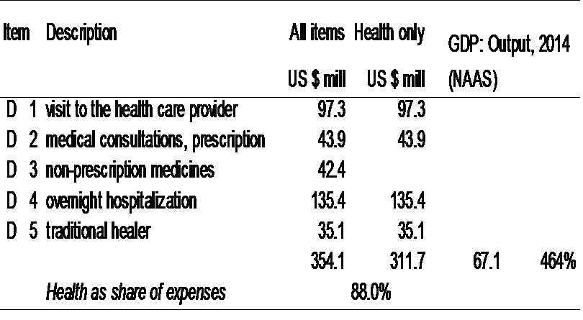
Households Health Expenses Reported, 2014

Slide 14
HIES 2016/2017 Challenges
Vehicles
Road conditions
Rainy season general impact on timeliness and safety
Tyres to be changed often and cost of maintenance of field vehicles is prohibitive
Deplorable roads or potential closure of main road (Lofa)
Breakdown of bridge and between some counties (Rivercess & Sinoe)

Slide 15
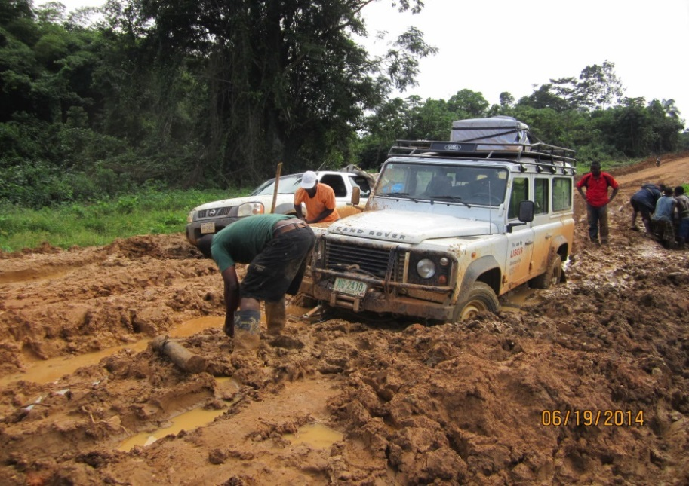
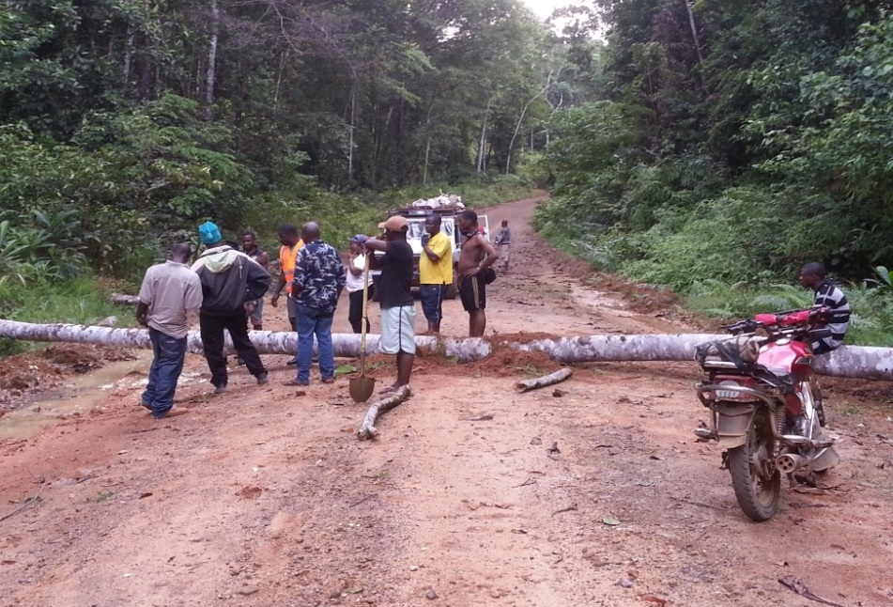
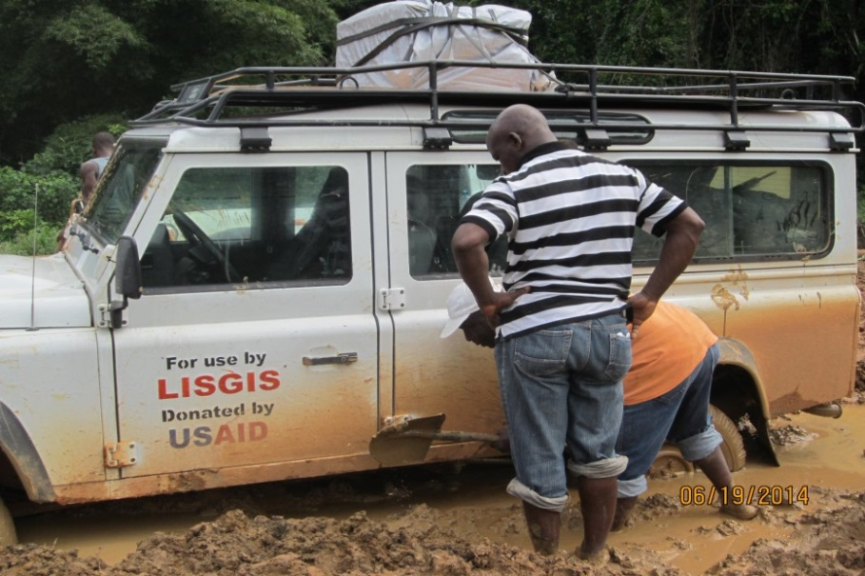
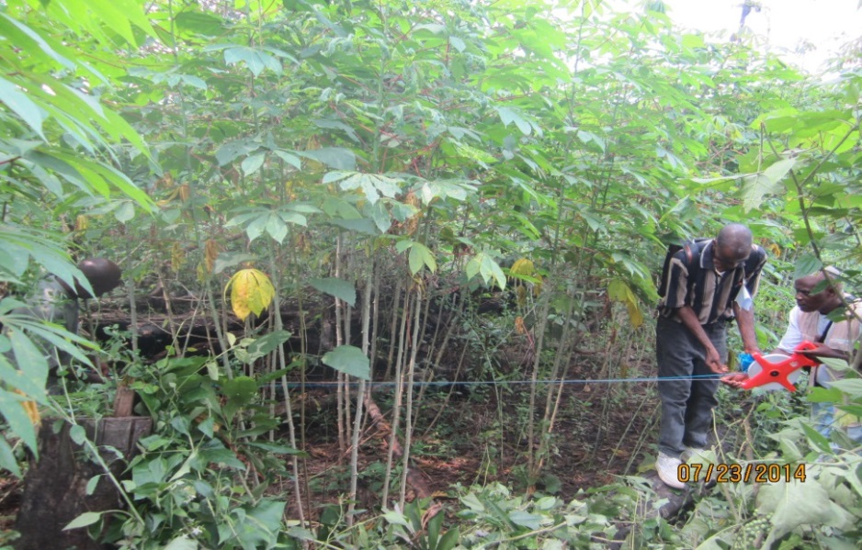
Implementation Challenges

Slide 16
Pending Activities
Oct – Dec 2016 Draft cleaning codes based on preliminary data collected
Oct – Nov 2016 Prepare Consumption Aggregate and draft Poverty number based on first 6-months of data
Feb – Apr 2017 Further Cleaning of all data
Feb – Apr 2017 Construction of design weights
May – Aug 2017 Analysis and reports to be prepared in Poverty, National Accounts, CPI, Statistical Abstract, AfT, SDGs
Dec 2017 Dissemination of HIES 2015-16 Results

Slide 17

Thank You

