Slide 1



The Program BRAVO!
(Birth Registration for All Versus Oblivion)
approach for linking civil registration to the health system

Slide 2
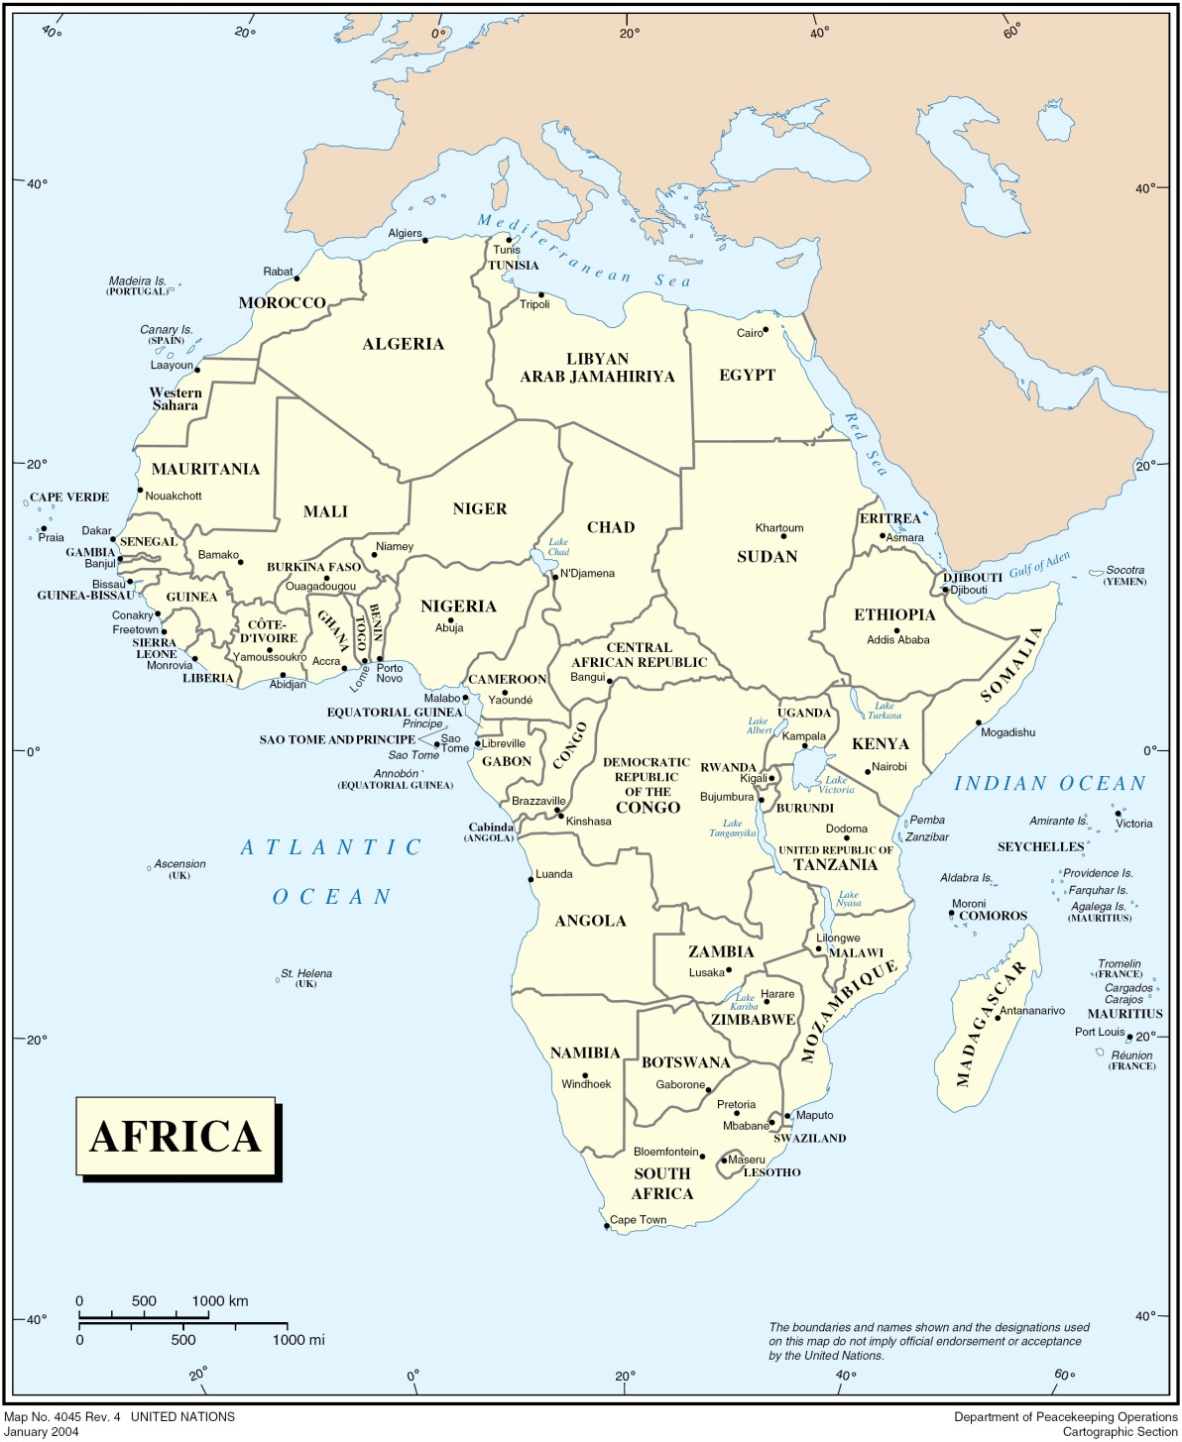
BRAVO!
collaborates with the Governments of
Burkina Faso, Malawi and Mosambique
In Burkina Faso 13 registration centers
In Malawi
4 registration centers
In Mozambique
10 registration centers

Slide 3
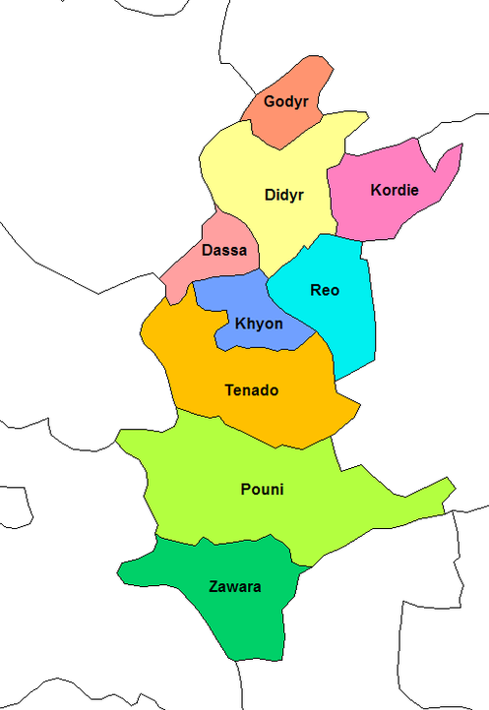
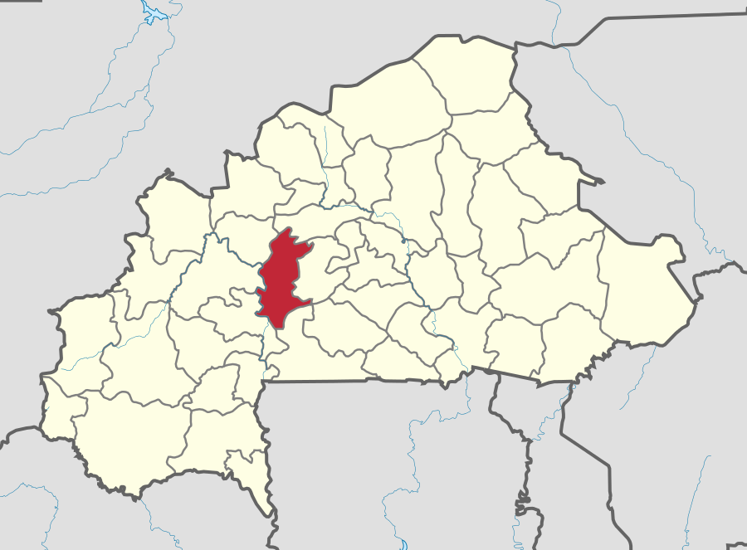
Impact evaluation study
in the Sanguié province, Burkina Faso

Slide 4
Method
Stable registration centers have been opened in every health facility of the urban district of Réo (68.000 inhabitants) and of the rural district of Godyr (22.000 inhabitants), promoting birth registration of children born or vaccinated there.
The two study districts are compared with two comparable control districts (Yako and Gomponsom).
Retrospective data of birth civil registrations in the time allowed by the law (60 days from birth) have been collected for the districts.
Data from birth civil registers and selected data collected from health registers for delivery and vaccination are captured in a database and compared, in order to assess how many children get out of birth registration procedure.
The impact evaluation study has been conducted for 12 months, in order to avoid distorting effects due to seasonality.
Impact evaluation study of the opening of birth registration centers in the health facilities that provide neonatal services (delivery, vaccination, pre- and postnatal care) at a very decentralized level.

Slide 5
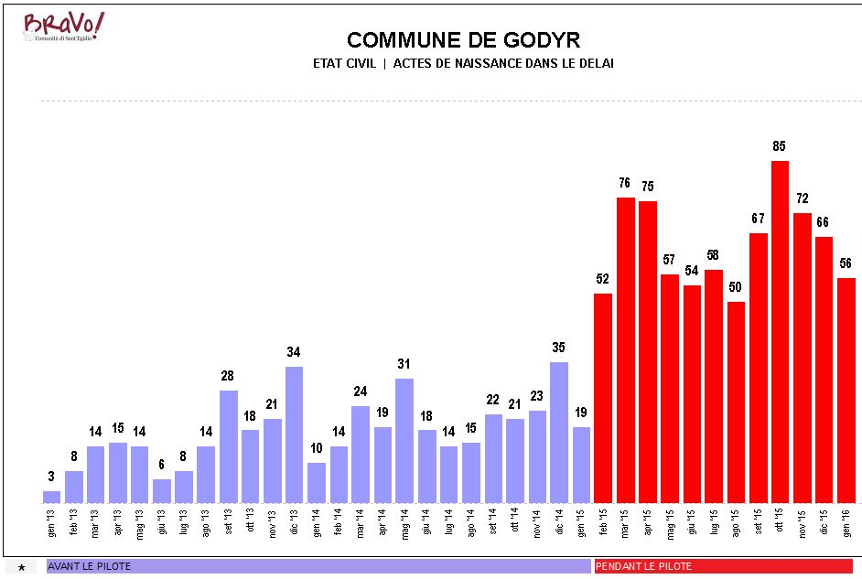
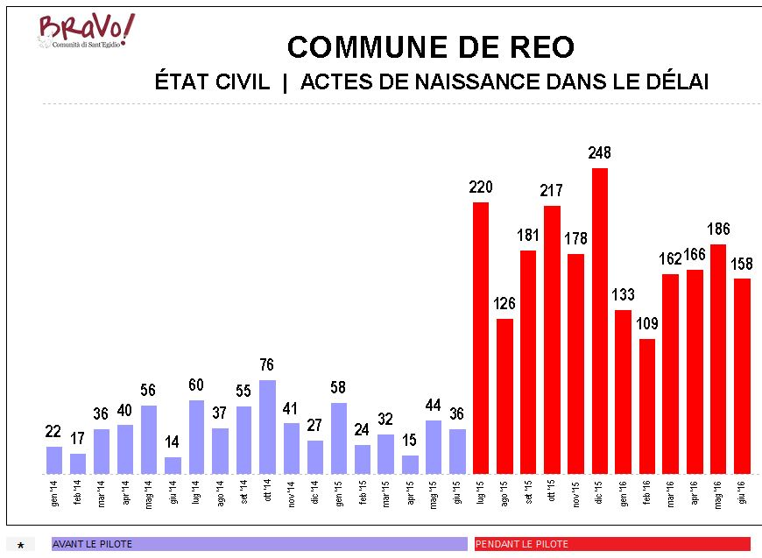
Increase in birth registrations
The number of birth certificates issued in the time allowed by the law have increased extremely comparing to the previous months both in Réo and in Godyr.
In Godyr we notice an increase of 357% In Réo of 453%.

Slide 6
Data
The children recorded in the civil registers for birth and in the health registers for delivery and vaccination, as long as born in the two districts and less than 60 days, are eligible for the study.
During the 12 months of the study, 3.288 eligible children were registered in the database collecting the data of the study.
87,41% of them received their birth certificate.
The birth registration rate of newborns (0-60 days) far exceeds the registration rate estimated for the Centre-Ouest region (62% of children 0-5 years MICS estimates 2010.
The majority of children attended the health facility two times in the first two months of life: at birth (registered in the Registre des accouchements – AC) and for the first vaccination (registered in the Registre des vaccinations – VC). A narrower number of children were just born or vaccinated there.
Crossing data form birth civil registers to those of health registers for delivery and vaccination we have a comparison between the number of children 0-60 days old who have had access to the services of the health facilities and the number of birth certificates issued to them.

Slide 7
Increase in birth registrations for selected groups of children

Slide 8
Data
Birth registration among children born and vaccinated in the health facilities is 91,95%.
Among those just born in the health facility is 70,63% and among those just vaccinated there is 76.05%.
Interestingly, 139 children came to the health facilities only for birth registration without attending any of the health services.
There is a significant number of children (10%) who came for vaccination being born in another district of the country or in Cote d’Ivoire. These data should provoke reflection in the legislator on how to manage in the most fair and efficient manner high mobility of the population, in order to avoid lack of registration or false statement.

Slide 9
Challenges
We could compare the registered children with the children attending health services, we actually don’t know the real figures of the children born in the study districts. We can assume that those children that get off the health system are the most vulnerable and need to be reached both from the health and civil registration systems.
12,59% of the children attending health services haven't been registered at birth. Our aim is to reach 100% of the newborns.
No death registration have been recorded in the period, although infant death rate in the region is 87 per 1.000 and in the interviews with the families some death is recorded. High coverage of birth registration and good performances of civil registration centers will probably help people understand the value of all registrations, including death registrations.

Slide 10
Conclusions
The data shows the very positive outcomes of linking civil registration to the health system for the increase of birth registration rate.
This method is very cost effective and have positive outcomes both for the civil registration and for the health system.
Very interesting developments will also result to the organization of health services from the computerization of data on newborns in the district, in order to promote the completion of the vaccination course, the periodic review of health, etc.
It will be critical to undertake positive actions in order to reach all families receiving health care.

