Slide 1

Progress in CRVS in South Africa
Presentation
to
12th African Symposium on Statistical Development
02-04 November 2016
Tunis Tunisia

Slide 2
Outline of the presentation
CRVS in South Africa
Background of the CRVS Assessment
Goal of the assessment
The scope of the assessment
The process
Challenges
Lesson learned
Way forward

Slide 3
The South African CRVS System
Department of Home Affairs (DHA)
The custodian of the identity of all South African citizens
Critical to which is the issuance of:
birth, marriage and death certificates;
identity documents (IDs) and passports;
citizenship; naturalisation and permanent residency certificates
Department of Justice and Correctional Services (DoJ&CS)
Responsible for:
Issuance of divorce decrees
Completion of divorce forms used produce statistics on divorces

Slide 4
The South African CRVS System ..Cont
Department of Health (DoH)
Responsible for ;
Certification of the occurrence of birth and death
Certification of causes of death
Statistics South Africa (Stats SA)
Responsible for;
Production of vital statistics
Annual publications of births, deaths (including causes of death), marriages and divorces

Slide 5
Background
South Africa CRVS assessment undertaken in October 2014.
Establishment of working groups;
Steering committee.
Technical Working group (TWG).
Task teams (Lead by TWG).
The assessment was lead by six departments involved in CRVS ;
Department of Home Affairs
Department of Health
Department of Justice and Correctional Services
Department of Basic Education (DBE);
The Presidency and
Statistics South Africa
Technical support from UN agencies

Slide 6



Goal of the assessment :
Identify strengths and weaknesses in the current systems and identify interventions for strengthening South Africa’s CRVS systems.
Obtain information that will enhance overall performance of the CRVS system and influence the direction of development of the systems
Establish an objective baseline that forms the basis for follow-up evaluations
Build consensus around priority areas for CRVS system strengthening; and mobilise technical and financial support for the implementation of a national strategic plan
Present exceptional learning from peers and clients/users from the self-assessment process.
Assist the government and partners to distinguish the key issues, and increase the use of CRVS records

Slide 7
The assessment process
A qualitative study (Self assessment).
Data collection was undertaken with all 9 provinces (two areas each).
Desk review:
Literature on current CRVS status
A comprehensive review of the policy and legal environment for CRVS in the country by legal team from three lead departments.
Data processing and analysis undertaken by the Technical Working Group (TWG).
Report writing by a small sub-group of TWG.

Slide 8
Way forward:
Report taken for external review.
Reconstitution of the CRVS teams in preparation for the strategic plan.
Communication of results to key stakeholders.
Advocacy for better support from national CRVS partners.
Mobilise for dedicated resources to complete the process.

Slide 9
Achievements
CRVS report finalised
Improved communication and coordination between government and NGO with CRVS interest.
Creation of a working group to undertake review of the DNF
Legislative reform introduced to improve civil registration, e.g. introduction of punitive measures for late registration of births.
Private –public partnership in deliver of services e.g. application for smart ID through banks.
Introduction of electronic data acquisition from Department of Home Affairs
Consistent publication of Births, deaths and marriages data based on civil registration data:

Slide 10
Percentage of births by month (2012−2014)
March had the highest proportion of birth occurrences for all the years

Slide 11
Top ten leading causes of death by sex- 2014
Male |  |  |  | Female
Rank | Number | % |  | Rank | Number | %
Tuberculosis | 1 | 22 545 | 9,5 |  | 1 | 15 174 | 7,1
Influenza and pneumonia | 2 | 11 202 | 4,7 |  | 6 | 10 739 | 5,0
Human immunodeficiency virus [HIV] disease | 3 | 11 160 | 4,7 |  | 7 | 10 685 | 5,0
Cerebrovascular diseases | 4 | 9 908 | 4,2 |  | 3 | 13 149 | 6,1
Other forms of heart disease | 5 | 9 872 | 4,2 |  | 4 | 11 418 | 5,3
Diabetes mellitus | 6 | 8 914 | 3,8 |  | 2 | 13 819 | 6,4
Chronic lower respiratory diseases | 7 | 7 300 | 3,1 |  | … | … | ….
Other viral diseases | 8 | 6 913 | 2,9 |  | 9 | 7 019 | 3,3
Intestinal infectious diseases | 9 | 6 796 | 2,9 |  | 8 | 7 607 | 3,5
Hypertensive diseases | 10 | 6 670 | 2,8 |  | 5 | 11 081 | 5,2
Malignant neoplasms of female genital organs | … | … | …. |  | 10 | 4 913 | 2,3
Diabetes second leading COD for females and influenza and pneumonia for males

Slide 12
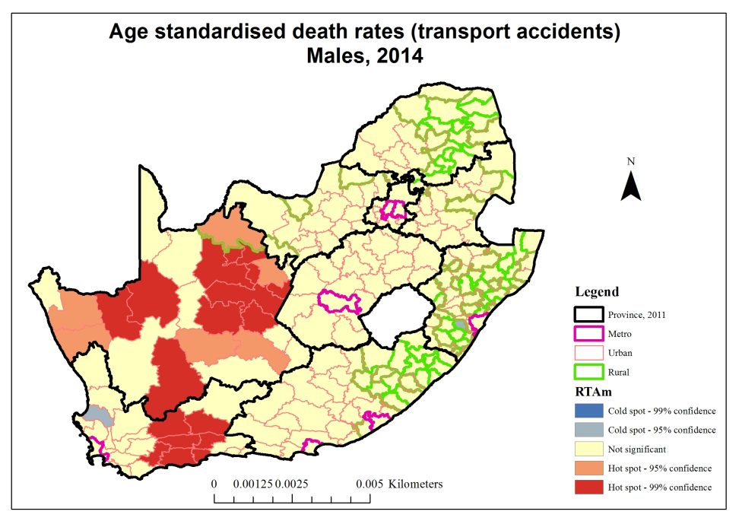
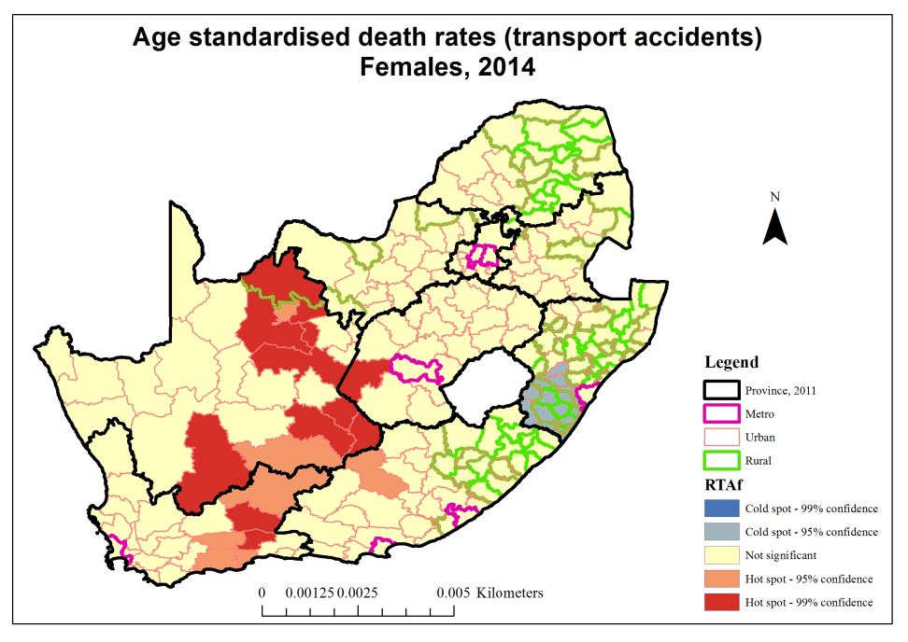
Hot and cold spots for transport accidents by sex

Slide 13
Challenges
Completion of assessment process delayed
Lack of resources to undertake upstream CRVS processes;
Review of report (Internal and external)
Dedicated personnel to complete the process.
Capacity of TWG affected by exit of key role players.
Transition from manual processing to electronic system slow.
Lack of cooperation from some of the critical stakeholders

Slide 14

Lessons Learned
Continued commitment of steering committee ensure sustainability of project
The level of cooperation between the partner departments in the assessment also contributed to the progress achieved in the assessment project.
Maintaining long term commitment
requires dedicated coordination mechanism.
Building capacity ensures sustainability of the
process.
Institutionalising processes ensures
sustainability
Realistic resources allocation (Human and
financial ) to important for project success.
Inclusion of risk mitigation strategies
critical to the success of the project.
General interest in the outcome of assessment and the improvement of CRVS among non-governmental organisations in SA.
Quality improvement in is a long term process
Creating a dedicated team at the beginning of
the project is critical

Slide 15
Thank You

