Slide 1

Tunisian Statistical
Business Register (TSBR)
Establishment and maintenance
Hassen AROURI
Director of business register and economic surveys
National Institute of statistics - Tunisia

Slide 2
Plan
Presentation of TSBR
    Legal framework
    Goals
    Sources
    Management
    Content
Quality control and imporovement
    Problems of administrative sources
    Quality improvement survey
    Statistical methodology of estimation
Publications

Slide 3
Legal framework : creation
1.1
Pursuant to the 94-780 decree of 4 April 1994:
  The Statistical Business Register (SBR) is created and managed by the National Statistical Institute (INS)
  INS attribute an identifier for each enterprise or establissment in the RNE
  INS is charged to codify economic activity using the tunisian national activity classification (NAT)

Slide 4
1.1
Legal framework : sources
Sources of update
Administrative sources : the General Fiscal Direction (DGI),the National Social Security Fund (CNSS) and each public structure having information about firms
➔ Exchange Agreement : dates, variables, classifications, definitions, …

Slide 5
TSBR Goals
1.2
Database of units
Database of statistics
Sampling frame

Slide 6
TBR Goals : Unit database
1.2
Coverage list of enterprises - establissments and update all relative information : activity status, activity, size, address, …
Normalisation and harmonisation enterprises information : using national classifications, unique identifier, …

Slide 7
TBR Goals : Statistical database
1.2
Publish business statsitics : enterprise number, employees, turnover, importation, exportation,…by activity, year, size, …
Enterprises demography : entry, exit, stillborn
Job creation : Gross and net job creation and destruction
Internationl studies : world bank (Which firms create the most jobs?, up-or-out dynamic ?, creative-destruction process?,…)

Slide 8
TBR Goals : Sampling frame
1.2
THE TBR is the unique business sampling frame :
  Economic activity national survey (ENAE)
  Small enterprises economic activity survey
  Employment and wages survey
  Surveys outside INS: Annual Survey of Competitiveness

Slide 9
Sources of update
1.3
Administrative sources
      Fiscal direction (DGI)
      Security and social fund (CNSS)
      Customs (douane)
      Industial Promotion agency (API)
Economic surveys

Slide 10
Administrative sources caracteristics
1.3
Source | Principal variables | Frequency | Coverage | Enterprise Identifier | Classifications
DGI (legal unit) | Identification, activities, turnover, benefits | quarterly | 700 thousand | Fiscal code | Fiscal classifications : address, activity, legal form
CNSS (Employer ,independant and salaries) | Identification, activity, salaried employee , wages | quarterly | 160 thousand | Employer code | CNSS classifications : activity, address
 | Identification | quarterly | 450 thousand | Independant code | proffession
 | Identification | quarterly | 1100 thousand | salaries
Douane | Identification, products | annual | 8000 | Fiscal code | NSH product classification
API (Industrial units) | Identification, activity, size | annual | 6000 | API code | NAT

Slide 11
Administrative sources problems
1.3
Absence of unique definition of « enterprise »
Absence of unique or common enterprise identifier
Multiple classifications used to code address and economic activity
Diversity in the way of writing the names of the society and person

Slide 12
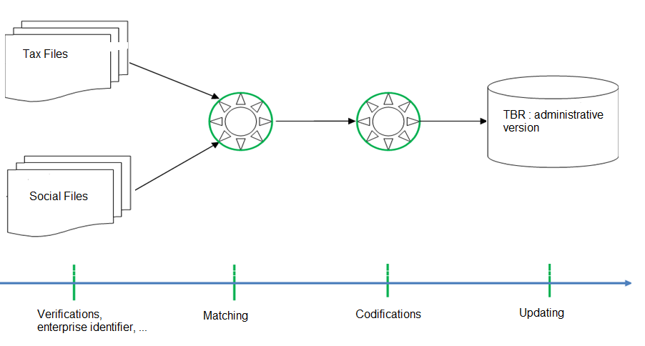
Updating the live register
1.4

Slide 13
Unit identifier and matching
1.4
Unit identifier :
Attributed to each legal unit (active or no)
sequential random with control key
No relation with the activity or address or size,…
Matching :
Search, for each fiscal code, the correspondant code in the other files (cnss code, api code,..)
Since 2010, the matching process is automates

Slide 14
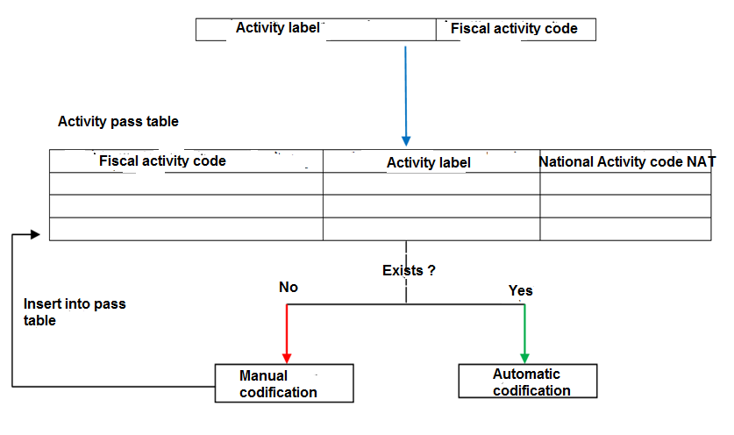
Variables codification
1.4
Codification of activity, Gouvernorat, Delegation is based on pass tables
Activity codification process :

Slide 15
TSBR contents
1.5
Units : private sector , associations, public enterprises and administrations
Private sector:
  Identification variables
  Caracteristics variables
  Size variables

Slide 16
TSBR : principal variables
1.5
Identification
Enterprise identifiers : INS, DGI, CNSS, douane, Api
Name, address( …,tel,email), dates
Caracteristics
Principal and secondary activity (nat96,nat09), legal form, nationality, fiscal regime (offshore, forfaitaire, reel, …)
Establissement : name, address, activity
Size
Employee, wages, turnover, benefits, export, import

Slide 17
2.
Quality control and improvement
Administrative sources problems
Solution 1 : Improvement quality survey
Solution 2 : Statistical methodology
السجل الوطني للمؤسسات
تحسين الجودة

Slide 18
Administrative source quality
2.1
Variable | Problems
Activity status | False active units (11%) : ( Delay declaration of cessation …)
Address | Address defaut (8%) Declaration , delay of update, …
Economic activity | Problem of details declaration, delay of update, special classifications, …
Employee number | Only registred employement (Formal : 70%, 90% exclude constructin),
Turnover | 65% of units make declaration (delay and update) (35% missing value)

Slide 19
TSBR quality improvement
2.2
Solution 1 : quality survey
      Control and improvement quality survey (2006-2008)
Solution 2 : developing statistical models using results of economic survey
      Diversify administrative sources and dissemination the results of economic survey
      (since 2009)

Slide 20
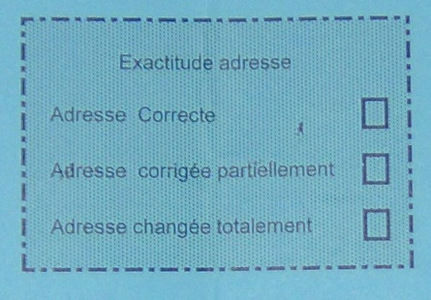
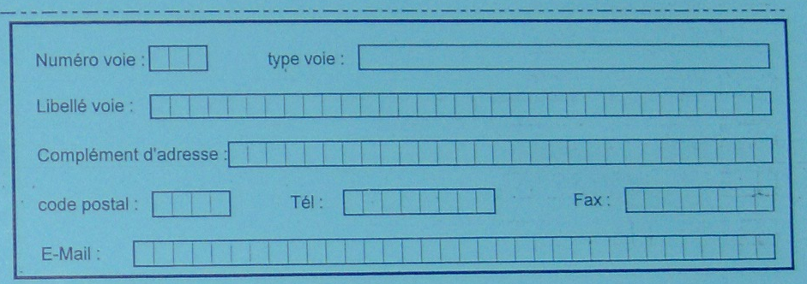
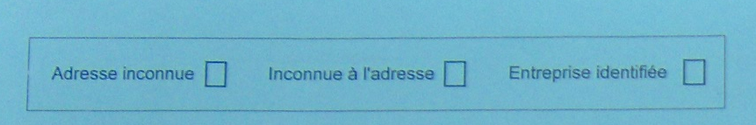
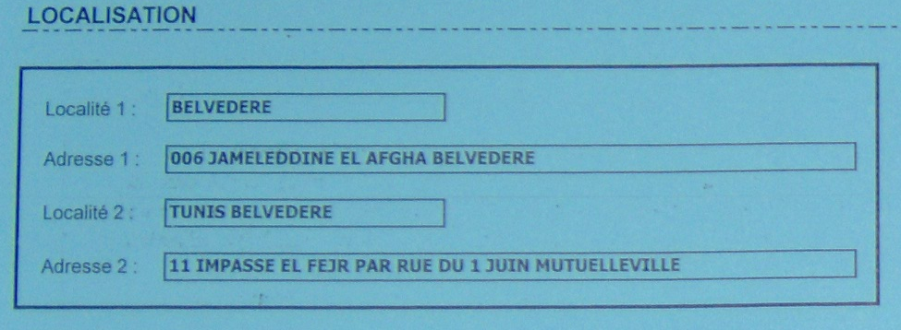
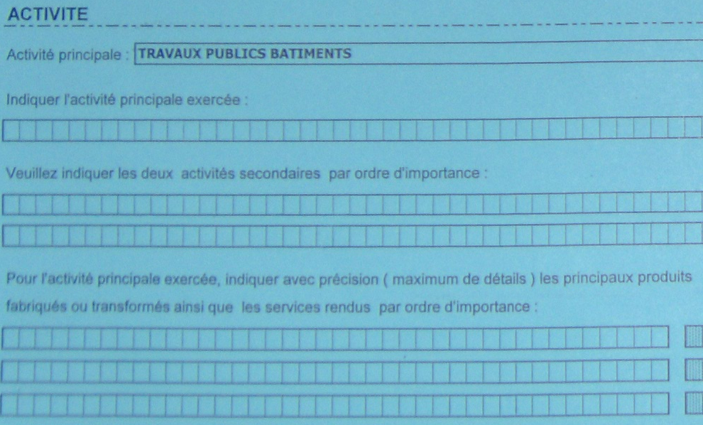
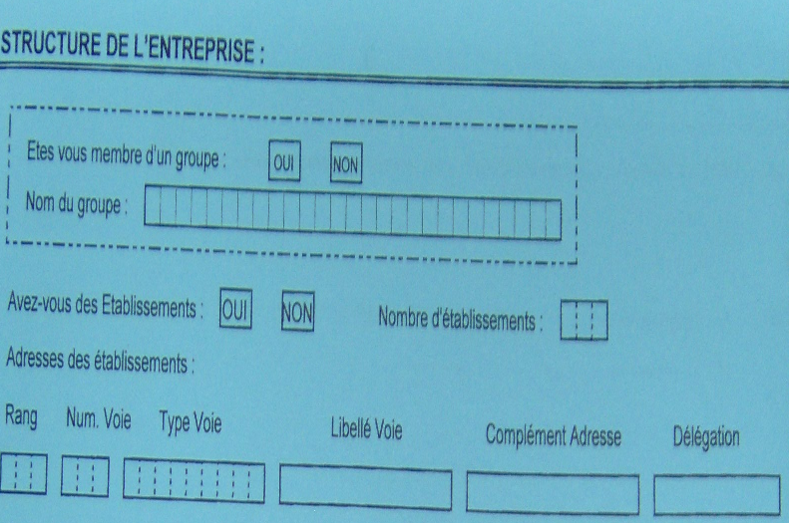
2.2
Control and improvement quality survey

Slide 21
Quality survey evaluation
2.2
Costs :
Preparation of questionnaire, technical study, survey manuel, storage application, …
15 thousand entreprises : 150 thousand dollars
Identification and response problems
Recourse to the second solution
Diversify the administrative sources
Develop a methodology for the dissemination of the results of economic surveys

Slide 22
imporvement quality statistical models
2.3
Variable | DGI | CNSS | API | Douane | Economic Surveys | Statistical model
Activity status | X | X | X | X | X | Probabilistic model ( logistic regression, signal of activity)
Address | X | X | X | X | X | Deterministic model (a prior quality of source)
Economic activity | X | X | X | X | X | Deterministic model (frequency on sources)
size | X | X |  | X | X | Probabilistic model (robust regression)

Slide 23
3.
Publications

Slide 24


Annual publication
3.1

Slide 25
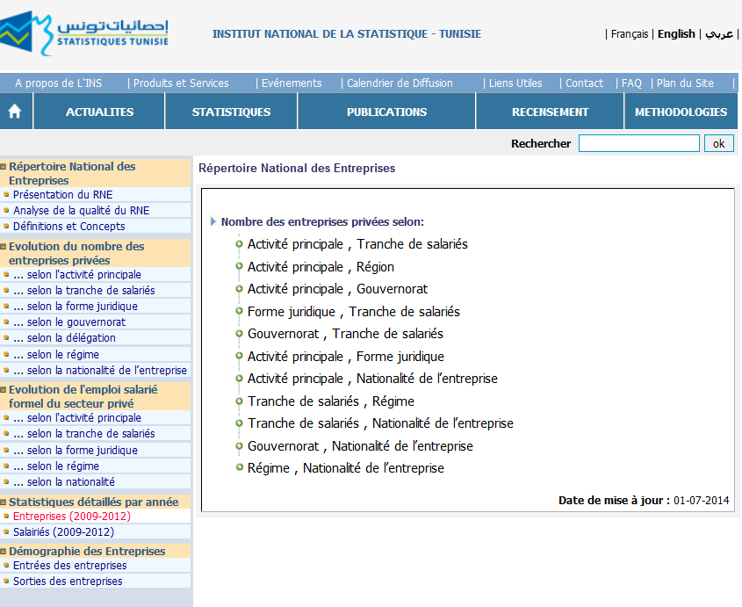
3.1
Web site : www.ins.tn (statistiques des entreprises)

Slide 26


Studies
3.2

Slide 27
3.2
Firm-Size and Employment Distributions

Slide 28
Net Job Creation in Tunisia
3.2

Slide 29
NJC by age and size
3.2

Slide 30
Growth of enterprises
3.2
EMPLOYMENT TRANSITIONS
Short-Run: Annual Transitions (1996-2010)
 | Size in year t+1
Size in year t | Exit | 1 | [2-5] | [5,9] | [10.49] | [49,99] | [100,999] | >=1000
1 | 6.51 | 91.98 | 1.34 | 0.10 | 0.06 | 0.01 | 0.01 | 0.00
[2-5] | 8.16 | 7.82 | 79.61 | 3.93 | 0.44 | 0.02 | 0.01 | 0.00
[5,9] | 6.91 | 1.30 | 14.18 | 68.75 | 8.71 | 0.10 | 0.04 | 0.00
[10.49] | 3.79 | 0.90 | 1.80 | 8.76 | 80.51 | 3.73 | 0.49 | 0.00
[49,99] | 2.72 | 0.61 | 0.43 | 0.50 | 16.04 | 67.84 | 11.84 | 0.01
[100,999] | 1.83 | 0.37 | 0.21 | 0.26 | 1.91 | 8.31 | 86.56 | 0.56
>=1000 | 1.59 | 0.00 | 0.14 | 0.14 | 0.14 | 0.14 | 11.56 | 86.27
Long-Run: 1996-2010
 | Size in 2010
Size in 1996 | Exit | 1 | [2-5] | [5,9] | [10.49] | [49,99] | [100,999] | >=1000
1 | 59.25 | 37.81 | 2.45 | 0.31 | 0.15 | 0.01 | 0.02 | 0.00
[2-5] | 53.36 | 15.59 | 25.44 | 4.29 | 1.21 | 0.05 | 0.07 | 0.00
[5,9] | 53.69 | 2.59 | 14.64 | 18.07 | 10.21 | 0.53 | 0.27 | 0.01
[10.49] | 46.54 | 2.18 | 5.71 | 9.69 | 28.93 | 4.92 | 2.02 | 0.02
[49,99] | 43.42 | 1.77 | 2.65 | 1.87 | 18.96 | 19.16 | 12.18 | 0.00
[100,999] | 38.11 | 1.17 | 1.93 | 1.17 | 7.37 | 10.30 | 38.44 | 1.51
>=1000 | 18.75 | 0.00 | 0.00 | 0.00 | 3.13 | 0.00 | 37.50 | 40.63

Slide 31
Conclusion
The Tunisian SBR is created since 1996 and maintained using administrative sources,
A methodology of quality improvement is developped : using deterministic and probabilistic methods,
The TSBR is a database of units, samples and statistics

Slide 32
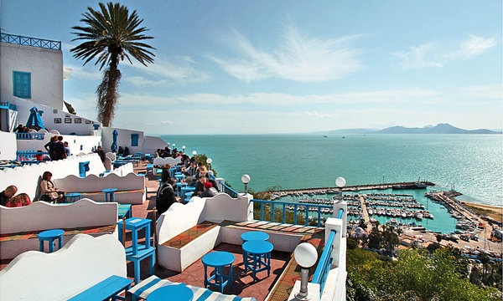
Thank you !

