Slide 1
An integrated approach to National Accounts Statistics
South Africa
Michael Manamela
October 2016

Slide 2
Levers of an integrated economic statistics
Statistics Act
Integrated business register

Slide 3

Legislative framework…
Professional independence
Statistical Council
Anchored on the fundamental principles of statistics

Slide 4
The statistical system in operation…
Legislative framework
Mainly a centralised statistical system
Recently assumed responsibility for expenditure based GDP)
Benefits of centralisation outweigh that of a decentralised approach
Centralisation provides improved and more efficient links between basic statistics and macroeconomic accounts
Tax based business register
Integrated statistical value chain
Strong user interactions

Slide 5

Sampling frame building blocks…
National Accounts
Survey 1
Survey 2
Survey 3
Survey ..n
Sampling frame
Administrative sources
Tax data investigations
Investigations of complex businesses
Business frame surveys

Slide 6
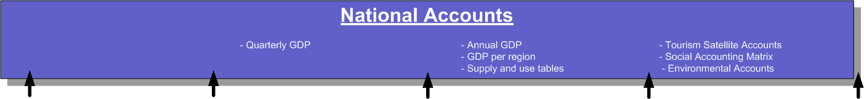
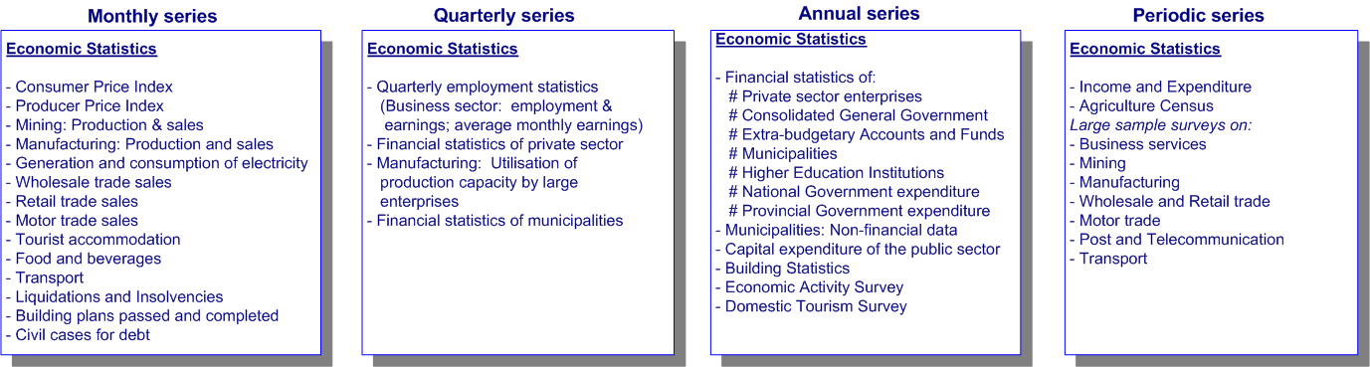
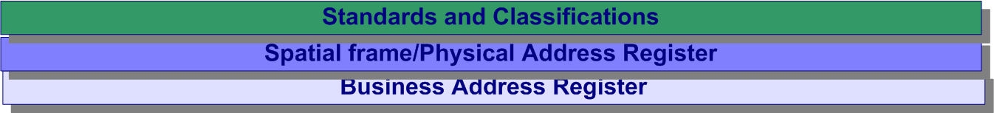
Integrated economic statistics…

Slide 7
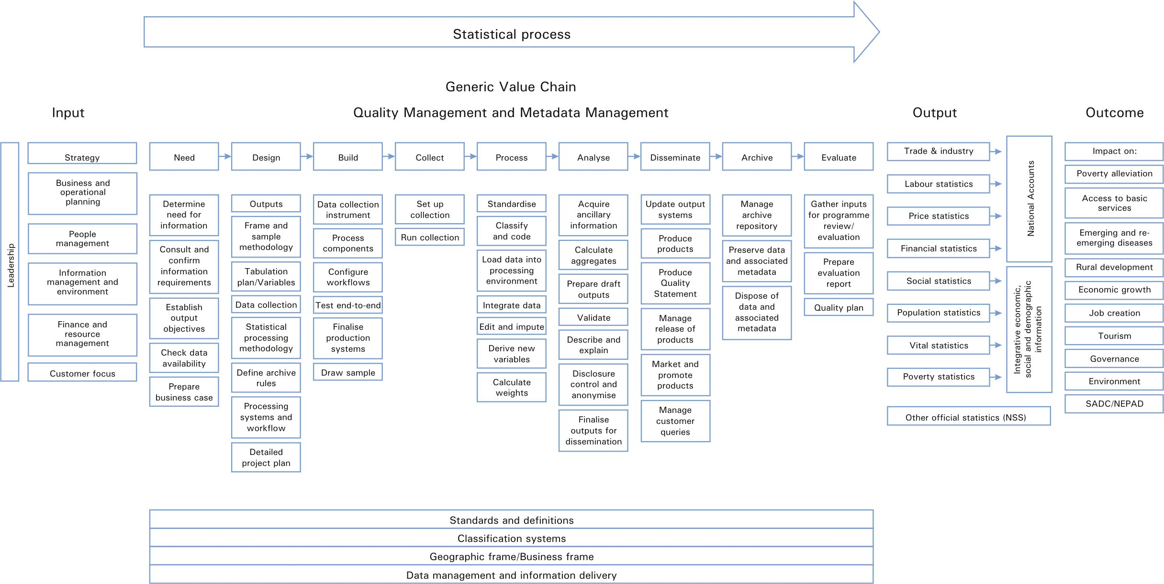
Integrated statistical vale chain…

Slide 8

Strong user interactions…
Data collection instruments
Censuses
Business surveys
Administrative sources
Indicators
Volume
Financial
User engagements
Internal users
Household surveys
Quantities
External users
National Accounts

Slide 9
More on national accounts…
10 industries
National accounts
Quarterly GDP
Regional GDP
Satellite accounts
Annual GDP
SUT
34 industries
10 industries
9 provinces
Tourism
Water use
Energy, etc.
64 industries
104 products

Slide 10
More on the recent integration of GDP into a single institution

Slide 11
Realignment of institutional mandates
The realignment of institutional responsibilities primarily sought to produce a set of coherent and integrated accounts derived from all three GDP approaches under one institution.

Slide 12
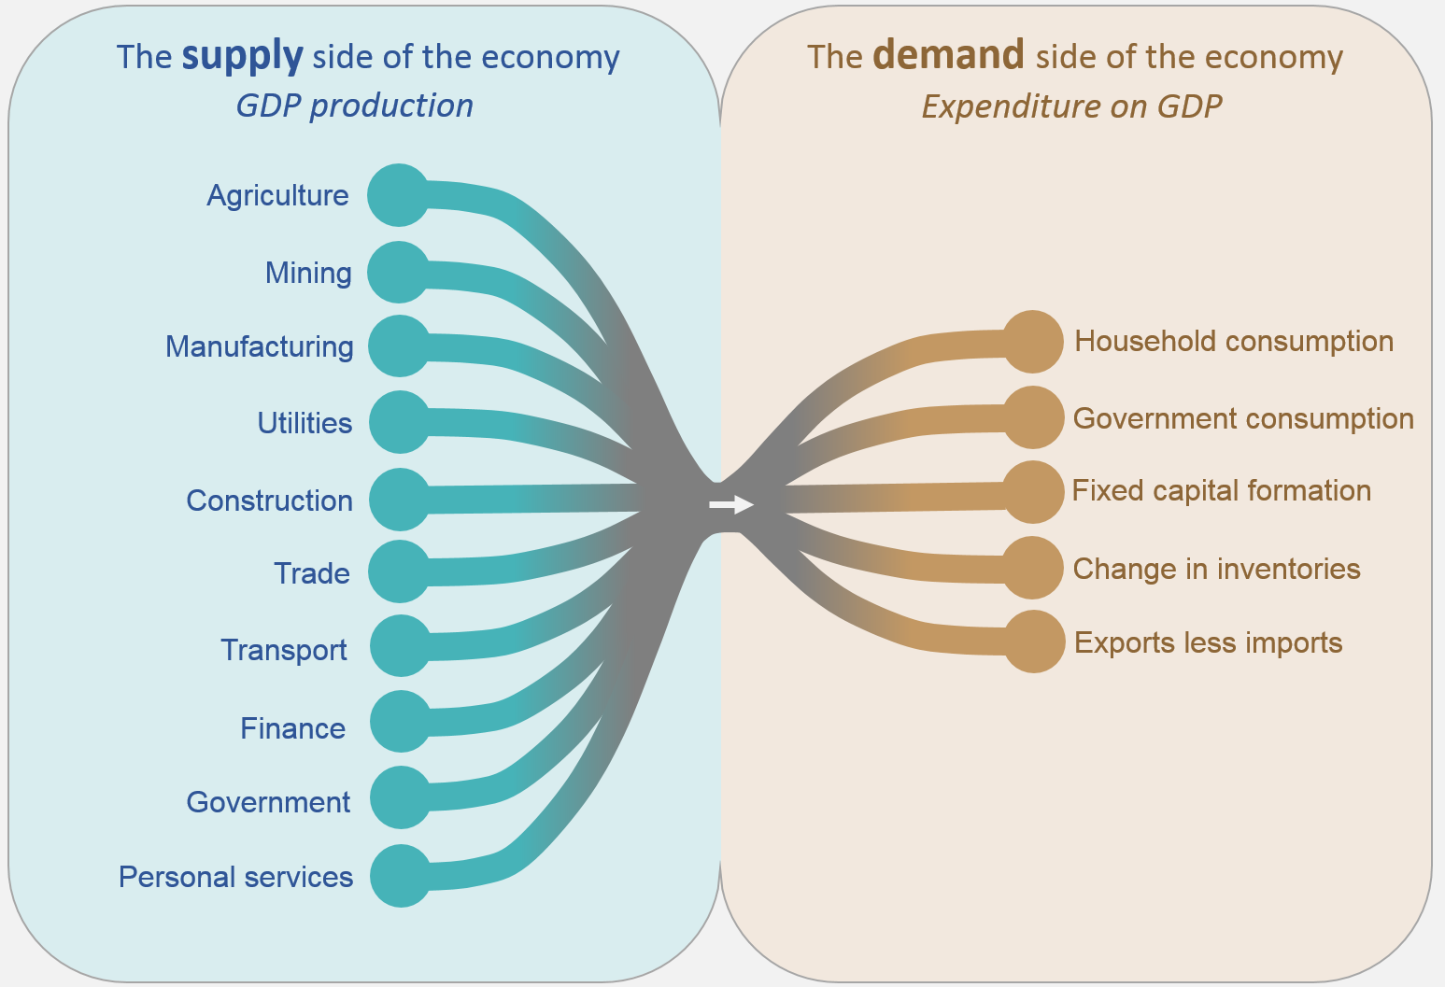
An integrated economic story

Slide 13
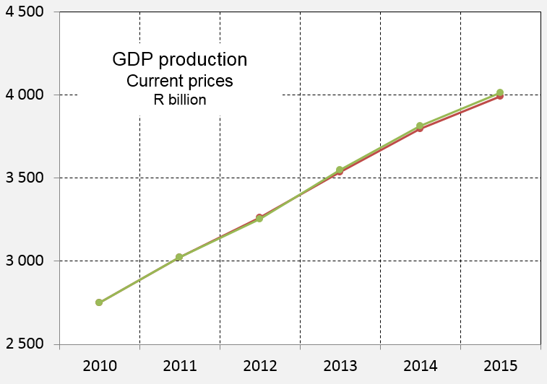
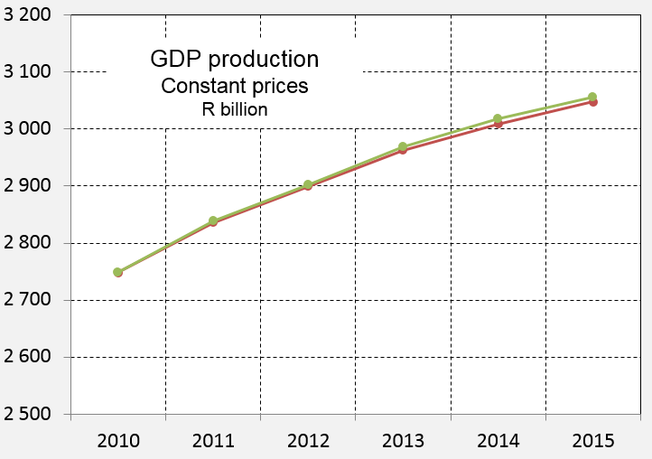

GDPp: Overview

Slide 14
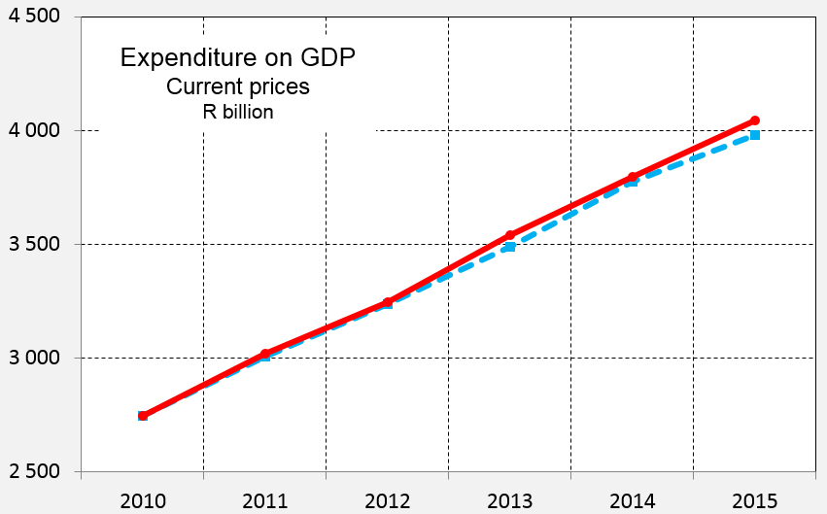
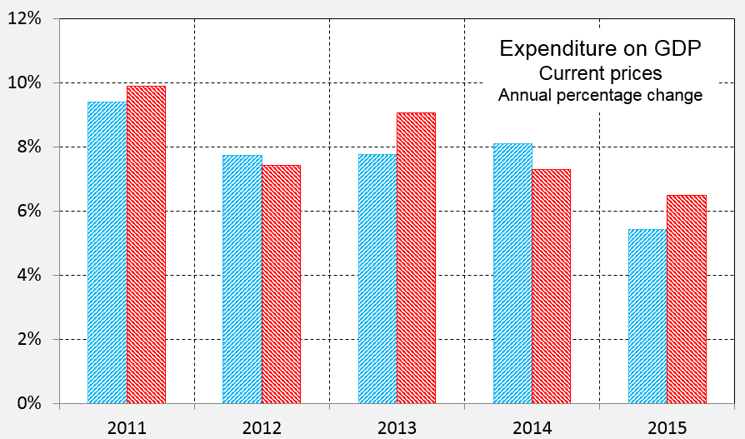


GDPe: Overview

Slide 15
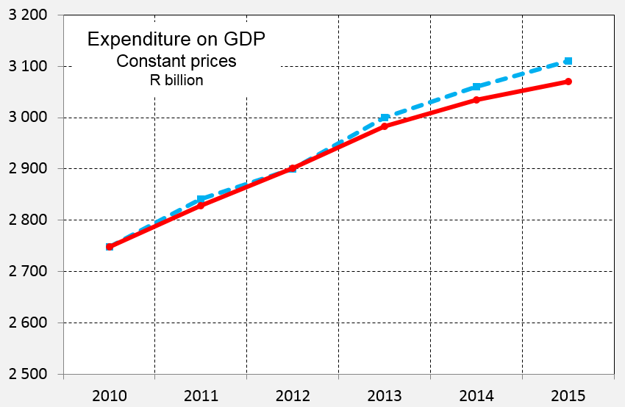
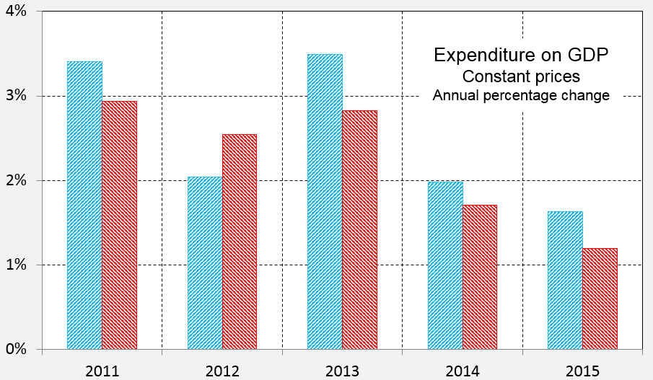
GDPe: Overview

Slide 16
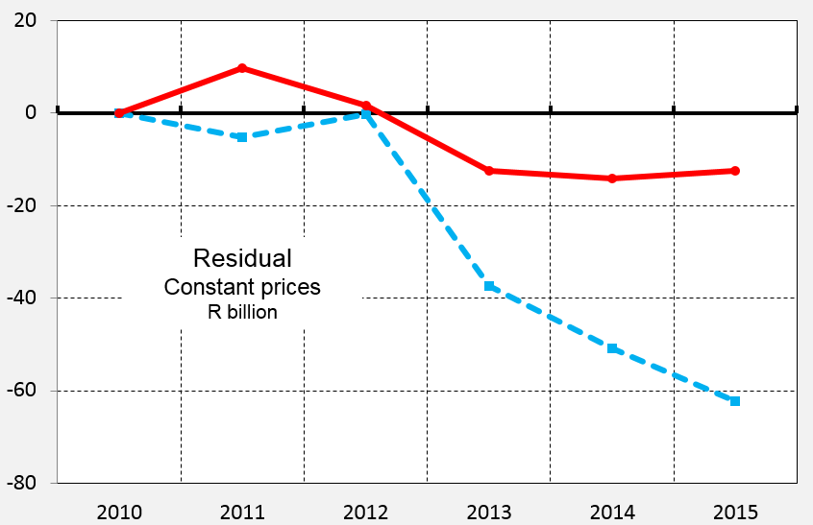
GDPe: Residual
The overall residual was reduced following the micro integration of the three approaches
An integrated estimation system - capable of lower level data analysis, achieved through a dedicated centralisation programme
Continuously identifies areas in the statistical system to increase the integration

Slide 17
Thank you

