Slide 1



Slide 2

Goals of the 2016 PHC
Scope of the 2016 PHC
Built-up to Census
Milestones
Data Collection
Census Data Processing
Challenges
Lessons Learnt

Slide 3

The goal of the 2016 Lesotho Population and Housing Census (PHC) is to contribute to the general improvement of lives of the Lesotho nation through the provision of most up-to-date and reliable data for development planning, informed policy formulation, proper service delivery as well as monitoring and evaluation of population related programmes and projects”

Slide 4

The census is meant to provide information on the size, distribution and characteristics of a country’s population.
A basic administrative use is in the demarcation of constituencies and allocation of representation to governing bodies.
The census is also an invaluable resource for research, providing data for scientific analysis of the composition and distribution of the population and for statistical models to forecast its future growth

Slide 5

2016 PHC involved a complete count of all persons including those in the cattle-posts and institutions
The count covered the usual residents of Lesotho who were found within the country at the time of the census (de facto count) as well as the usual members of households residing outside the country (de jure count).
The 2016 PHC was undertaken on 10th APRIL 2016

Slide 6
Planning for a census involved identifying objectives/outputs, activities to be undertaken, timelines and required resources.
The development of project document, displaying census objectives and strategies that are aligned with activities.
Establishment of administrative/organisational structures such as census committees
Development of cartographic/GIS mapping programme and implementing it.
Development of Census Parliamentary Proclamation
Development of census tools

Slide 7

PRE-CENSUS ACTIVITIES
Census logo designed and approved in 2014.
Project document finalised by experts assigned by the UNFPA in 2015.
The cartography coordinating team trained on cartography and GIS applications in RSA in 2015.
Geo-Space International (RSA) engaged to provide expertise in cartography and mapping exercise in 2015.
Demarcation of Enumeration Areas (EA)s completed in August 2015.
The census parliamentary proclamation endorsed and passed by the authorities – legal notice number 59 of 2015.
Census data collection tools finalized and approved by the Census Technical Committee in January 2016.

Slide 8
Data Processing Team trained on CSPro android application for 2016 PHC.
The Data Processing Team developed and tested an application to be used for data collection.
Census pilot conducted in October 2015.
Pilot Feedback meeting held on the 19th October 2015 – deliberations on the findings.

Slide 9
Recruitment requirements
Enumerators – 6000 (5776 for EA’s and 224 for Institutions and cattleposts)
Specs
Diploma Holders in Social Science subjects
Aged less or equal to 50
Should not be physically challenged
Assistant Supervisors – 1500
specs
BA Degree holders in Social sciences (Demography, Statistics, Economics, Sociology etc)
Aged less or equal to 50 &
not physically challenged
IT Coordinators – 50
Specs
Holding a degree in Computer science or honors degree in computer science
Aged less or equal to 50

Slide 10
Transport
Number of vehicles
100 – government vehicles from other ministries
250 – Privately hired vehicles
Procurement
All stationery, publicity materials (t-shirts, bags, caps, reflector vests, banners, adverts, etc), IT equipment etc. were procured on time.

Slide 11
2 November 2016
Training Schedule
TOT (20) trainers plus (50) IT Coordinators February 2016.
Level I training of Constituency Supervisors (300) in March, 2016.
Level II training of 1 500 Area assistant Supervisors in March 2016.
While Level III training was for Enumerators (approximately 6 000) in March – April, 2016.
11

Slide 12
2 November 2016
Personnel
IT Experts were based at Headquarters and districts.
At Headquarters:
Developers, mainly BoS staff who were assisted by temporary staff and an external expert (Consultant) in PDA application development and implementation.
Database Administrators, mainly BoS IT staff, assisted by temporary staff and an external expert (Consultant).
Network and Security Administrators, mainly BoS IT staff, assisted by temporary staff and an external expert (Consultant).
Computer technicians and additional IT officers were engaged on temporary basis.
At the field:
IT Coordinators were deployed on temporary basis to assist
Enumerators during data collection
Supervisors for data transfer
12

Slide 13
2 November 2016
Use of servers at Headquarters
Servers, housed at BoS HQ and accessed through internet services.
Fixed computers with internet connectivity in each of the district offices
An Internet Service Provider(ISP) was engaged throughout the data collection exercise for internet services.
13

Slide 14
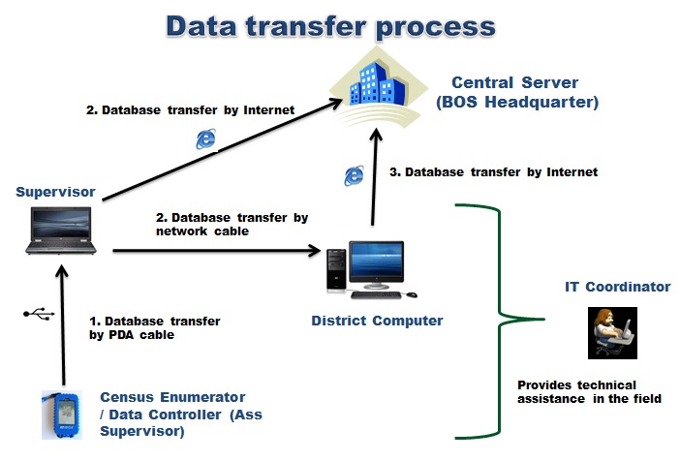
2 November 2016
14

Slide 15

Equipment and materials
Delayed acquisition and delivery of equipment (tablets, power banks & solar chargers). This caused a problem of not being able to test the equipment before distributing to the training centres even to upload the application into the gadgets and assigning ID Codes for enumerators and supervisors.
Training
Training centres were not adequate in other areas and lacked the capacity to accommodate the number required to be trained hence additional training centres had to be sourced immediately and this delayed training.

Slide 16

In the field
Devices malfunctioning- the application had a problem of hiding the data. That’s when enumerators started re-enumerating thinking that their data has been deleted. But eventually the application was remotely upgraded through the server.
Some Enumerators swapped EA’s with their friends without informing their supervisors hence this caused a serious problem since their tablets could not accept their ID Codes simply because they were in the wrong areas.
Data Processing
There was a problem of duplicates in the main data file because of the problem of Enumerators re-enumeration of households when they discovered that they do not see the data in their gadgets.

Slide 17
Despite the good work that Cartography/GIS division did, time allocated for the work was not enough hence some EA’s were still too big.
Procurement of equipment (hand-held devices) should be done well in advance to allow ample time for uploading applications and the testing.
The number of IT Controllers was not adequate enough to cover all Enumerators in case of need with a ratio of about 1:120 hence in future the number should be increased.
Its important also to make provision for enough time between delivery time for equipment and commencement of work.

Slide 18
P.o Box 455
Maseru. 100
00266-22323852 (BOS)
E-mail : census@bos.gov.ls
Web site: http//www.bos.gov.ls

