Slide 1

African Centres of Excellence in ICT-enabled data Richmond Tiemoko UNFPA East and Southern Africa Regional Office

Slide 2
Justification of the initiative
Moving Africa into open data revolution for increased accountability and quality delivery in the implementation of the Agenda 2063 and the 2030 agenda for Sustainable Development.
All the 54 African countries engaged to embark in digital census data collection and management as part of the implementation of 2020 round of censuses (2015-2024).

Slide 3
Justification of the initiative 1/2
So far, 5 countries in Africa have successfully conducted their census data collection using mobile devices, with IBGE technical support (Cabo Verde, Sao Tome and Principe, Senegal, Cote d’Ivoire, Lesotho).
Increasing number of countries (7 in 2014) requesting such technical support from IBGE.
Need for a mid to long term solution to ensure adequate response and also sustainability

Slide 4
Objectives
Implementation of ASSD vision to foster coordination and collaboration as well as experience sharing on Population data.
Tap into Africa expertise and south-south cooperation for “ICT enabled data production, analysis, dissemination, utilization and management, through multi stakeholder engagement”

Slide 5






Three +1 Leaders
:

Slide 6
Pillars
Technology Hub
Developing
Testing new solutions
Knowledge Hub
Collect information on operations
Capacity Strenghtning
Training Hub
Training
Exploring Big Data
Assess best practices
Country support
Project support
Database
INNOVATION
MEMORY
SKILLS SHARING

Slide 7
Role of the COE
Capacity Building:
Focus on capacity building of NSS in general and NSOs as part of the census in particular;
Incubate talented young African statisticians and demographers by investing in youth exposure, mentoring and coaching, and in South-South collaboration and triangular cooperation to ensure increased and sustainable support to the NSS;
Serve as regional hub for capacity development: internship; regional training in IMIS development and management, CSPro Android; development of apps based on standard census questionnaire;
…

Slide 8
Role of the CoE
Knowledge Exchange Platform:
Serve as a virtual and physical regional hub for knowledge access, management, transfer and mobilization to bridge the gap and make connections between research/expertise and policy/practice in the area of quality data for people-centred and sustainable development and with the involvement of the chief technical advisory system.
Empower citizens (mobile vital registration system or medical information for front-line health practitioners in remote or humanitarian settings), etc.

Slide 9
Role of the COE
Innovation Hub to Foster Efficiency within the National Statistical System:
Contribute to the development of applications with the view of finding innovative and forward-looking solutions to known key problems, challenges and opportunities within the national statistical systems (health, education, statistics, civil registration and vital statistics, etc.) in the regions.
Manage effectively and use of the many mobile devices made available as the censuses are conducted in the regions.

Slide 10
Strategic Partners
African NSOs
Network of Young African Statisticians and Demographers (YASD)
AfriStat, AfDB, ECA, AUC
Regional Economic Communities (RECs)
Brazilian Cooperation Agency (ABC)/Brazilian Institute of Geography and Statistics (IBGE)
UK Department for International Development (DFID)
US Census Bureau - CD in CSPRO
CELADE/ECLAC
UNSD
World Bank

Slide 11
UNFPA Role
UNFPA has a long standing engagement and partnership with governments through NSOs in data production, analysis, dissemination and utilization, particularly in census;
Plays facilitating role: initiates dialogues, maintains negotiations, conducts needs assessment, facilitates missions, and engages with UNFPA country offices and partners;
Conducts regular “environment scanning” and articulates technical needs of countries and proposes ways of addressing them;
Provides high quality technical, programmatic and operational support to countries.

Slide 12
UNFPA ESATO Planned activities
Under regular resource and programme
2020 round of census
CRVS
Data revolution
Under DfiD funded project

Slide 13



UNFPA ESARO related-activities planned under DFID
Support to Creation of regional Centre of Excellence:
Training on CSPro Android
Exposure of YASD
Documentation of best practices in ICT-enabled census:
REDATAM-based IMIS (national, regional, monitoring SDG ICPD related indicators):

Slide 14
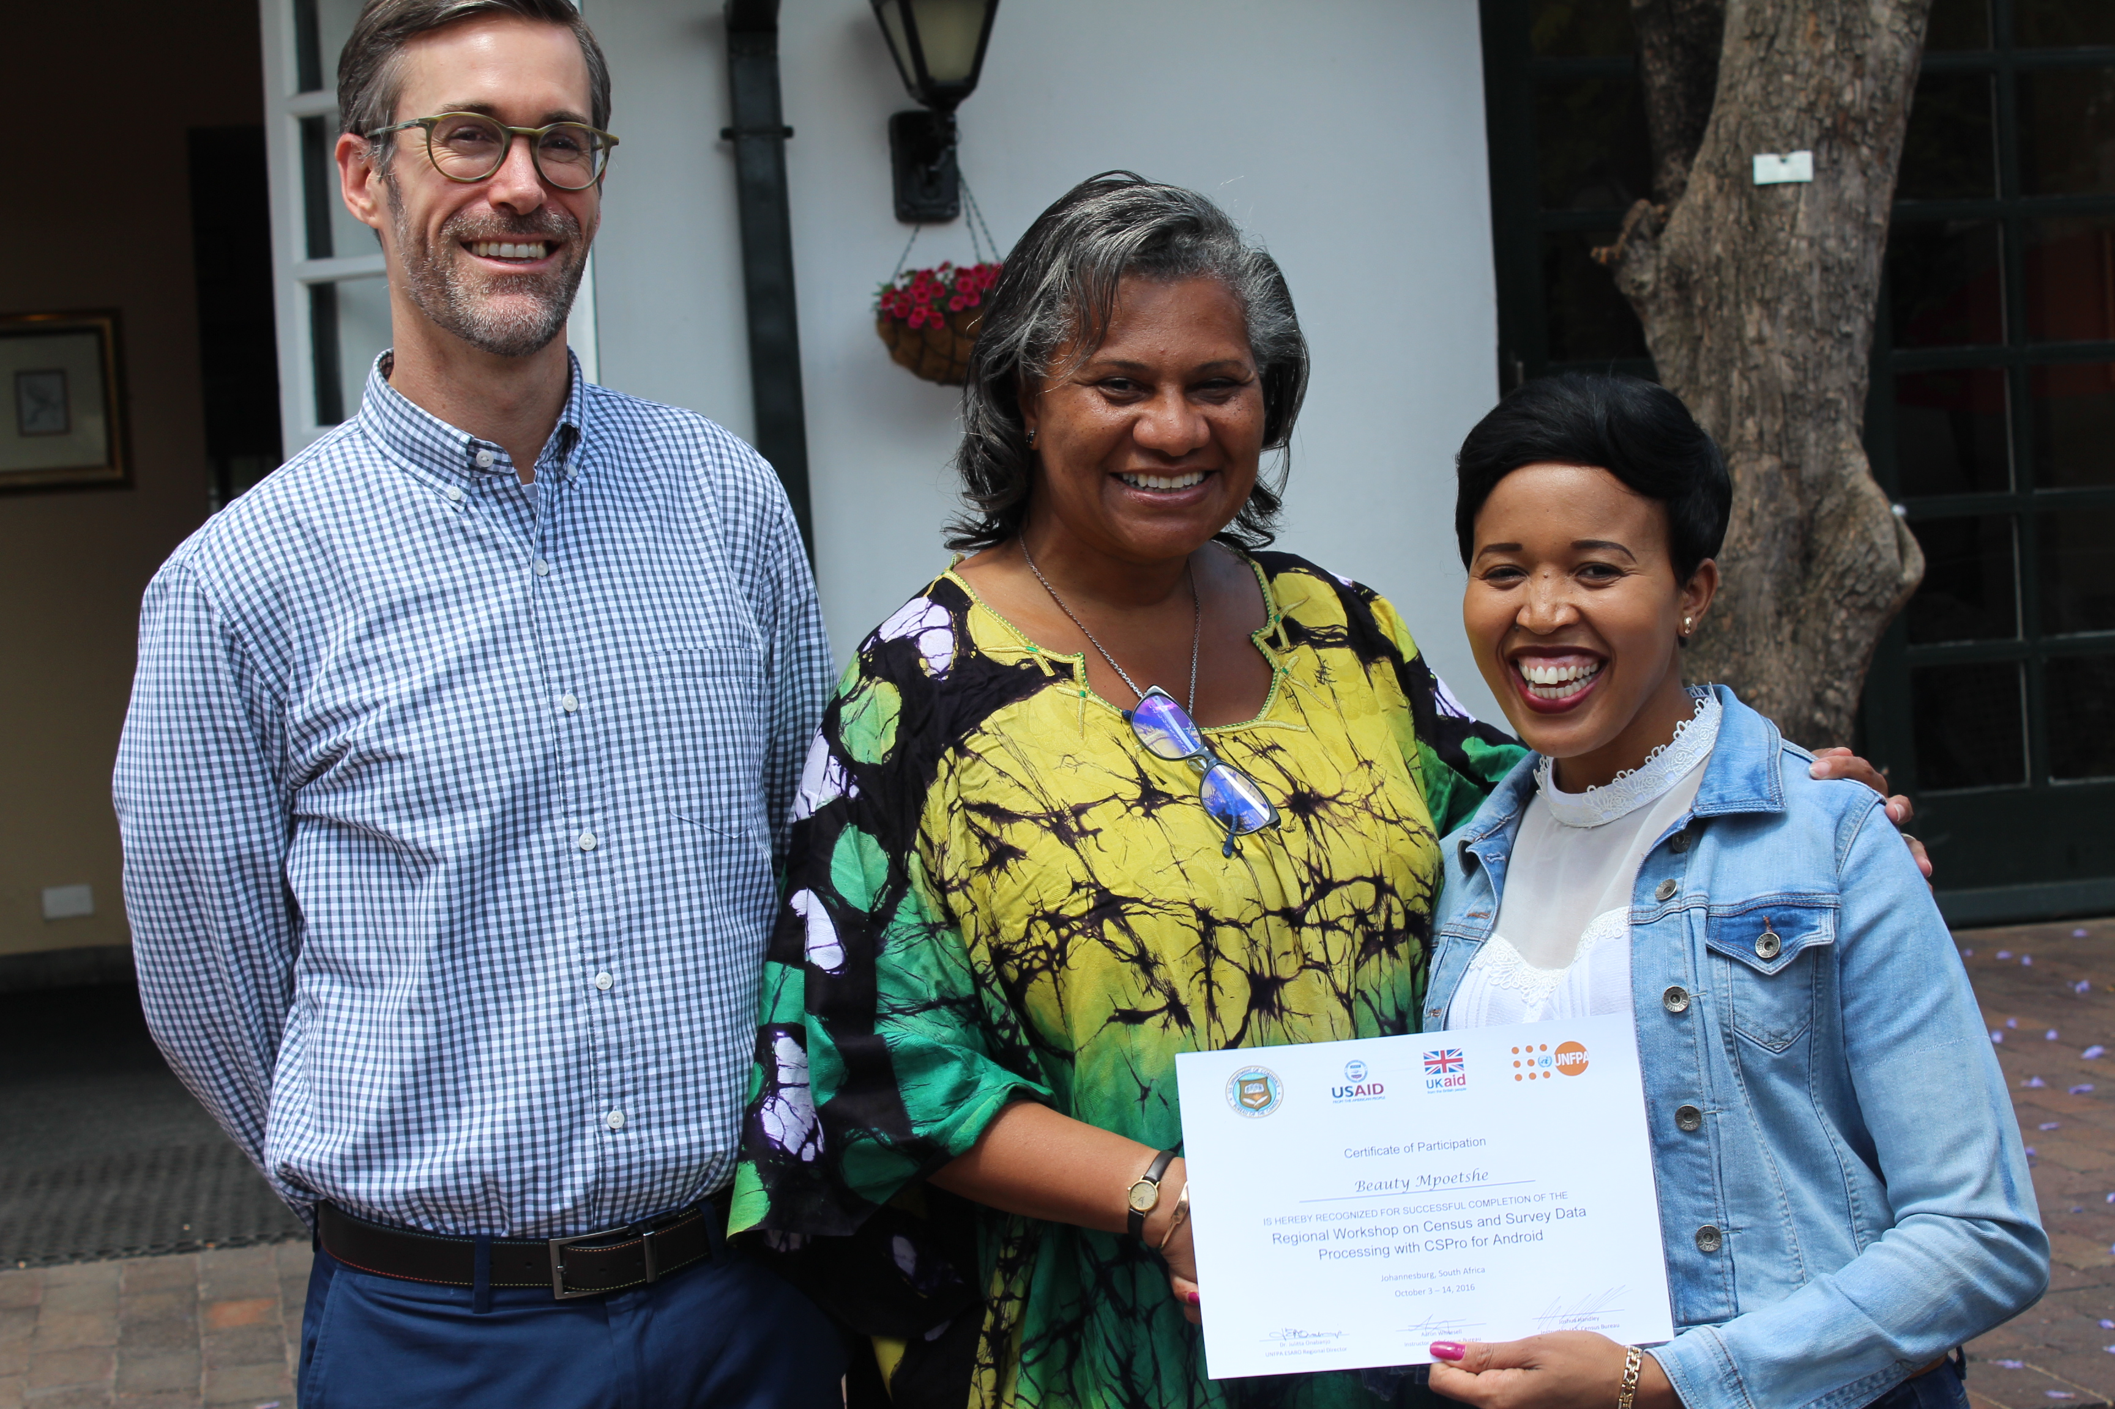
Progress
Technical and Financial support in 2016-2017
Procurement of 248 mobile devices
Capacity building in CSPro and REDATAM-IMIS
Development of the strategy of the CoE
Establishment of the CoE

Slide 15
Next Steps
Finalize the strategy of the Centres of Excellence
Official Launch of the Partnership
Census related Skills Mapping
Update on census and surveys undertaking with technological requirement

Slide 16
Conclusion
The Success and relevance of the CoE will depend of the 3 centres but mainly on the willingness of African statisticians and stakeholders support and contribute to its works

