Slide 1


Progress report of Africa Programme for Accelerated Improvement of CRVS
Malgorzata Cwiek
Economic Commission for Africa

Slide 2
Africa Programme for Accelerated Improvement of Civil Registration and Vital Statistics (APAI-CRVS)
Guided by policy directives of the Conference of African Ministers Responsible for Civil Registration
  1st Conference in Addis Ababa (2010) – conceptualization and focus on holistic approach
  2nd Conference in Durban (2012) – moving action to countries
  3rd Conference in Yamoussoukro (2015) – consolidation
Steered by Regional Core Group – ECA (Secretariat), AUC, AfDB, ASSD, UNFPA, UNHCR, Unicef, WHO, Indepth Network, PARIS21, Plan International

Slide 3
CRVS at ASSD
7th ASSD (January 2012, Cape Town, South Africa) – “Improving Civil Registration and Vital Statistics Institutional and Human Infrastructure”
8th ASSD (November 2012, Yamoussoukro, Cote d’Ivoire) – “Standardisation of Causes of Death Classification and Statistics in Africa”
9th ASSD (February 2014, Gaborone, Botswana) – “Promoting Use of Civil Registration and Vital Statistics in Support of Good Governance in Africa”
10th ASSD (January 2015, Kampala, Uganda) – “A Decade of Statistical Development: Revolutionising Censuses and Civil Registration and Vital Statistics towards Africa Agenda 2063”
11th ASSD (November 2015, Libreville, Gabon) – “Promoting Use of Information and Communication Technology Solutions in Improving CRVS in Africa”

Slide 4
Guiding principles of APAI-CRVS
Promoting country ownership and leadership
Promoting phase-based, holistic and systemic approach at country and regional level
Building capacities of national and regional CRVS institutions
Promoting innovation and knowledge sharing
Promoting coordination at national and regional level

Slide 5
Importance of CRVS for SDGs
We resolve, between now and 2030, to end poverty and hunger everywhere; to combat inequalities within and among countries; to build peaceful, just and inclusive societies; to protect human rights (…). (…) we pledge that no one will be left behind. (…) we wish to see the Goals and targets met for all nations and peoples and for all segments of society.
Transforming our world: the 2030 Agenda for Sustainable Development
Is universal and inclusive
Leaves no one behind
Is a building block for an identity ecosystem
Helps improve service delivery to all people
CRVS
Provides legal documents of vital events to each individual
Helps realize and protect human rights
Provides vital statistics/population data at lower level
Enables evidence-based policy making and monitoring of policy effects

Slide 6
SDG targets related to CRVS
Target | Indicators
Target 16.9 By 2030, provide legal identity for all, including birth registration | Indicator 16.9.1 Proportion of children under 5 years of age whose births have been registered with a civil authority, by age
Target 17.19 By 2030, build on existing initiatives to develop measurements of progress on sustainable development that complement gross domestic product, and support statistical capacity-building in developing countries | Indicator 17.19.2 (b) Proportion of countries that have achieved 100 per cent birth registration and 80 per cent death registration

Slide 7

CRVS for measurement of SDGs

Slide 8
Key achievements of APAI-CRVS since 2010
Conference of Ministers Responsible for Civil Registration established as a biennial permanent forum of AUC
Strengthened collaboration between CR and VS institutions through African Symposia on Statistical Development
Significantly improved in-country and regional coordination
Provided country assistance in assessment and development of strategic improvement plans
Trained over 500 CRVS functionaries
Developed public good documents:
Guidelines and tools for comprehensive assessment
Guidelines for strategic planning
CRVS Digitization Guidebook
Africa Mortality Statistics Strategy
Created a global momentum on CRVS
Put in place a separate implementation strategy for English and French speaking countries
Formation of the Regional Core Group
Add a CRVS decade and day

Slide 9
Focus areas in the last year
Comprehensive assessments and strategic plans
Improvement of death registration and mortality statistics
Producing vital statistics from civil registration records
Promotion of knowledge sharing
APAI-CRVS 5-year Strategic Plan
Establishment of the monitoring framework

Slide 10
Progress in country assessments and plans
27 countries completed the assessments, 26 developed strategic improvement plans
3 assessments are in progress, 14 further countries have initiated the process
Assessment completed: Angola, Botswana, Burkina Faso, Burundi, Cameroon, Ethiopia, Eritrea, Ghana, Kenya, Lesotho, Liberia, Mali, Mozambique, Namibia, Niger, Nigeria, South Africa, Swaziland, Tanzania, Uganda, Zambia, Algeria, Djibouti, Egypt, Morocco, Somalia, Sudan, Tunisia
In progress: Madagascar, Rwanda, Senegal
Initiated: Benin, Chad, Central African Republic, Congo, Cote d'Ivoire, Democratic Republic of the Congo, Gabon, Gambia, Guinea-Bissau, Malawi, Mauritania, Sierra Leone, South Sudan, Zimbabwe

Slide 11
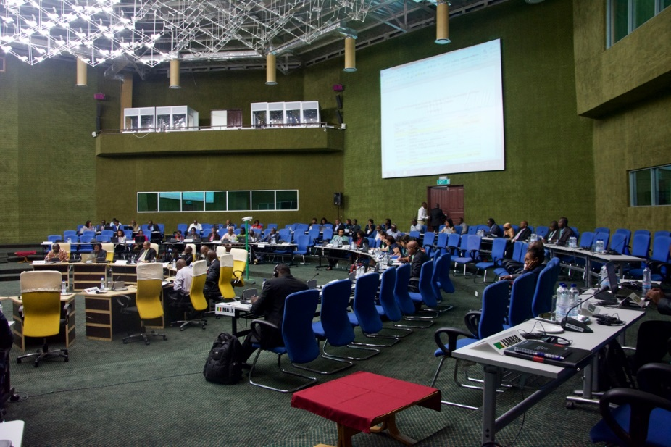
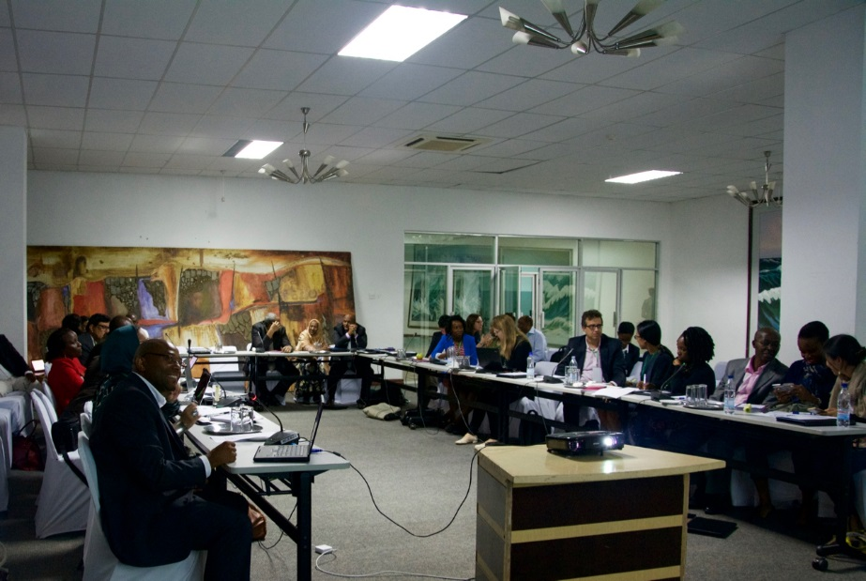
Progress in country assessments and plans – ctd.
Two Experience Sharing Workshops on CRVS Assessments and Plans held in February 2016 in Addis Ababa, Ethiopia and May 2016 in Lusaka, Zambia to provide the provide the countries with an opportunity to share
  their vision of building an efficient and effective CRVS system;
  results of assessment of CRVS system and plans developed for its improvement;
  experience of undertaking (or planning) CRVS assessments and development of plans;
  strategy for implementation of the CRVS plans;
Workshops were attended by representatives of 29 countries, Core Group Members, development partners, senior advisors
Meetings resulted in a set for recommendations for the revision of the guidelines and highlighted new challenges

Slide 12
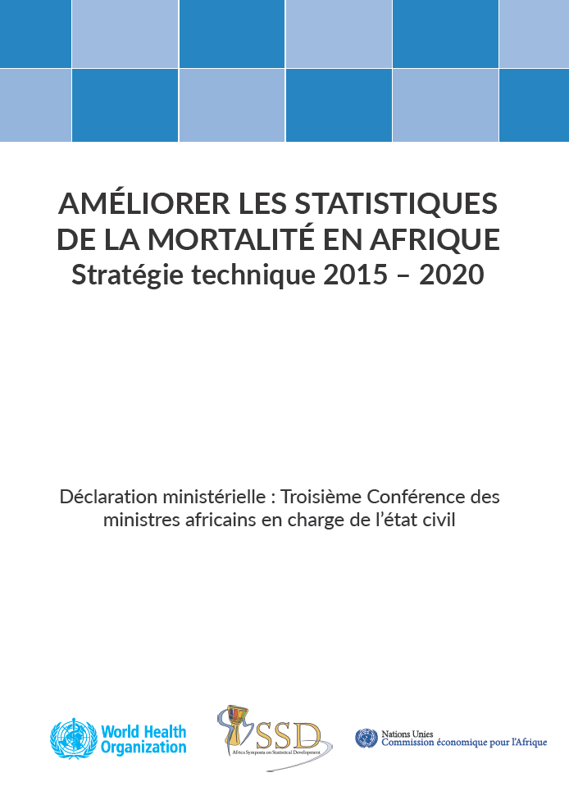
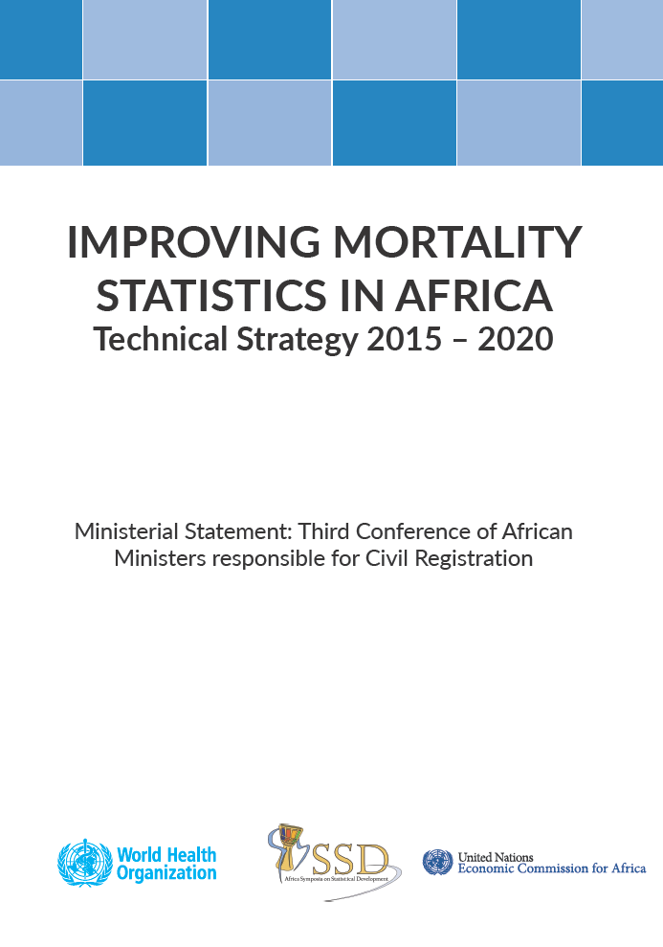
Improvement of death registration and mortality statistics
Africa Mortality Statistics developed jointly by ECA and WHO and presented in the last session of ASSD
Development of a Practical Guide on Improvement of Death Registration and Cause of Death Information Processes and research template for in-depth country studies is in progress
Workshop on the Practical Guide was held in May 2016 in Lusaka, Zambia

Slide 13
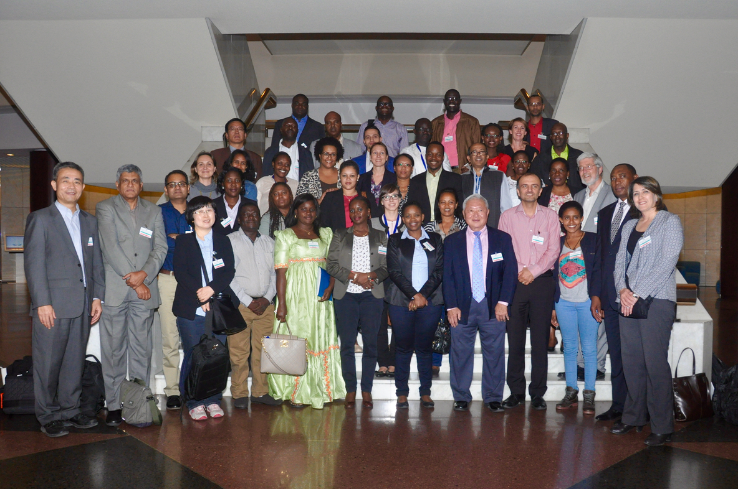
Producing vital statistics from civil registration
Training manual on producing vital statistics from civil registration records has been developed by ECA and ESCAP and is being finalized
Vital statistics report template and guidelines have been developed by ECA, ESCAP and Statistics Norway and are being finalized
An Expert Group Meeting on both publications was held in May 2016 in Addis Ababa, Ethiopia

Slide 14
APAI-CRVS 5-year Strategic Plan
Every one visible in Africa!
To register the occurrence and characteristics of all vital events in Africa for improved service delivery and informed evidence-based planning and decisions through an efficient and complete civil registration and vital statistics system
Evidence based development and transformation of society
Legal rights and privileges to individuals
Trusted statistics
Improved governance and public service delivery
Institutional excellence at continental and national levels
Strategic outcomes
Civil registration process
Vital statistics process
Stakeholder management and coordination process
Management and governance of the CRVS programme
Processes
Information capital
Human capital
Organisational capital

Slide 15
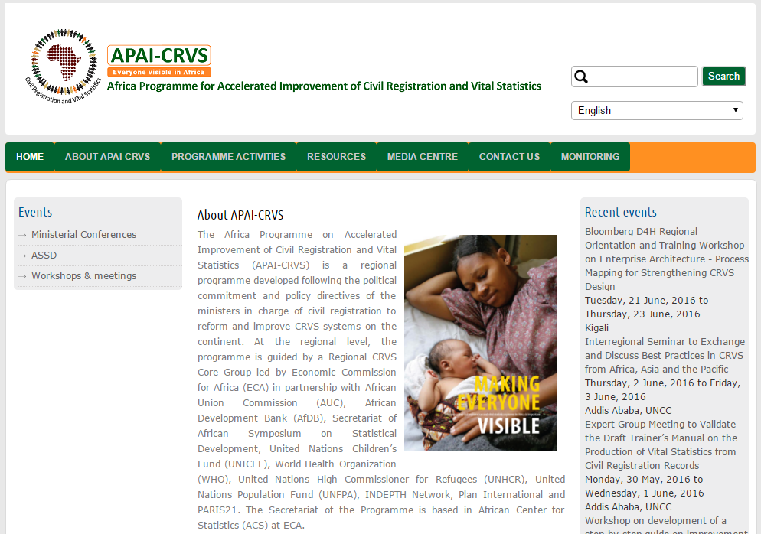
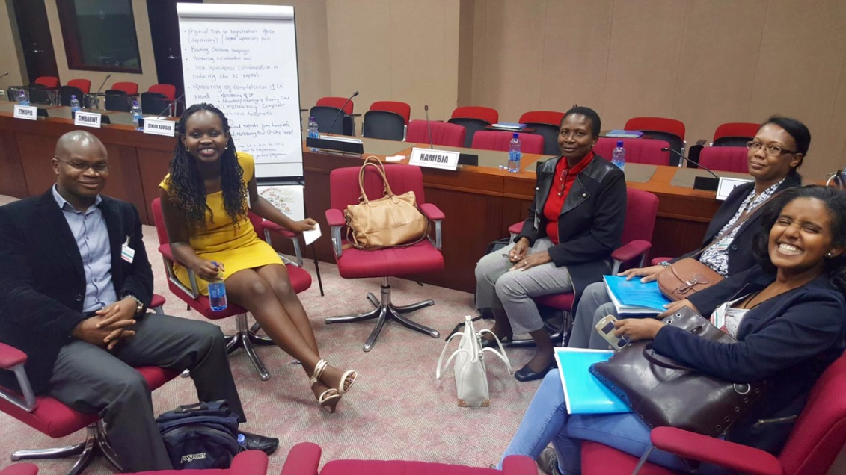
Promotion of knowledge sharing
Inter-Regional Seminar to Exchange and Discuss Best Practices on CRVS from Africa and Asia Pacific in June 2016 in Addis Ababa, Ethiopia organised with ESCAP
Launch of APAI-CRVS website – http://www.apai-crvs.org
ECA and other Core Group members participated in the development of global e-learning course on CRVS coordinated by World Bank

Slide 16

Establishment of the monitoring framework
Monitoring form to be filled on-line:
  Part A: CR system legal framework
  Part B: Organization and functioning of the CRVS system
  Part C: Completeness of registration and accessibility of the registration centers
Monitoring process:
Submission deadline extended to
30 November 2016
1. Verification of access to the form on the website
2. Formation or reconvening of a group representing all main stakeholders
3. Scheduling of a meeting and sharing the form with all the participants in advance
4. Holding of the meeting and collection of inputs from all the stakeholders
5. Research for additional evidence if needed
6. Finalizing of the answers and validation them with all the stakeholders
7. Submission of the final answers through APAI-CRVS website by a designated focal point

Slide 17
Major challenges
Not enough technical resources and experts available at the regional level on various technical fields (causes of death, ICT, law, vital statistics, CRVS in fragile states)
Donor coordination
Limited resources of Secretariat
Lack of routine monitoring of the progress on the country level
No mechanism yet in place to review the quality of assessments and plans
Need for support to the countries on moving to implementation of the plans
Increasing focus of the Governments on establishment of national identification systems without due consideration for linkage with CRVS

Slide 18
Coming soon from APAI-CRVS…
On vital statistics:
Vital statistics report template
Training materials on compilation of vital statistics from civil registration records
But also:
Practical guide on death registration
Guidelines on civil registration in conflict areas
Guidelines on advocacy and communications for civil registration
And many others
Operational guidelines on civil registration and vital statistics
4th Conference of African Ministers Responsible for Civil Registration
News and regular updates on http://www.apai-crvs.org

Slide 19
Contact details:
Malgorzata Cwiek
Email: mcwiek@uneca.org
Or “Contact us” on http://apai-crvs.org/

