Slide 1
The current state of implementing the 2008 SNA in Africa
Xiaoning Gong
Chief, Economic Statistics and National Accounts Section, ACS, UNECA
at
12th ASSD, 2-4 Nov 2016, Tunis, Tunisia

Slide 2
Outline of the Presentation
Overview of the Project
  Challenges
  Objectives of the project
  Players and stakeholders
  Problems and issues to be addressed by the Project
  Scheme and architecture of the African Project on SNA
  Three stages and expected accomplishments
  Governance structure of the project
  Implementation strategy
  Current status

Slide 3
Different Versions of SNA Used
SNA in use | Number of Countries | % share
2008 SNA | 10 | 20.8
1993 SNA | 36 | 75
1968 SNA | 2 | 4.2
Total | 48 | 100

Slide 4
Different Versions of Classification Used
Classification of Activity | Currently Used
ISIC Rev 3 | 7
ISIC Rev 3.1 | 6
ISIC Rev 4 | 16
NAEMA | 10
NAEMA rev1 | 5
Other | 4

Slide 5
Scope of National Accounts
Activities | Currently compiling | %
SNA 2008 compliance for production and asset boundaries | 17 | 35%
IT tool for compilation of national accounts | 25 | 52%
Employment matrix | 11 | 23%
Supply and use table (SUT) | 25 | 52%
Production approach GDP by industrial economic activities: | 34 | 71%
Production approach GDP-- by institutions | 20 | 42%
Expenditure approach GDP | 36 | 75%
Quarterly GDP | 16 | 33%
Production and generation of income accounts | 23 | 48%
Sector accounts up to capital account | 18 | 38%
Sector accounts up to financial accounts | 5 | 10%
Balance sheets | 1 | 2%

Slide 6
Base-year for Constant GDP
Countries | Base Year | Countries | Base Year
Egypt | 2011/12 | Sao Tome and Principe | 2008
South Sudan | 2011 | Benin | 2007
Swaziland | 2011 | Cape Verde | 2007
Liberia | 2010 | Comoros | 2007
Malawi | 2010 | Madagascar | 2007
Nigeria | 2010 | Mauritus | 2007
South Africa | 2010 | Morocco | 2007
Zambia | 2010 | Tanzania, United Republic of | 2007
Ethiopia | 2010-11 | Togo | 2007
Uganda | 2009/10 | Botswana | 2006
Djibouti | 2009 | Ghana | 2006
Mozambique | 2009 | Niger | 2006
Zimbabwe | 2009 | Seychelles | 2006

Slide 7
Base-year for Constant GDP (Cont’d)
Countries | Base Year | Countries | Base Year
Sierra Leone | 2006 | Mali | 1997
Burundi | 2005 | Tunisia | 1997
Cameroon | 2005 | Côte d'Ivoire | 1996
Chad | 2005 | Sudan | 1981/82
Congo | 2005
Democratic Republic of Congo | 2005
Guinea-Bissau | 2005
Gambia | 2004
Lesotho | 2004
Mauritania | 2004
Algeria | 2001
Gabon | 2001
Burkina Faso | 1999
Senegal | 1999

Slide 8
Problems and Issues to Be Addressed
• Limited Human, Financial, and Technical Resources
• Weak Capacity and Statistical Infrastructure
• Unharmonious National Accounts Systems
• Inconsistency and Incompleteness in the Coverage of the Economy
• Early Stages in the Development of National Accounts
For more info . . .
List location or contact for specification (or other related documents)

Slide 9
developed by the
African Group on National Accounts
under the umbrella of the
Statistical Commission for Africa
The African Strategy for the Implementation of the 2008 SNA
Objective
Implementation of 2008 SNA in all African countries
Aim
overcome statistical weaknesses by brining together all African countries to work together to implement SNA 2008

Slide 10



United Nations Economic Commission for Africa
African Union Commission
Major roll players
African Group on National Accounts
African Development Bank

Slide 11
Collaboration & Support to Member States
MS
ECA
AUC
RECs
Secretariat
Afristat
AfDB

Slide 12
Governance Structure of the African Project
Meetings of the Heads of
AUC, AfDB and UNECA
Annual Progress Report
Continental Steering Committee (CSC)
Governance
Annual Progress Report
Executive Board
(UNECA, AUC, AfDB)
CSC Secretariat
(at UNECA)
Statistical Commission for Africa (StatCom-Africa) / Committee of Directors General (CoDG)
Implementation
African Group on National Accounts (AGNA)
Pan-African Institutions, Member States, AFRISTAT, Regional Economic Communities
National Statistical Systems
National Strategy Coordinators, National Statistics Offices and Others

Slide 13
Project Design and Interventions
Problems / Issues to Be Addressed | Project Design and Interventions
Limited Human, Financial, and Technical Resources | Continental project approach for all the countries to work together Advocacy and NSDS to mobilize resources for national statistical system Building human and technical capacity
Weak Capacity and Statistical Infrastructure | Strengthen the statistical institution and infrastructure
Unharmonious National Accounts Systems in the Continent | The new SNA system, i.e. the 2008 SNA provides an opportunity to harmonize the national accounting systems in African countries
Inconsistencies and Incompleteness in the Covering of the Economy | Informal sector Exhaustiveness SUT and commodity flow approach Integrate national accounts statistics with other sectoral statistics
Early Stages in the Development of National Accounts | Phased approach in the implementation of the 2008 SNA

Slide 14
Architecture of African Project on SNA
Implementation of SNA 2008
Country Plans and Actions
Capacity Building
Institutional Strengthening
Advocacy Campaign
Compiling Technical Documents
Coordination, Monitoring, Evaluation, and Reporting

Slide 15
Pillar 1: Country plans and actions
Allows member states to align 2008 SNA with African statistical strategies and macroeconomic priorities
Pillar 2: Technical assistance (AfDB)
Strengthen statistical institutions and the capacity of national statistics systems
Adopt IT tools, conduct seminars and training workshops
Pillar 3: Institutional strengthening (Afristat)
Develop and strengthen coordination structures and systems

Slide 16
Pillar 4: Technical documents (ECA)
Serve as operational guides for the compilation of national accounts
Development of a guidebook and handbook
Pillar 5: Advocacy campaign (AUC)
Organized at a continental, regional and national levels
Pillar 6: Coordination, monitoring, evaluation and reporting
Close monitoring of the project implementation plan
Production and dissemination of monitoring and evaluation reports

Slide 17
Expected Accomplishments & Outputs
Output 1.1: Application of modern IT tools for compiling, processing, and analyzing statistical information
Output 1.2: Establishment and strengthening of needed institutions
Output 2.1: Availability of technical document on use of administrative data for national accounts compilation
Output 2.2: Availability of financial resources for national accounts activities
Output 3.1: SNA Continental Steering Committee and Secretariat established and functional
Output 3.2: Monitoring, evaluation, and reporting developed and related results produced

Slide 18
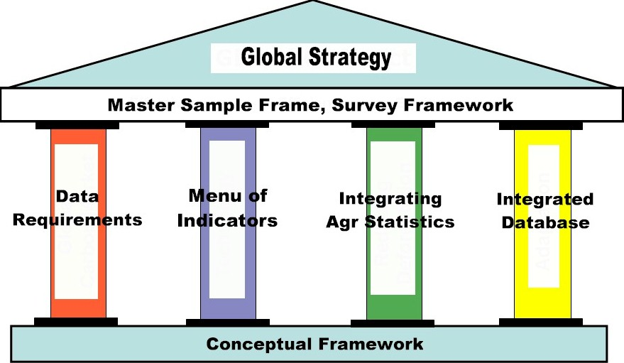
Architecture of African Project on SNA
Implementation of SNA 2008
Country Plans and Actions
Capacity Building
Institutional Strengthening
Advocacy Campaign
Compiling Technical Documents
Coordination, Monitoring, Evaluation, and Reporting

Slide 19
Country Plans and Actions: Led by Member States
Country Plans and Actions

Slide 20
Status of National Action Plans
Up to May 2016, among the 48 countries that responded to the questionnaire:
32 countries reported that they have formulated national actions plans for implementing the 2008 SNA.
10 countries reported that they are currently in the process of formulating national action plans. The 10 countries are: Angola, Botswana, Ghana, Lesotho, Malawi, Mozambique, Swaziland, Uganda, Togo, and Zambia.
5 countries reported having no action plan and have expressed their need for technical assistance to develop their action plans. The 5 countries are: Central African Republic, Chad, Comoros, Equatorial Guinea and Liberia.

Slide 21
Planned Year for Adopting the 2008 SNA
Planned year | Number of Countries | % share
2010-15 | 9 | 19.1
2016 | 9 | 19.1
2017 | 12 | 25.5
2018 | 8 | 17
2020 + | 2 | 4.3
Not decided | 8 | 14.9
Total | 48 | 100

Slide 22
Basic Economic Statistics for SNA
Data sources | Included in action plan | Currently Implementing | Will be implementing
Administrative data | 19 | 29 | 11
Census
Population Census | 13 | 26 | 13
Agriculture Census | 12 | 15 | 16
Livestock Census | 12 | 11 | 18
Other Census | 3 | 10 | 1
Household surveys | 15 | 30 | 13
Informal sector survey | 11 | 16 | 24
Establishment and/or enterprise Survey | 16 | 22 | 18
Other sources | 8 | 5 | 4

Slide 23
Capacity Building: Led by AfDB
Capacity Building
Capacity Building

Slide 24
Institutional Strengthening: Led by RECs & Afristat
Institutional Strengthening

Slide 25
Training Needs
Domains | Number of Countries | %
Concepts, definitions, and classifications of 2008 SNA | 27 | 56%
Collection and processing of sources data | 24 | 50%
Use of IT tools for the compilation of national accounts | 29 | 60%
SNA 2008 compliance -- for production and asset boundaries | 31 | 65%
Employment matrix | 35 | 73%
Supply and use table (SUT) | 29 | 60%
Quarterly GDP | 28 | 58%
Production accounts | 25 | 52%
Distribution and redistribution of incomes accounts | 29 | 60%
Capital account | 31 | 65%
Financial account | 32 | 67%
Balance sheets | 32 | 67%
Analysis of national accounts results | 33 | 69%

Slide 26
Technical Assistance Needs
Domains | Number of Countries | %
Concepts, definitions, and classifications of 2008 SNA | 21 | 44%
Collection and processing of sources data | 21 | 44%
Use of IT tools for the compilation of national accounts | 26 | 54%
SNA 2008 compliance -- for production and asset boundaries | 26 | 54%
Employment matrix | 25 | 52%
Supply and use table (SUT) | 21 | 44%
Quarterly GDP | 24 | 50%
Production accounts | 17 | 35%
Distribution and redistribution of incomes accounts | 25 | 52%
Capital account | 22 | 46%
Financial account | 24 | 50%
Balance sheets | 22 | 46%
Analysis of national accounts results | 26 | 54%
Other areas | 12 | 25%

Slide 27
Advocacy Campaign: Led by AUC
Advocacy Campaign

Slide 28
Compiling Technical Documents: Led by ECA
Compiling Technical Documents

Slide 29
Coordination, Monitoring, Evaluation, and Reporting: Led by Secretariat
Coordination, Monitoring, Evaluation, and Reporting

Slide 30
Demand-Supply Matrix for CB.docx

Slide 31
Current Status
Progress:
Secretariat operationalized
Continental Steering Committee established
Challenge:
Funds to support the operations & activities
Agreed Project Implementation Plan (PIP)

Slide 32
Thank you for your attention!

