Slide 1
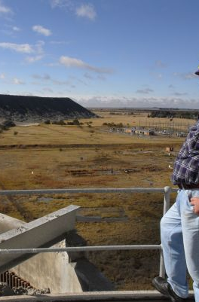



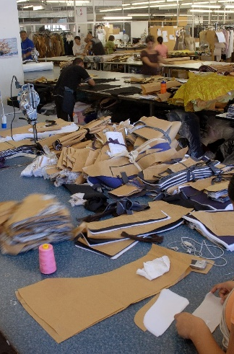
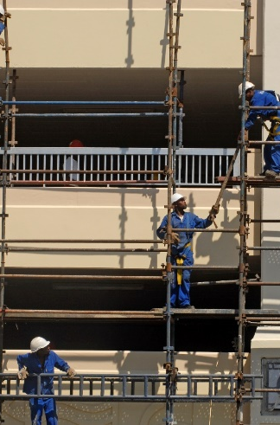
Quarterly Employment Statistics, Q2:2022

Slide 2
QES Background
01
QES is an enterprise-based sample survey
02
QES collects information on employing businesses registered for VAT with annual turnover greater than R300 000
R300 000
03
Samples are drawn from private non-agricultural businesses e.g. factories, offices, stores as well as national, provincial and local government entities
04
Sample size of approximately 20 000 was selected
2

Slide 3








QES Coverage
INCLUDES
2
EXCLUDES
*Mining & quarrying
Agriculture, hunting, forestry and fishing
9
3
Community & personal services
Manufacturing
8
Business services
Electricity, gas and water supply
4
The informal business sector
Transport, Storage
&
Communication
Wholesale
trade, retail trade, motor trade and hotels and restaurants
Construction
7
5
Domestic services
6
* Administrative data from DMRE
3

Slide 4
QES Variables
Estimates are published on a quarter lag (SDDS)
    Number of employees
    as at the last month of the reference quarter
    Average monthly earnings
    for the middle month of the reference quarter
    Gross earnings
    for the three months of the reference quarter
4

Slide 5

Results for Q2:2022

Slide 6
QES
Q2:2022
EMPLOYMENT RESULTS
Number of persons employed in Q2:2022
from in Q1:2022
Q/Q
Y/Y
There was a quarterly decrease of
jobs (or ) in Q2:2022 compared with Q1:2021.
Jobs increased by (or ) in the reference quarter compared with the same quarter of 2021 (Q2:2021).
6

Slide 7
EMPLOYMENT RESULTS
QES
Q2:2022
Q2:2022
Q1:2022
Number of persons employed Full-time:
Number of persons employed Part-time:
Full-time jobs decreased quarter-on-quarter by and year-on-year full-time jobs decreased by .
Part-time jobs decreased quarter-on-quarter by while year-on-year part-time jobs increased by .
7

Slide 8
QES
Q2:2022
There was a quarterly net decrease of jobs in Q2:2022. Most of the job losses were reported in part-time employment with a net decrease of and full-time jobs decreased by .
Quarter-on-quarter employment change
*Data for mining industry is not available separately for part-time
8

Slide 9
QES
Q4:2021
QES
Q2:2022
Year-on-year QES reported a net gain of jobs in Q2:2022 compared with Q2:2021.
Part-time jobs increased by while full-time jobs decreased by .
Year-on-year employment change
*Data for mining industry is not available separately for part-time
9

Slide 10
QES
Q4:2021
QES
Q2:2022
The mining industry reported net increase of jobs in the first quarter of 2022.
Year-on-year the industry increased by when comparing Q2:2022 with Q2:2021.
Number of employees
* Revised estimates
10

Slide 11
QES
Q2:2022
The trade industry reported net gain of jobs in the second quarter of 2022 compared to Q1:2022.
Year-on-year the industry added jobs compared with same quarter of 2021.
Number of employees
* Revised estimates
11

Slide 12
QES
Q2:2022
The community services industry reported a net loss of jobs in the second quarter of 2022 compared to Q1:2022.
Year-on-year the industry increased by jobs compared with same quarter of the previous year (i.e. Q2:2021).
Number of employees
Decrease due to the Census 2022 contracts which ended in second quarter.
* Revised estimates
12

Slide 13
QES
Q2:2022
The total number of persons employed decreased by in the second quarter 2022 to from in Q1:2022.
Year-on-year total employment increased by compared with same quarter of the previous year (i.e. Q2:2021).
Number of employees
* Revised estimates
13

Slide 14
Total gross earnings increased by billion (or ) from billion in Q1:2022, to billion in Q2:2022.
QES
Q2:2022
Basic salary/wages
bn
billion
Bonus payments
Overtime payments
bn
bn
billion
billion
14

Slide 15
QES
Q2:2022
Gross earnings increased by billion (or ) in the second quarter of 2022 compared to Q1:2022. Increases in gross earnings were due to increases in basic salary/wages by billion and overtime payments by billion. There was a decrease reported in bonus payments
by billion.
Quarter-on-quarter changes in gross earnings
*Data for mining industry is not available separately for bonuses & overtime payments
15

Slide 16
QES
Q2:2022
Year-on-year gross earnings increased by billion (or ). Increases were due to basic salary payments made by billion, bonus payments by billion and overtime payments by billion.
Year-on-year changes in Gross Earnings
*Data for mining industry is not available separately for bonuses & overtime payments
16

Slide 17
There was a quarterly increase of % in gross earnings in the second quarter of 2022 compared to Q1:2022. Year-on-year earnings increased by in the second quarter of 2022 compared with same quarter of the previous year.
QES
Q2:2022
Quarter-on-quarter
% change
Year-on-year
% change
* Administrative data from DMR
17

Slide 18
The total gross earnings paid to employees increased by billion from
billion in Q1:2022 to billion in Q2:2022.
QES
Q2:2022
Year-on-year gross earnings increased by billion compared with the same quarter of the previous year (i.e. 2021:Q2)
Rands
Billions
647Bn
* Revised estimates
18

Slide 19

Average Monthly Earnings (AME)
May 2022

Slide 20
QES
Q2:2022
AME including bonuses and overtime payments increased by from in February 2022 to in May 2022.
Year-on-year AME increased by .
Average monthly earnings (AME)
Q/Q
Q/Q
Y/Y
20

Slide 21
QES
Q2:2022
All industries reported increases in average monthly earnings in the second quarter compared with Q1:2022.
Year-on-year the construction industry reported the most increase of in AME while the electricity industry increased the least by .
Quarter-on-quarter
(%)
Year-on-year
(%)
* Administrative data from DMRE
21

Slide 22
QES
Q2:2022
Average monthly earnings were measured at in the formal non-agricultural sector of the economy in May 2022.
* Revised estimates
22

Slide 23

Recap
QES
Q2:2022
Number of employees decreased by Q/Q & increased by Y/Y.
Gross earnings increased by
billion Q/Q & increased by billion Y/Y.
Full-time jobs decreased by
Q/Q & decreased by Y/Y.
Basic salaries/wages increased by billion Q/Q & increased by billion Y/Y.
Part-time jobs decreased by
Q/Q and Y/Y gained by .
Bonus payments decreased by
billion Q/Q & increased by billion Y/Y.
Average monthly earnings increased by Q/Q & increased by Y/Y.
Overtime payments increased by billion Q/Q & increased by billion Y/Y.
23

Slide 24


Ndzi Hela Kwala
StatsSA
@StatsSA

